Slide 1
Different reproduction

Slide 2
Smart Start
What factors do organisms need to reproduce?
Hint: think Punnett square!

Slide 3
Your typical Punnett square
A a
A
a
AA Aa
Aa aa

Slide 4
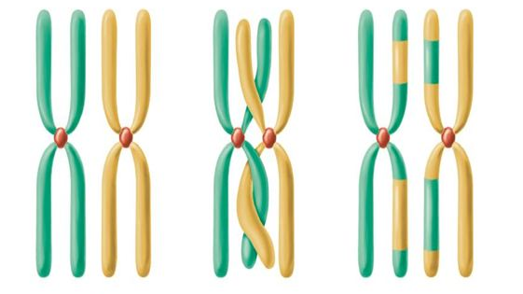
Genetic variation
What’s the point?

Slide 5
What if ……
What if there was only one parent?
Can it happen?
What would the offspring look like?

Slide 6
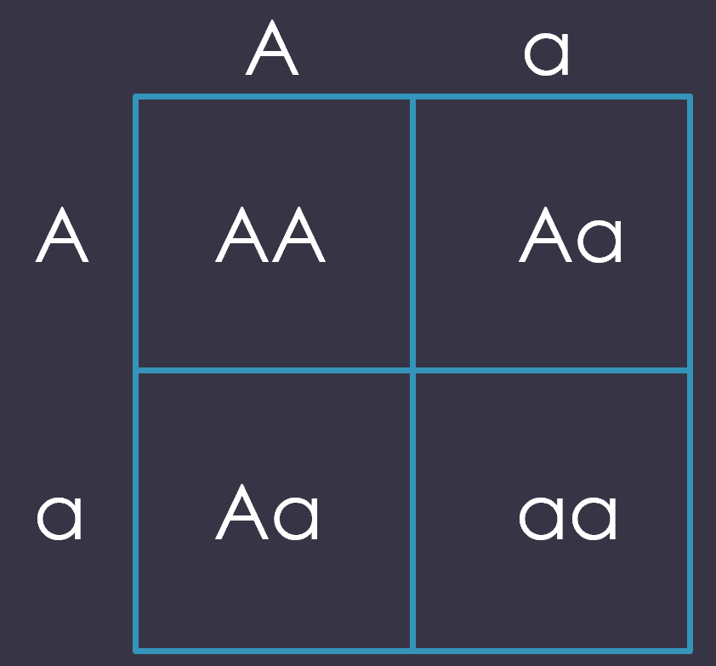
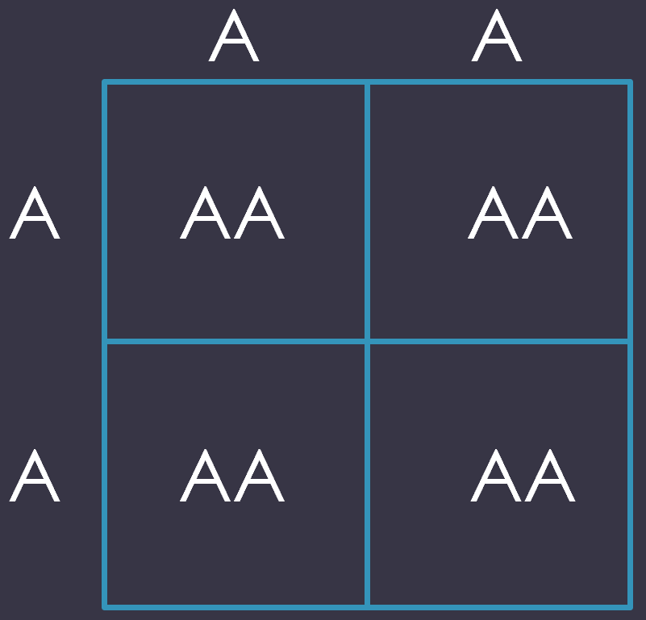
Different modes of reproduction
Sexual
Asexual
Must have 2 parents
Offspring are genetic recombinants (mixing) of parents
New unique individual
Must have only one parent
Offspring are genetically same as parent
Clone

Slide 7
Why?
What are the advantages of asexual reproduction?
Usually, more offspring
Shortages of males or females
Faster
What are disadvantages?
Less genetic variation
Less able to adapt
Susceptible to environmental factors

Slide 8
Examples
Sexual
Asexual
Many eukaryotes
Many prokaryotes

Slide 9
Lets talk Binary fission
What is it?
What can do binary fission?
The organism replicates all the DNA, so it has 2 copies, then splits. This leaves 2 organisms.
Prokaryotes

Slide 10
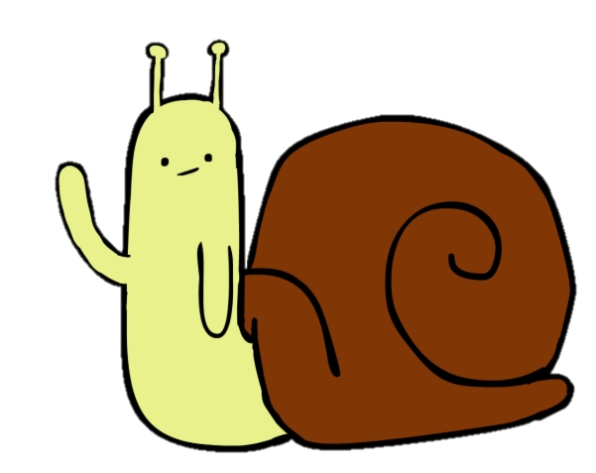
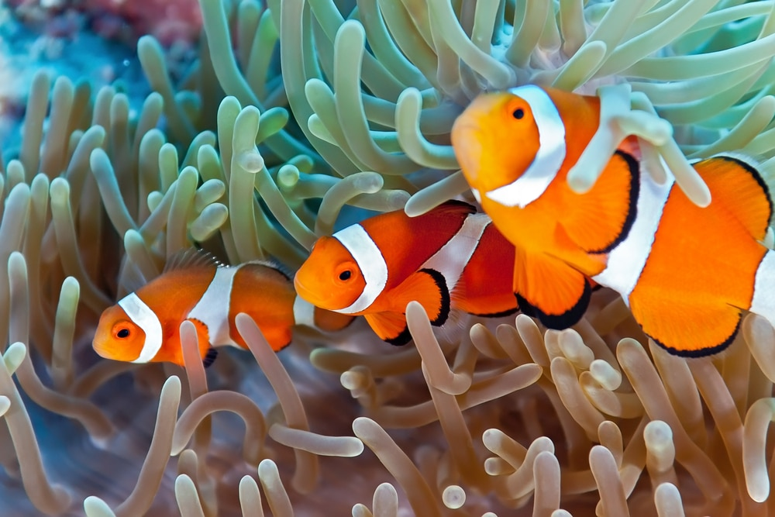
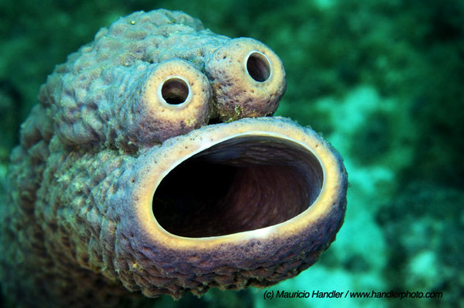
Can organisms choose?
Some can!
Hermaphroditic organisms
Has both male and female reproductive organs
Snails, sponges, etc.
Can swap between male and female based on mate availability
clownfish

Slide 11
What else?
Parthenogenesis
Asexual reproduction among EUKARYOTES!

Slide 12
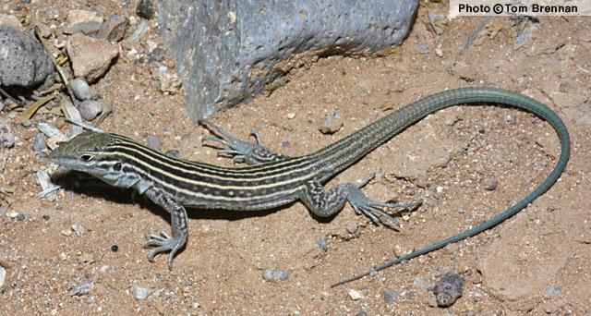
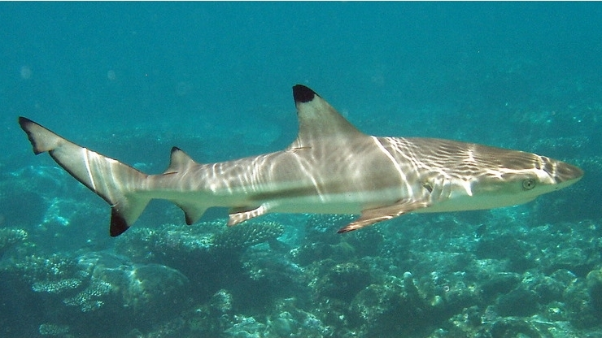
Parthenogenesis
New Mexico Whiptail
Sharks
All-female lizard species
Blacktip reef sharks, zebra sharks, and so many more

Slide 13
