Slide 1
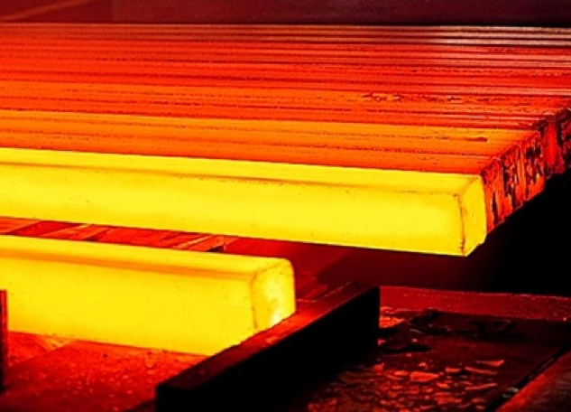
Methods of Heat Transfer
Standards:

Slide 2
Think of 5 examples in which heat energy is transferred in things that you do everyday. (List them in your notes.)
Water being heated for your shower
Raw bacon and eggs cooking for breakfast
Water freezing into ice for hot beverages
Dew evaporating from the grass when the sun hits it.

Slide 3
Heat Energy Transfers
Thermal energy transfers happen all around us
Thermal energy can be transferred in 3 ways:
Conduction
Convection
Radiation

Slide 4
Conduction
The transfer of energy between two objects that are in contact with one another
(HAPPENS IN SOLIDS)
Heated particles collide with each other and transfer their energy.
Example: metal spoon gets warmer as you stir hot soup
Example: metal coat-hanger gets warm when roasting marshmallows

Slide 5
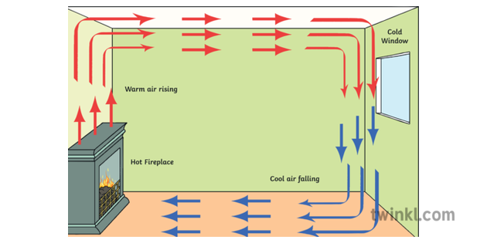
Convection
The transfer of energy THROUGH LIQUIDS AND GASES.
The particles of the fluid moves from one location to another carrying their energy along with them.
Example: Heat leaves a coffee cup as steam rises
Example: Regions near the equator are warmer because warm air from the equator spreads out from the equator.

Slide 6
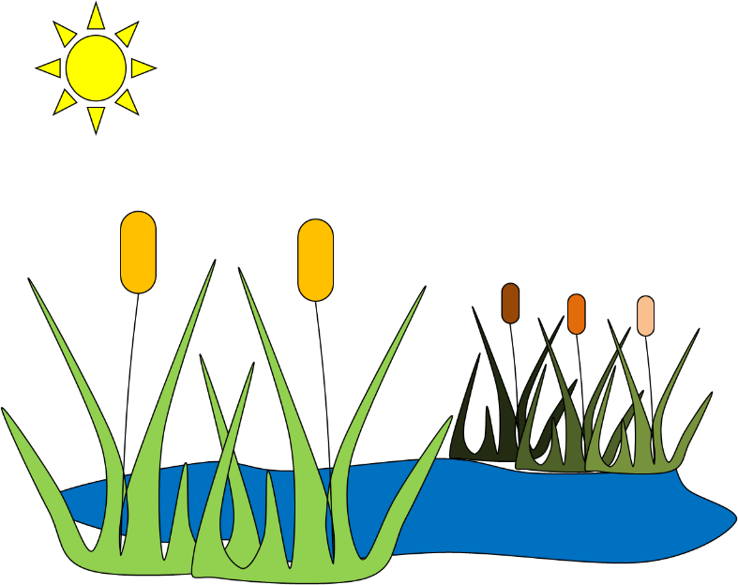
Radiation
The transfer of heat by electromagnetic waves (light waves, UV rays, infrared radiation, microwaves, gamma rays)
Ex. Warmth from a tanning bed
Ex. Sunlight heating the pavement
Ex. Heat from a Microwave
Heat from the sun warms the water

Slide 7
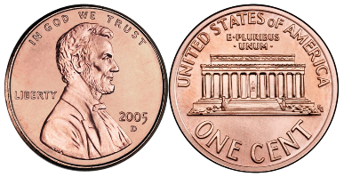
Conductors & Insulators
Conductor
Any material through which energy can be easily transferred
Ex. Metals
Gases are poor conductors because their particles are too spread out.
Insulator
Any material through which energy cannot be easily transferred.
Ex. Rubber, wood, some fabrics, some liquids

Slide 8
Conductor or Insulator?
Wooden spoon
Notes:
insulator

Slide 9
Conductor or Insulator?
Styrofoam coffee cup
Notes:
Insulator

Slide 10
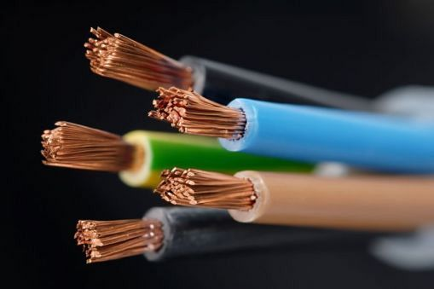
Conductor or Insulator?
Notes:
Both: The copper wire is a conductor, while the outside coating is an insulator

Slide 11
Conductor or Insulator?
Notes:
insulator

Slide 12
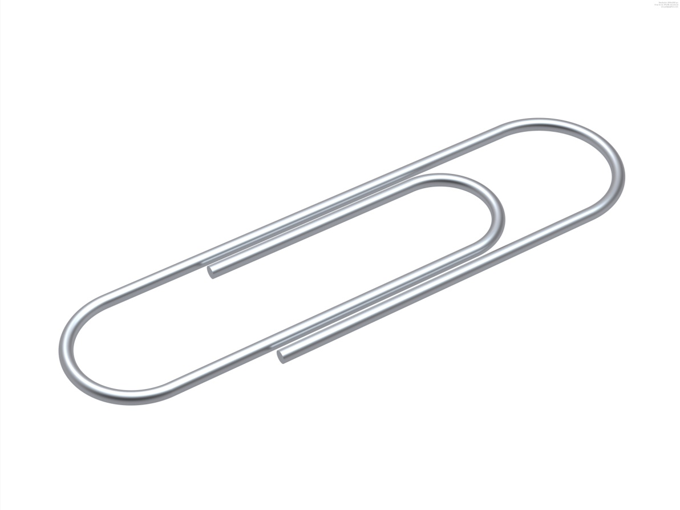
Conductor or Insulator?
Notes:
conductor

Slide 13
CONDUCTION, CONVECTION & RADIATION EXPLAINED
https://www.youtube.com/watch?v=kNZi12OV9Xc

Slide 14
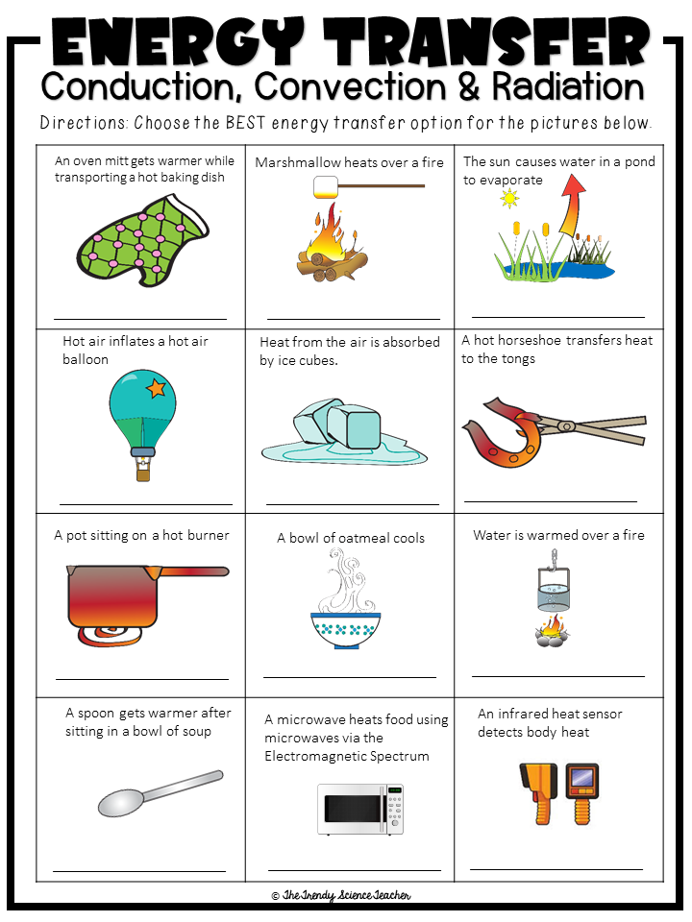
PRACTICE
Complete the
Conduction, Convection &
Radiation worksheet

