Slide 1
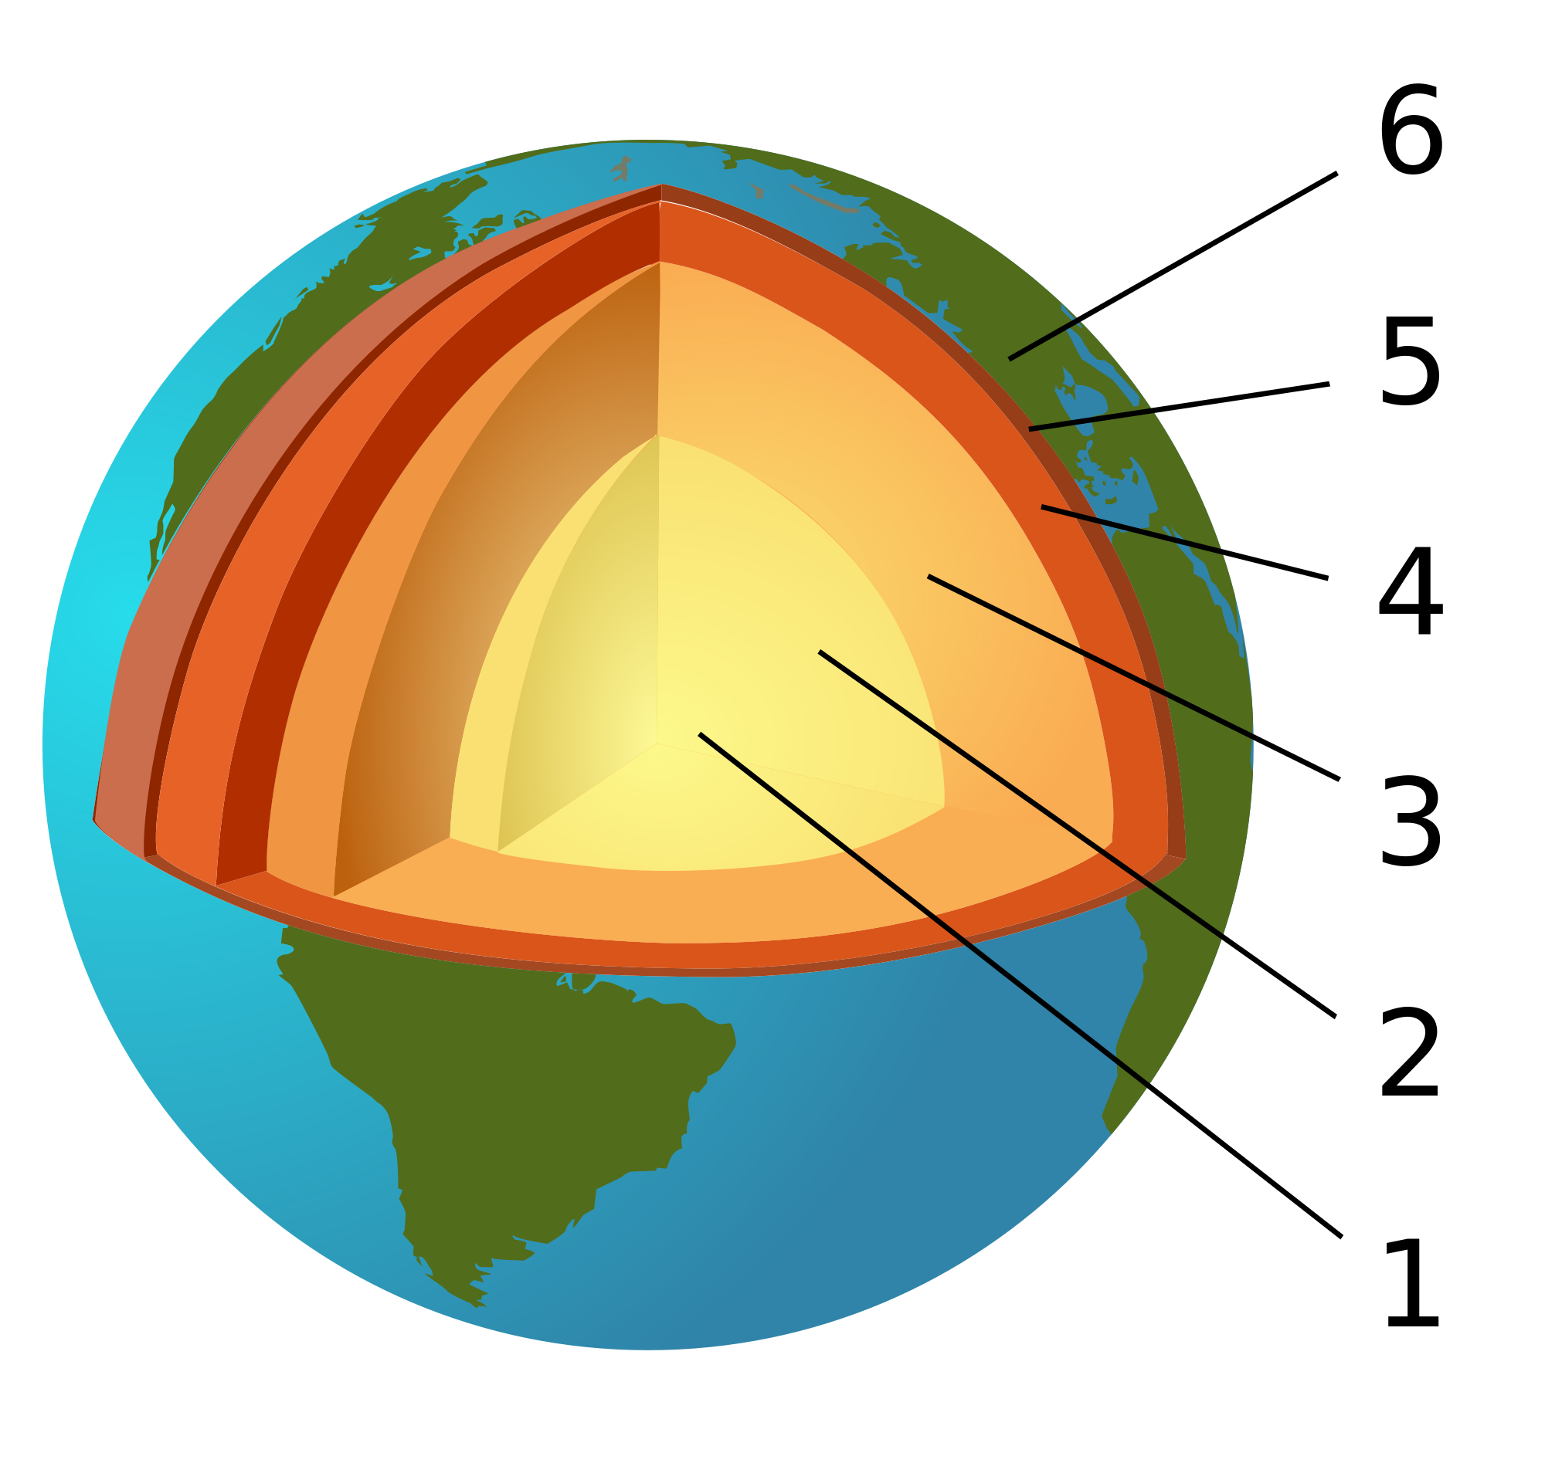
For questions
27 & 28
27. Which layer is
the inner core?
28. Which layer
or layers are
the mantle?

Slide 2
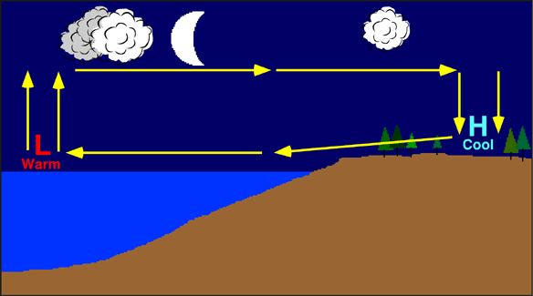
#19

