Slide 1
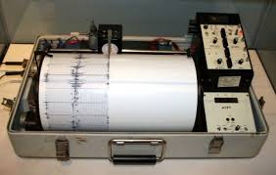
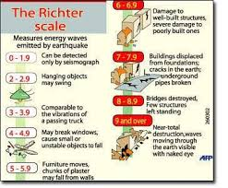
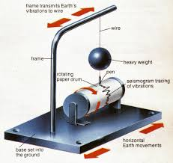
The Richter scale is a rating of an earthquake’s magnitude based on the size of the earthquake’s seismic waves, but does not work well for large or distant earthquakes.
https://www.google.com/search?q=picture+of+the+richter+scale&espv=2&biw=1164&bih=544&tbm=isch&imgil=x_DM-L6bU3Pn4M%253A%253BDbvd_e7vOOcHTM%253Bhttp%25253A%25252F%25252Fwww.eoearth.org%25252Fview%25252Farticle%25252F164389%25252F&source=iu&pf=m&fir=x_DM-L6bU3Pn4M%253A%252CDbvd_e7vOOcHTM%252C_&dpr=1.65&usg=__RVdlA9NadlmBgYcFak9Ty-5ocpE%3D&ved=0CDYQyjdqFQoTCKy4pJbxickCFcM7JgodqbMK-g&ei=l_9DVuyQLcP3mAGp56rQDw#imgrc=dKf3yT14ITqeLM%3A&usg=__RVdlA9NadlmBgYcFak9Ty-5ocpE%3D

Slide 2
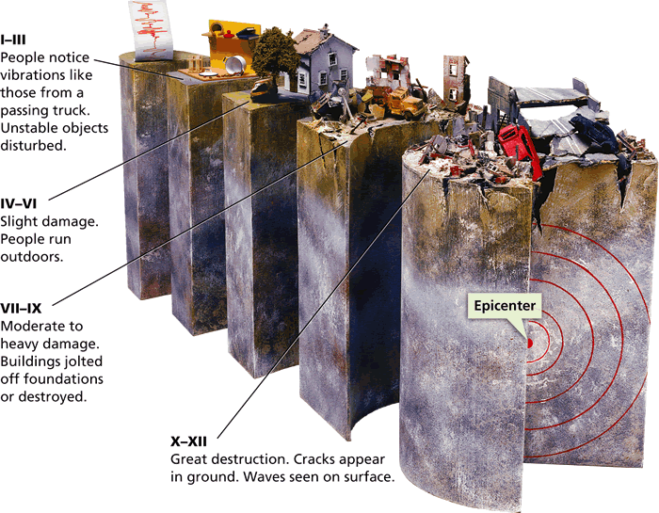
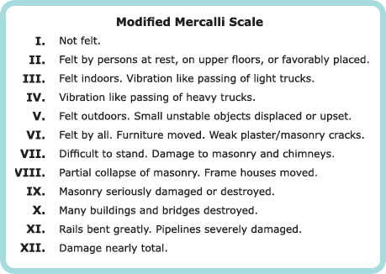
The Mercalli scale was developed to rate earthquakes according to the amount of damage at a given place.

Slide 3
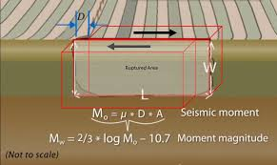
The moment magnitude scale a rating system that estimates the total energy released by an earthquake.

Slide 4
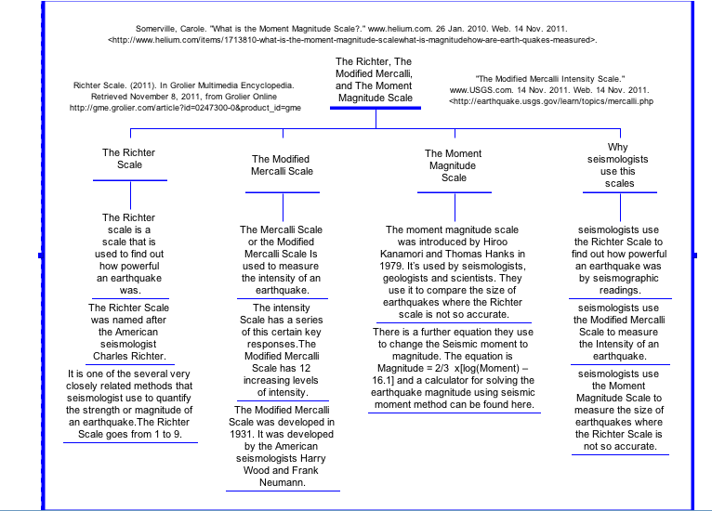

Slide 5
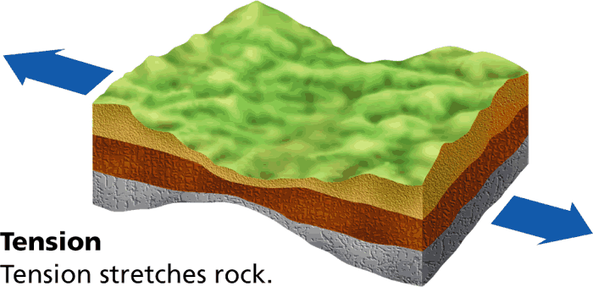
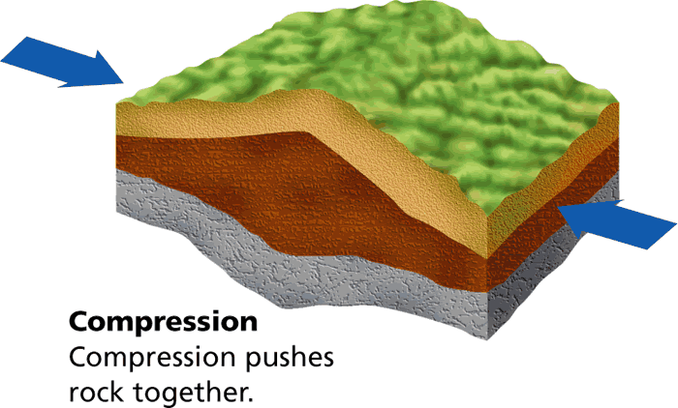
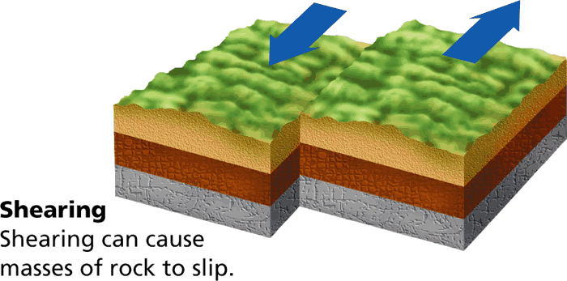
The stress force called tension pulls on the crust, stretching rock so that it becomes thinner in the middle. Produces normal fault.
The stress force called compression squeezes rock until it folds or breaks. Produces reverse fault.
Stress that pushes a mass of rock in two opposite directions is called shearing. Produces strike-slip fault.

Slide 6
