Slide 1
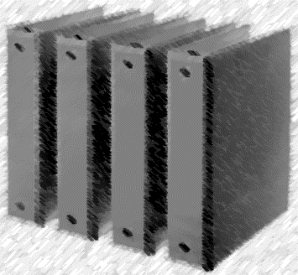
Mr. Lewis
2019-20

Slide 2
Take out supplies for Binder set-up!!

Slide 3
LHNB Rules:
Notebook MUST Be brought to class everyday!
Pages in notes section will include a “Table of Contents,” which must be numbered correctly.
Teacher will periodically check notebook to insure student organization and accuracy

Slide 4
Label your book:
Using a marker, write your name on the spine of your notebook.
If you need duct tape, let me know.
First and Last Name

Slide 5
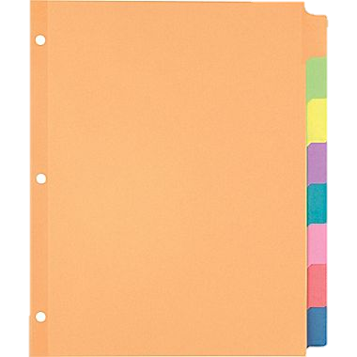
LHNB Tabs:
Label 5 of your tabs:
Warm-ups
Vocabulary
Southwest Asia
Southeast Asia
Africa
Put any unused tabs in the back of your binder!

Slide 6
Syllabus:
Place your syllabus in your binder before your tabs.

Slide 7
Warm-ups:
Your Warm-ups divider should be after the syllabus.
Include some paper.

Slide 8
Vocabulary:
Your vocabulary divider should be after your warm-ups. Include some paper.

Slide 9
Southwest Asia:
Your “Southwest Asia” divider should be after your vocabulary. Be sure to include some paper.

Slide 10
Table of Contents:
“Table of Contents”
Topic Page
Your Table of Contents page should be after your “Southwest Asia” Divider.
1

Slide 11
Southeast Asia:
Your “Southeast Asia” divider should be after your “Southwest Asia”. Be sure to include some paper.

Slide 12
Table of Contents:
“Table of Contents”
Topic Page
Your Table of Contents page should be after your “Southeast Asia” Divider.
1

Slide 13
Africa:
Your “Africa” divider should be after your “Southeast”. I will let you know what goes here!

Slide 14
Proper Order:
On Cover :
First and Last Name
Class Period
First and Last Name

Slide 15
Syllabus:
Syllabus

Slide 16
Warm-ups:
Warm-ups

Slide 17
Vocabulary:
Vocabulary

Slide 18
Southwest Asia:
Southwest Asia

Slide 19
Table of Contents:
“Table of Contents”
Topic Page
1

Slide 20
Southeast Asia:
Southeast Asia

Slide 21
Table of Contents:
“Table of Contents”
Topic Page
1

Slide 22
Africa:
Africa

