Slide 1
Monday, November 13, 2017
6 problem check: front:6, 12, 18 Back: 6, 12, 18
Core Bites # 68
Concept: Multiplication equations
Assignment #24: p. 83 (2 – 36 even)
http://studyjams.scholastic.com/studyjams/jams/math/algebra/mult-div-equations.htm
https://www.youtube.com/watch?v=f7Xx7Xfs-QY

Slide 2
Tuesday, November 14, 2017
6 problem check:6, 12, 18, 24, 30, 36
Write the original problem, show your work, and circle your answer please
Core Bites #69
Concept: Division Equations
Assignment #25: p. 86 – 87 (2 – 26 evens only)
https://www.khanacademy.org/math/algebra/one-variable-linear-equations/alg1-one-step-mult-div-equations/v/simple-equations

Slide 3
Wednesday, November 15, 2017
6 problem check: 2, 8, 12, 16, 22, 26
Write the original problem, show your work, and circle your answer please
Core Bites #70
Concept: Review of Equations and Solutions, and One Step Equations all operations
Assignment #26: handout
https://www.khanacademy.org/math/cc-sixth-grade-math/cc-6th-equations-and-inequalities#cc-6th-intro-equations
https://www.khanacademy.org/math/algebra/one-variable-linear-equations/alg1-one-step-mult-div-equations/v/simple-equations

Slide 4
Thursday, November 16, 2017
Pass in homework
Core Bites #71
Concept: Test: One Step Equations
Assignment #25: Thanksgiving Math Packet due 11/27

Slide 5
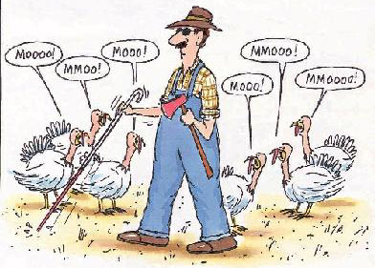
Friday, November 17, 2017
Pass in Core Bites for the week
Concept: IXL
Assignment #28: IXL lab day

