Slide 1
Family familia

Slide 2
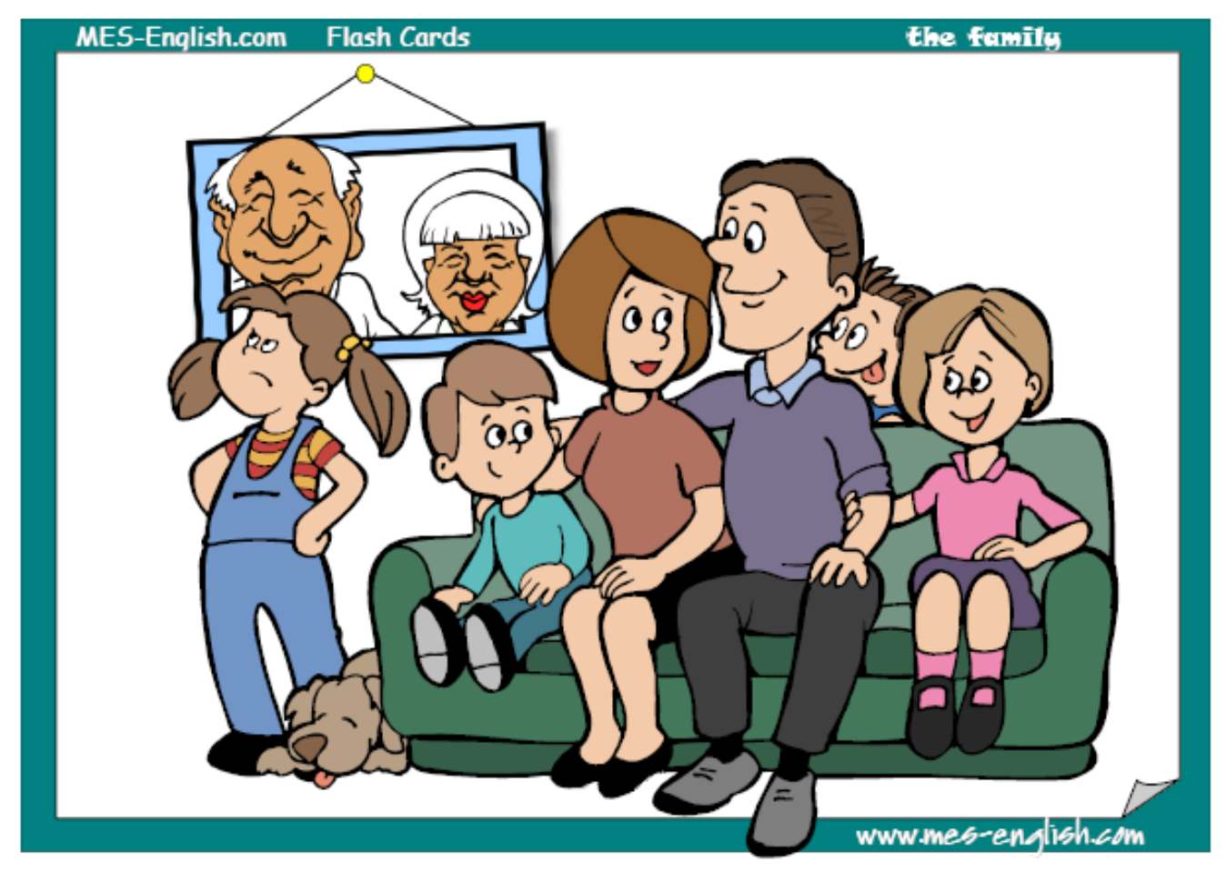
Family familia

Slide 3
Mother madre

Slide 4
Father padre

Slide 5
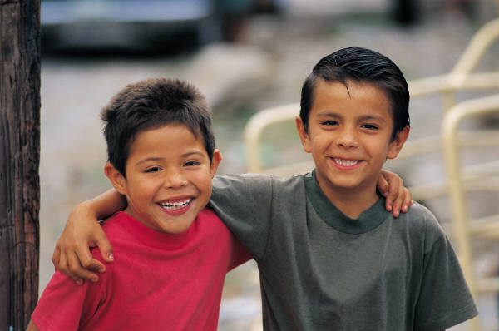
Brother hermano

Slide 6
Sister hermana

Slide 7
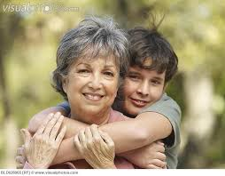
grandmother
abuela

Slide 8
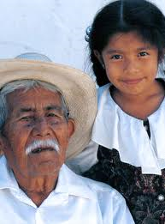
grandfather
abuelo

Slide 9
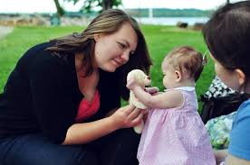
aunt
tía

Slide 10
uncle
tío

Slide 11
Cousin primo

Slide 12
Cousin prima

Slide 13
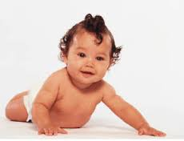
baby
bebé

Slide 14
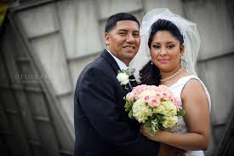
Husband

Slide 15
wife

Slide 16
Family: Videos & Songs
http://www.youtube.com/watch?v=PBxR_XrQds0 video with vocabulary
http://www.youtube.com/watch?v=dH5RTW0gh30 song with vocabulary
http://www.youtube.com/watch?v=oEWXE_V4Mqw simple vocabulary video
http://www.youtube.com/watch?v=GiRUF7hvWuM simple vocabulary song
Games:
http://www.freddiesville.com/family-members-fun-games/

