Slide 1
Food /Table Vocabulary

Slide 2
Plate

Slide 3
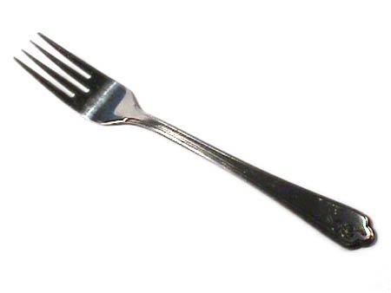
fork

Slide 4
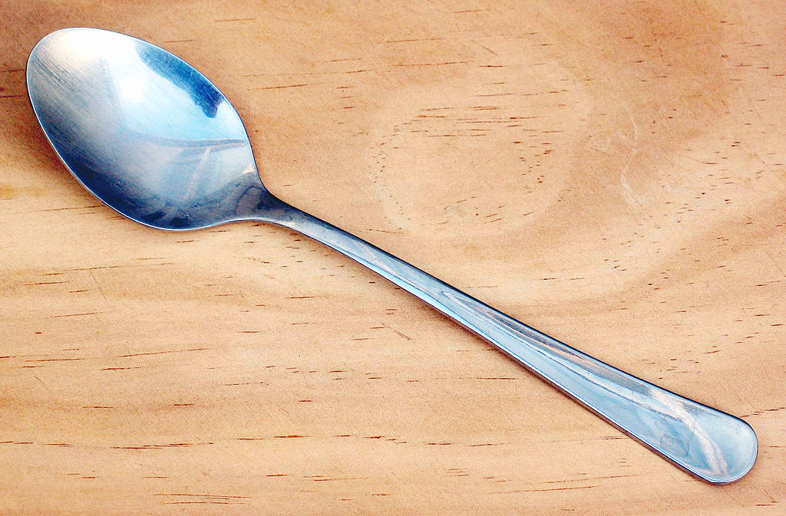
spoon

Slide 5
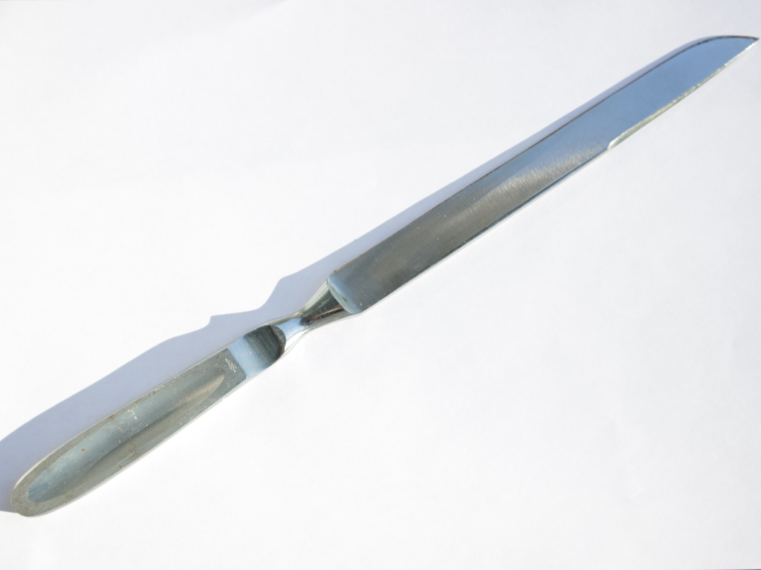
knife

Slide 6
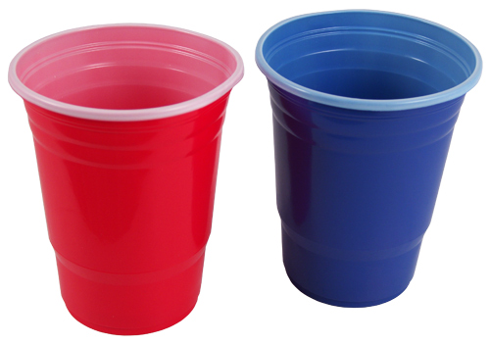
cup

Slide 7
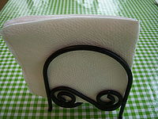
napkin

Slide 8
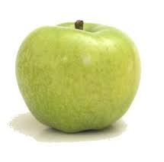
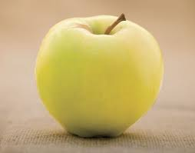
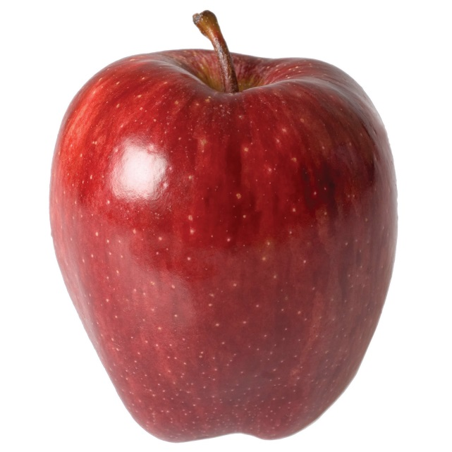
apple

Slide 9
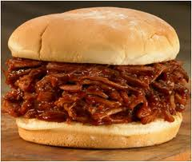
BBQ Pork Sandwich
sandwich de cerdo a la barbacoa

Slide 10
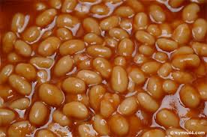
Baked beans
frijoles al horno

Slide 11
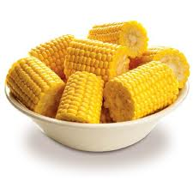
Corn cobbette
cobbette maíz

Slide 12
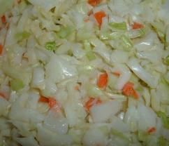
Cole slaw
ensalada de col

Slide 13
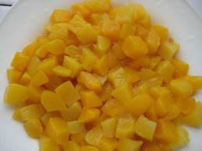
Diced peaches
melocotones cortados en cubitos

Slide 14
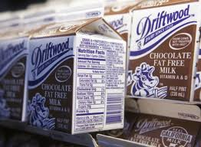
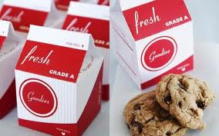
Milk
chocolate milk
white milk
leche con chocolate
leche blanca

Slide 15
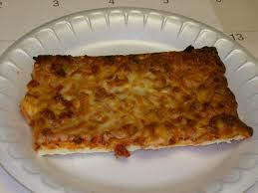
pepperoni pizza
Pizza de peperoni

Slide 16
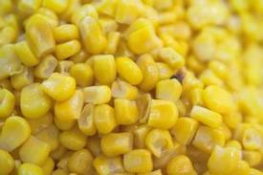
golden corn
maíz de oro

Slide 17
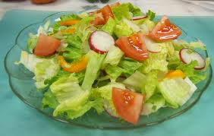
tossed salad
ensalada mixta

Slide 18
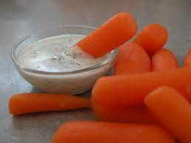
carrot sticks with ranch
palitos de zanahoria con aderezo ranchero

Slide 19
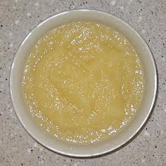
applesauce
coba

Slide 20
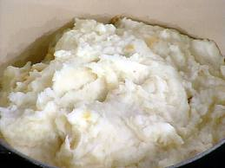
creamed potatoes
papas a la crema

Slide 21
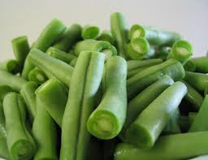
green beans
judías verdes

Slide 22
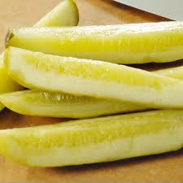
dill pickle spear
lanza de la salmuera de eneldo

Slide 23
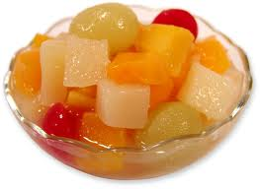
fruit cocktail
cóctel de frutas

Slide 24
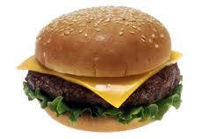
cheeseburger
hamburguesa con queso

Slide 25
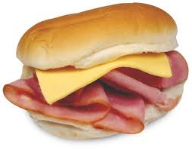
ham and cheese

Slide 26
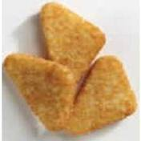
potato triangle

Slide 27
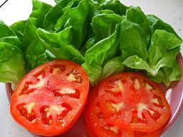
lettuce and tomato

Slide 28
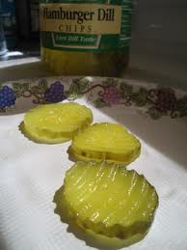
dill pickle chips

Slide 29
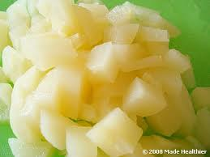
diced pears

Slide 30
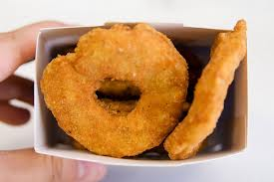
chicken rings

Slide 31
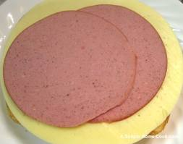
bologna and cheese

Slide 32
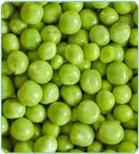
green peas

Slide 33
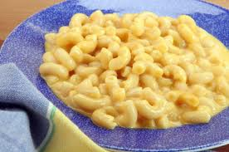
layered mac and cheese

Slide 34
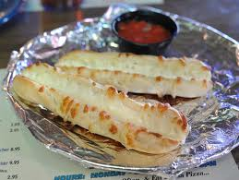
max cheese stix

Slide 35
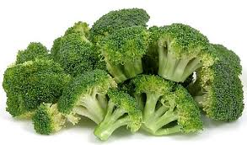
broccoli

Slide 36
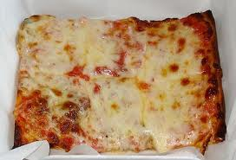
cheese pizza

Slide 37
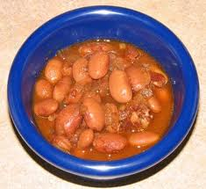
pinto beans

Slide 38
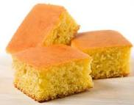
cornbread

Slide 39
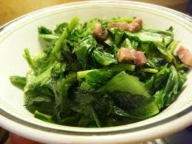
turnip greens

Slide 40
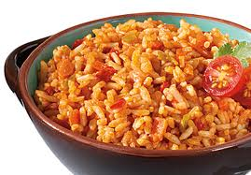
Spanish rice

Slide 41
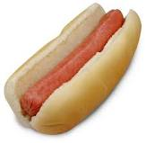
hot dog

Slide 42
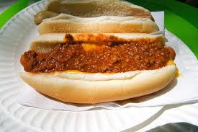
hot dog chili

Slide 43
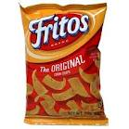
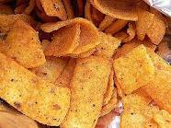
Frito corn chips

Slide 44
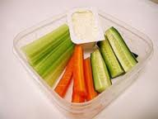
veggie sticks

Slide 45
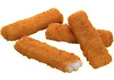
fish sticks

Slide 46
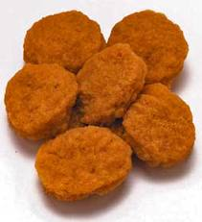
chicken nuggets

Slide 47
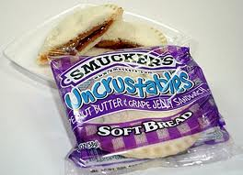
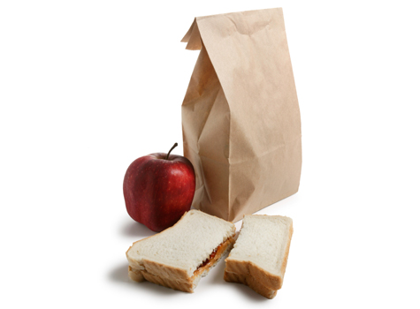
bag lunch

Slide 48
http://www.abcya.com/pizza.htm
http://www.eslgamesplus.com/fast-food-esl-vocabulary-memory-game-hamburger-bread-hot-dog/
http://www.eslgamesplus.com/vegetable-vocabulary-memory-game-for-esl/
http://www.eslgamesplus.com/esl-vegetable-vocabulary-memory-game-for-low-beginners/
http://www.eslgamesplus.com/tableware-vocabulary-esl-memory-game/
http://www.eslgamesplus.com/fruits-vocabulary-memory-game-for-esl/
http://www.eslgamesplus.com/drinks-vocabulary-memory-game-for-esl-learning-and-teaching/
http://www.freddiesville.com/games/food-memory-game/
http://www.freddiesville.com/games/food-sentence-monkey-game/
http://www.freddiesville.com/games/food-vocabulary-word-search-puzzle-online/

