Slide 1
Seasons
Seasons vocabulary
K.E.1.3 Compare weather patterns that occur from season to season.

Slide 2
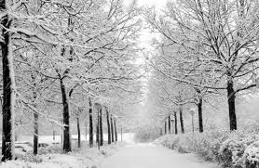
Winter

Slide 3


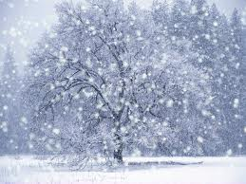
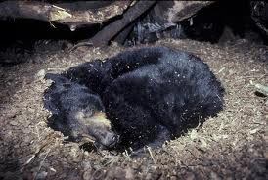
= no leaves on trees
snowflakes
= cold, sometimes snowy weather
= some animals sleep during
the winter (called hibernation )

Slide 4

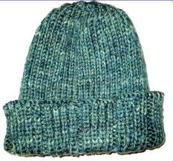
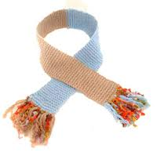
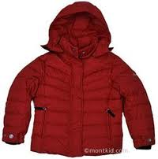
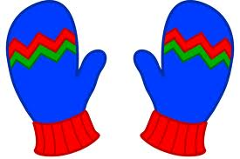
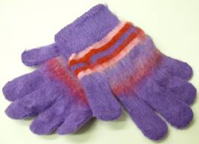
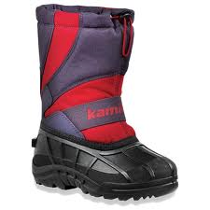
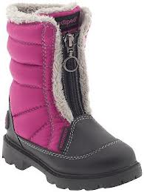
Clothing
toboggan
scarf
coat
mittens
boots
gloves

Slide 5

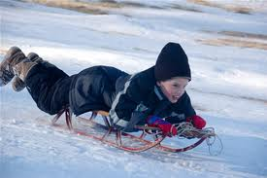
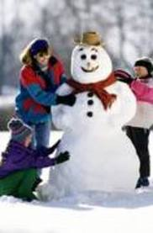
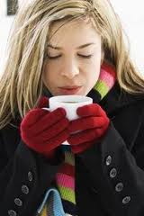
Things to do in winter:
sledding
build a snowman
drink hot chocolate

Slide 6




holidays that are in winter:

Slide 7
Winter Songs
https://www.youtube.com/watch?v=HboTmLb9iCc
https://www.youtube.com/watch?v=tbbKjDjMDok&list=PLPG0TDJLNkYJ0w_2u-kezflnr-Tr2idXZ

Slide 8
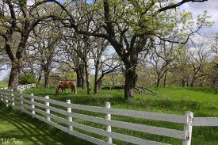
Spring

Slide 9

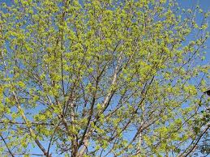
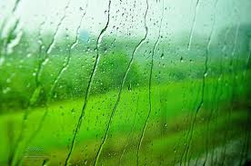
= leaves begin to grow on trees
= weather can be cool or warm and often rainy

Slide 10

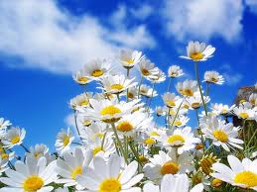
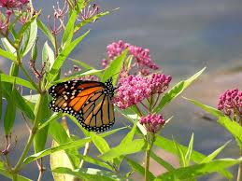
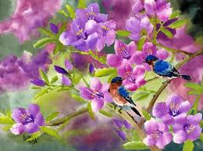
= flowers begin to bloom and grow
= animals, birds, and insects are everywhere

Slide 11

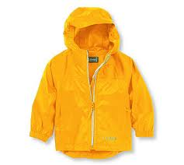
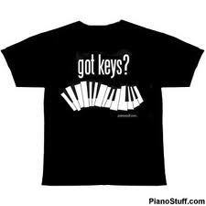
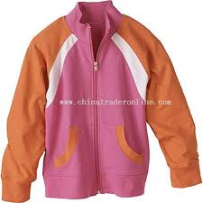
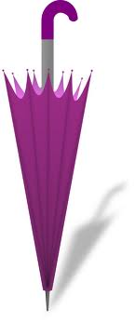
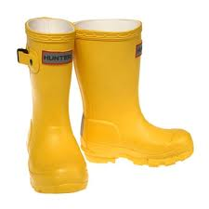
clothing
t-shirt
raincoat
jacket
umbrella
rain boots

Slide 12

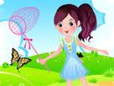
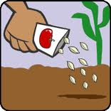
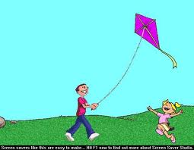
Things to do in spring:
chase butterflies
plant seeds
fly a kite

Slide 13

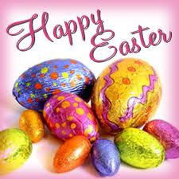

holidays that are in spring:

Slide 14
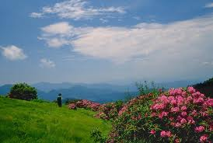
Summer

Slide 15

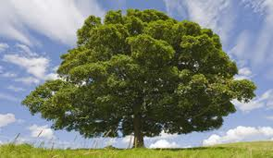
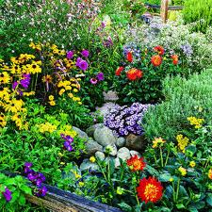
= Trees are full of green leaves
= Flowers are in full bloom

Slide 16

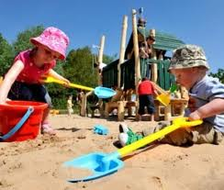
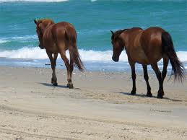
= The weather is hot.
= Animals play

Slide 17

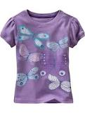
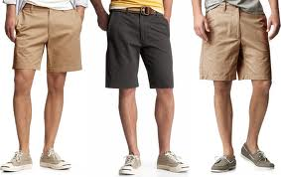
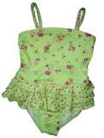
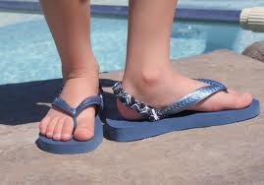
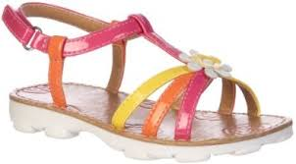
clothing
t-shirt
shorts
swimsuit
sandals
flip flops

Slide 18

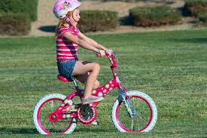
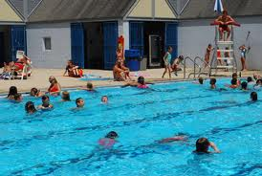
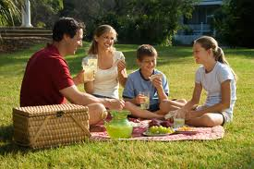
things to do in summer:
ride a bike
swim
go on a picnic

Slide 19


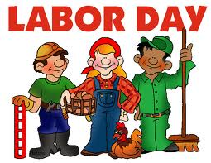
holidays that are in the summer:

Slide 20
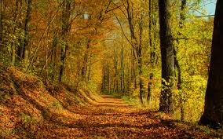
Fall

Slide 21


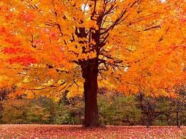
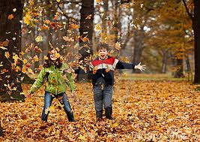
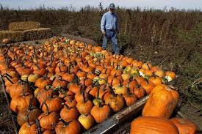
= Leaves change colors and fall from the trees
= The weather begins to get cooler.
= Farmers harvest their crops.

Slide 22
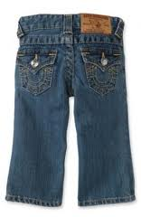
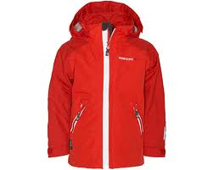
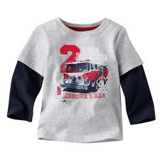
Clothing
jacket
jeans or pants
long-sleeved shirt

Slide 23

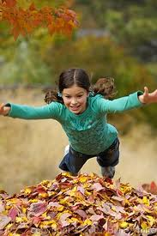


Fall
things to do in the fall:
rake leaves
jump in leaves
carve a pumpkin

Slide 24




holidays that are in the fall:

Slide 25
Songs about Fall/Autumn
https://www.youtube.com/watch?v=ASRFQQ4K688

Slide 26
Songs, games
https://www.youtube.com/watch?v=F-zOCgn5CyA (Seasons Rap)
https://www.youtube.com/watch?v=x5Lig67t2xg (4 seasons song)
http://www.youtube.com/watch?v=ksGiLaIx39c (four seasons)
Http://www.youtube.com/watch?v=dE1n6rlTPPk (autumn leaves)
http://www.brainpopjr.com/science/weather/seasons/
Big Book: A Year Goes By
In The Yard

Slide 27
Games
http://www.sheppardsoftware.com/scienceforkids/seasons/seasons.htm
http://www.turtlediary.com/kindergarten-games/science-games/seasons.html

