Slide 1
Animals
ELP Standard 1

Slide 2
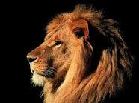
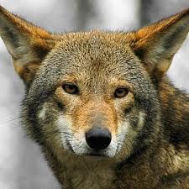
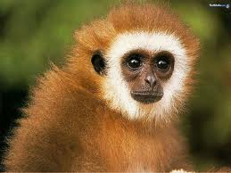
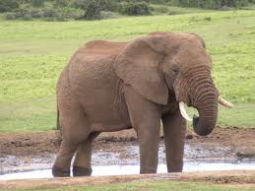
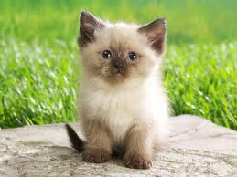
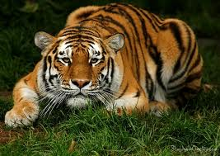
animals
animales

Slide 3
Farm animals https://www.youtube.com/watch?v=EwIOkOibTgM
Old MacDonald https://www.youtube.com/watch?v=5oYKonYBujg
http://www.sheppardsoftware.com/preschool/animals.htm
http://sheppardsoftware.com/preschool/animals/farm/animalfarmgame.htm
http://www.eslgamesplus.com/memory-games/

Slide 4
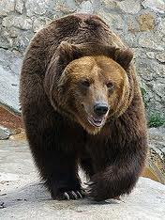
oso

Slide 6
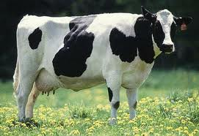
cow
vacas

Slide 8
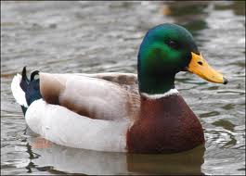
duck
pato

Slide 10
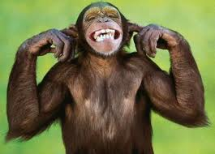
monkey
mono

Slide 12
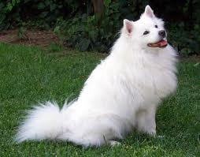
dog
perro

Slide 14
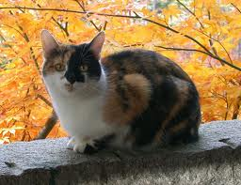
cat
gato

Slide 16
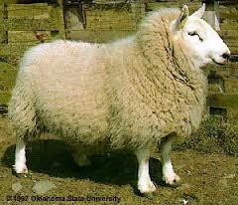
sheep
oveja

Slide 18
elefante

Slide 20
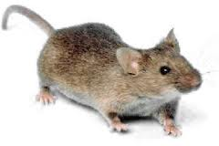
mouse
ratón

Slide 22
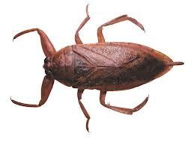
insecto

Slide 24
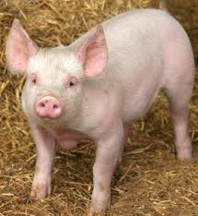
pig
cerdo

Slide 26
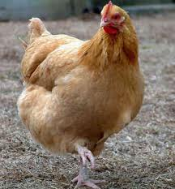
chicken
pollo

Slide 28
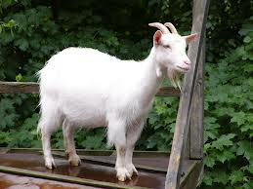
goat
cabra

