Slide 1
FEELINGS/ EMOTIONS sentimientos y emociones
By burcu özdemir

Slide 2
Games, etc.
http://www.anglomaniacy.pl/feelingsMatching.htm
http://www.anglomaniacy.pl/feelingsPictureTest.htm
http://www.mes-games.com/feelings.php
SONGS:
https://www.youtube.com/watch?v=zEk48QQSPo4
https://www.youtube.com/watch?v=ca8SUuG8vdA
Worksheets:
http://bogglesworldesl.com/kids_worksheets/emotions.htm
p. 69 Avenues workbook Level A
http://www.toolsforeducators.com/writing/feelings.php

Slide 3
happy

Slide 4
sad

Slide 5
tired

Slide 6
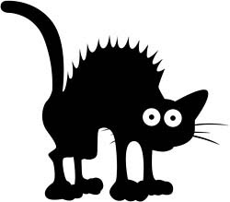
scared

Slide 7
angry
mad

Slide 8
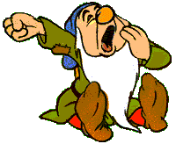
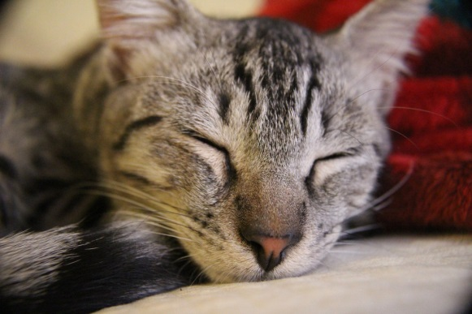
sleepy

Slide 9
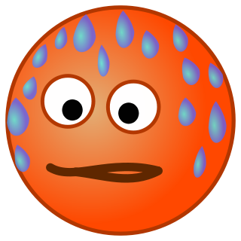
hot

Slide 10
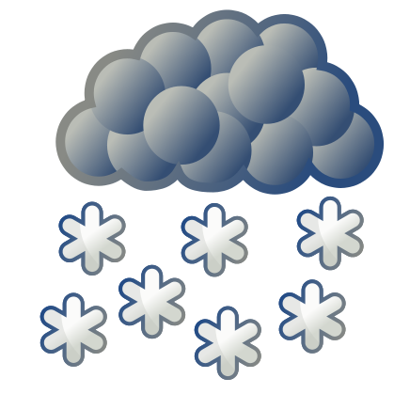
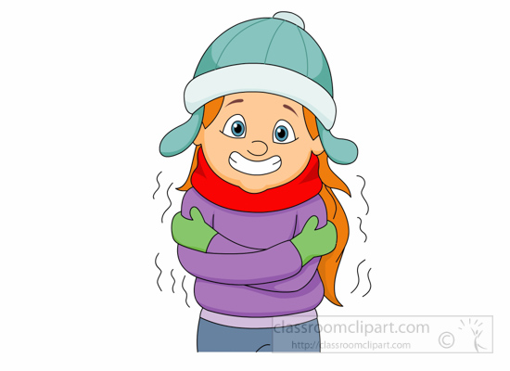
cold

Slide 11
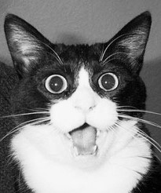
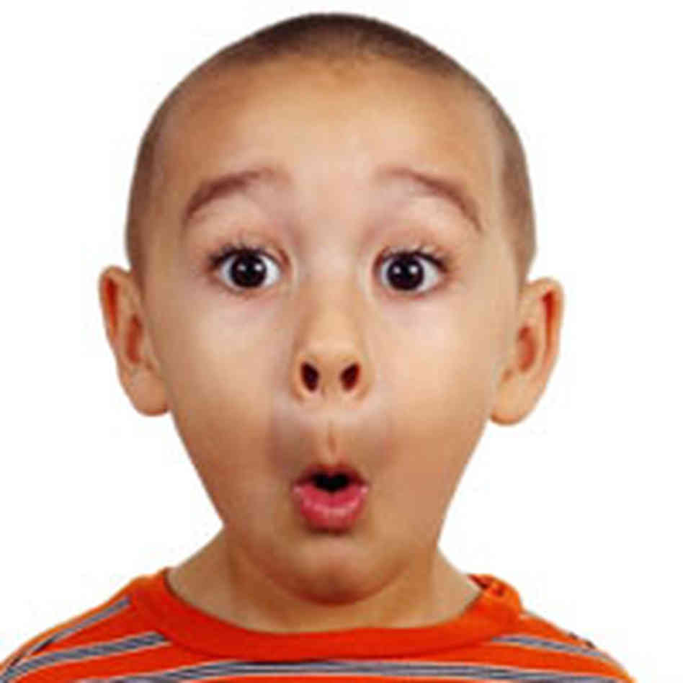
surprised

Slide 12
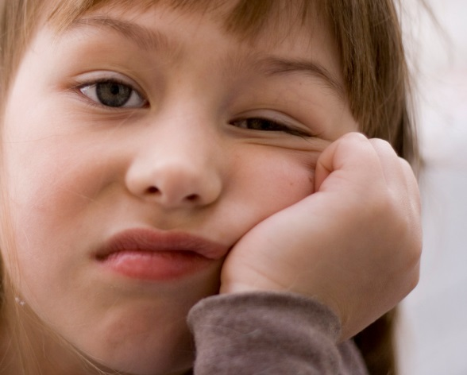
bored

