Slide 2
This simple, but engaging game is great for small group instruction or as
an independent center.
Print the game on cardstock and put inside a transparent protective
sleeve. Supply the student with a thin Expo marker
and a die. The student will roll the die, say the word that is in
the column they rolled, write the word while saying the
spelling and then read the word again. You can have your
students play until one column of words is filled in completely
or until the entire board is filled out. The great thing about this
is that you can reuse the sheets for another group of students.
All you have to do is have your student erase the Expo marker
once he/she is finished.
I’ve also included a black and white version if you’d prefer not to print
in color.
You’ll notice that I typed in words for Dolch Word List 1 and all you have
to do to change the words is click on the text box, delete the
word in the box and type your own. I love having this option so you
can print words that are specific to your learners. ☺

Slide 3
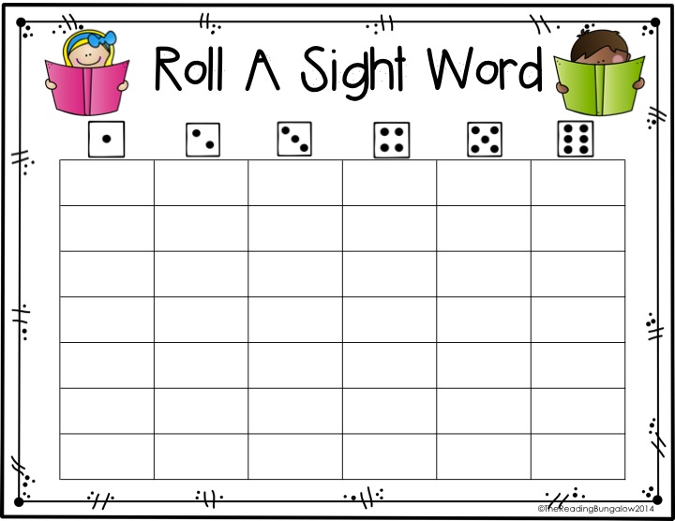
the
to
and
he
you
it
List 1

Slide 4
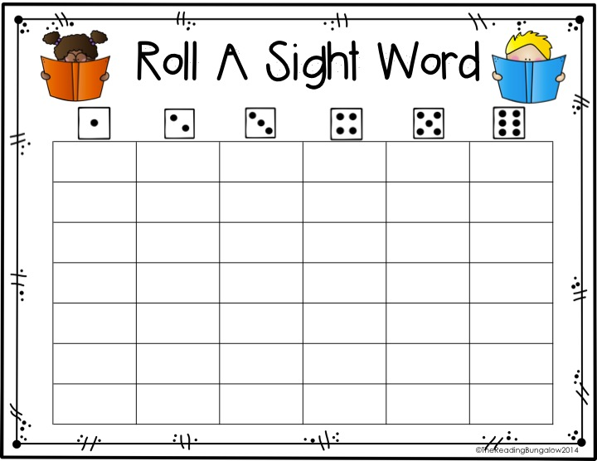
of
in
was
said
his
that
List 1

Slide 5
pet
fed
goat
ate
beg
roar
List 1

Slide 6
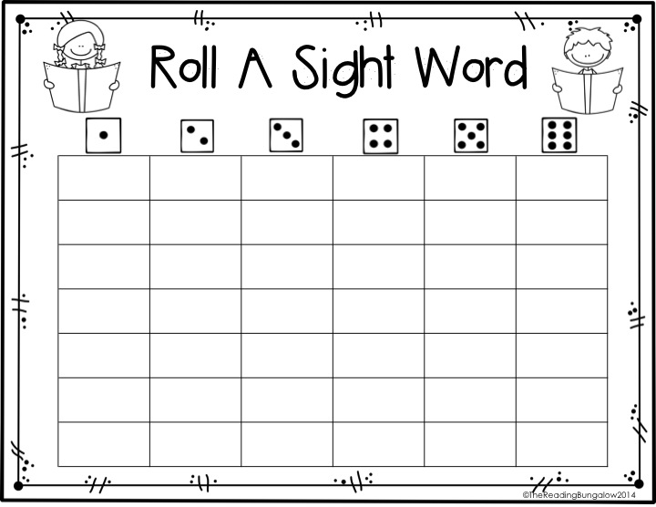
eight
eyes
outside
inside
treat
count
List 1

Slide 7
count
treat
eyes
eight
inside
outside
List 1

Slide 8
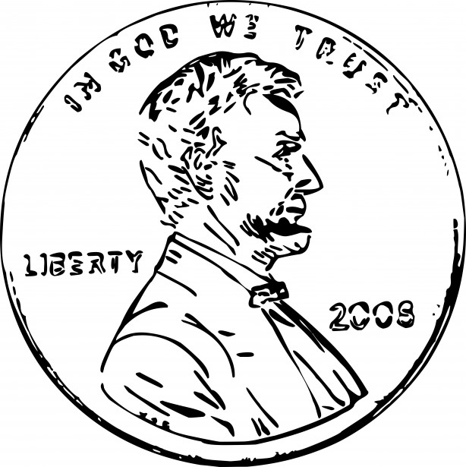
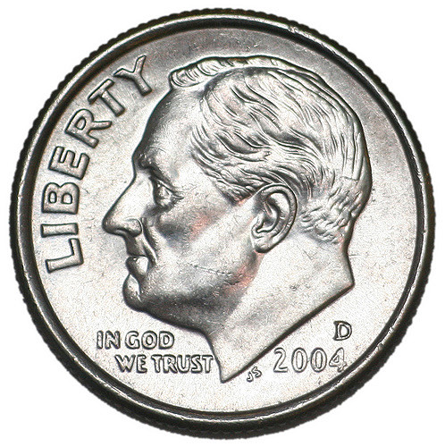
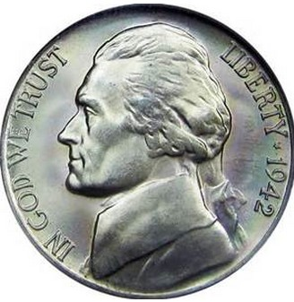
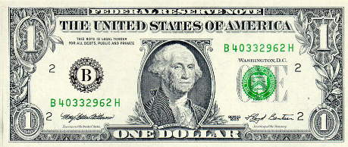
buy
penny
dime
nickel
quarter
dollar
List 1

Slide 9
Thank you to these talented artists!
Thank you for downloading my product. If you have any questions please email at thereadingbungalow@gmail.com
For fan freebies visit me at
https://www.facebook.com/TheReadingBungalow

