Slide 2
AVTF II

Slide 3
Audio/Video Technology
& Film III.

Slide 6
Students are granted two “free” tardies to class for the year. Upon arriving late to class, the student will be marked tardy by the instructor and given a warning. Anyone who has received two warnings and comes to class late will be issued detention. If a student has already served detention and is tardy again, the student will receive a disciplinary referral in place of a second detention.
two

Slide 9
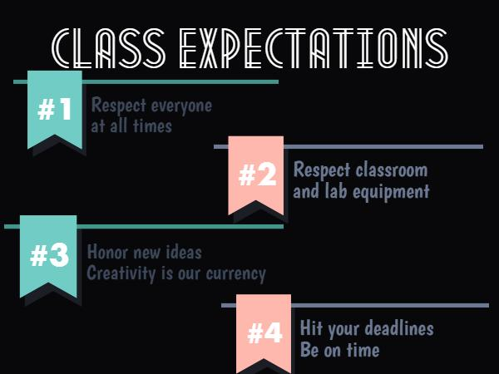

Slide 10
