Slide 1
Parts of Speech
Noun- person, place, thing, or idea
For example: girl, home, desk, liberty
Pronoun- a word used in place of a noun
For example: he, her, its, where
Adjective- a word that describes (modifies) a noun or pronoun
For example: pretty, blue, hilarious
Verb- represents an action or state of being
For example: run, have, do, is
Adverb- a word used to modify a verb, adjective or another adverb; tells how, when, where, how much or how often
For example: slowly, always, really, yesterday

Slide 2
Parts of Speech
Adverb- a word used to modify a verb, adjective or another adverb; tells how, when, where, how much or how often
For example: slowly, always, really, yesterday
Conjunction- a word used to join other parts of the sentence
For example: and, or, however, therefore
Preposition- a word which shows relationships between words in the sentence; think of the relationship between a squirrel and a tree
For example: on (the tree), to (the tree), through (the tree)
Interjection- a word that shows intense emotion
For example: Wow, Oh, Oops

Slide 3
What is a sentence fragment?
A sentence fragment does not have all the basic parts of a complete sentence.
Fragments do not express a complete thought and are missing important information.
To identify sentence fragments, use a simple test:
1. Does the group of words have a subject?
2. Does it have a verb?
3. Does it express a complete thought?
If the answer to any of these questions is no, you have a fragment.

Slide 4
What is a run-on sentence?
A run-on sentence is two or more complete sentences run together as one.
Run-on sentences can be confusing because they do not show where one idea ends and another one begins.
EXAMPLES
Reading is important textbooks help students learn.
Schools today usually have books for every student, most schools also have televisions and computers.

Slide 5
How to combine sentences Inserting phrases
You can combine sentences by inserting a phrase from one sentence into another.
Prepositional Phrase
This car can park easily. It can park in tight spaces.
This car can park easily
in tight spaces.
Participial Phrase
Sam swung the bat. He was focusing on the ball.
Focusing on the ball,
Sam swung the bat.
Appositive Phrase
There we met Chula. Chula is Sandra’s dog.
There we met Chula,
Sandra’s dog.

Slide 6
How to combine sentences Using compound subjects and verbs
Join the verbs or subjects of the two sentences with a coordinating conjunction such as and, or, or but.
IF
THEN
Subjects are the same
Keep the subject and join the verbs
Ice reduces swelling.
Ice relieves pain.
Ice reduces swelling and relieves pain.
Verbs are the same
Keep the verb and join the subjects
Jaguars have spots.
Leopards have spots.
Jaguars and leopards have spots.

Slide 7
How to combine sentences Creating compound sentences
If the two sentences are related and equally important, you can form a compound sentence.
A compound sentence is made by joining the two sentences with
a comma and a coordinating conjunction
a semicolon
OR
a semicolon and a conjunctive adverb
We went there; however, they came here.
We went there, but they came here.
We went there; they came here.
We went there.
They came here.

Slide 8
How to combine sentences Creating complex sentences
Another way to combine sentences is to form a complex sentence.
A complex sentence contains one independent clause and one or more subordinate clauses.
A subordinate clause (or dependent clause) has a subject and a verb but does not express a complete thought and cannot stand by itself as a sentence.
Independent Clause
Subordinate Clause
The audience clapped
until the entire choir had left.

Slide 9
What is subject-verb agreement?
Singular subjects take singular verbs.
Singular
Subject
Singular
Verb
Earline attends college.
Earline attends college.
Earline attends college.
Plural subjects take plural verbs.
Plural
Subject
Plural
Verb
Both women attend college.

Slide 10
What is subject-verb agreement? Phrases or clauses between subjects and verbs
group of words
Sometimes a group of words comes between the subject and the verb.
Subject
Verb
Verb
Visitors
leave their coats here.
to the museum
leave their coats here.
When deciding if a verb should be singular or plural, you can usually ignore words between the verb and its subject.
Subject
Verb
Visitors
to the museum
leave their coats here.

Slide 11
What is subject-verb agreement? Compound subjects
A compound subject is two or more subjects that are joined by a coordinating conjunction and that have the same verb.
Subjects joined by and usually take plural verbs.
Subject 1
Subject 2
Verb
Ramón
and
she
like hiking.
Singular subjects joined by or or nor take a singular verb.
Singular
Singular
Verb
Marcelo
or
Donya
knows the address.

Slide 12
Solving common agreement problems Subjects after verbs
In some sentences, the subject comes after the verb.
Subject
Here
(is, are)
is
a set of keys.
a set of keys.
When the subject follows the verb . . .
1. Find the subject.
2. Make sure that the verb agrees with it.

Slide 13
Solving common agreement problems Don’t and doesn’t
The contractions don’t and doesn’t should agree with their subjects.
Don’t is the contraction of do not. Use it with I and you and with all plural subjects.
Singular |  | Plural
I | don’t | we | don’t
you | don’t | you | don’t
 |  | they | don’t
Doesn’t is the contraction of does not. Use it with all singular subjects except I and you.
Singular |  | Plural
I | don’t | we | don’t
you | don’t | you | don’t
 |  | they | don’t

Slide 14
What is pronoun-antecedent agreement?
A pronoun “points” to a noun or another pronoun called its antecedent.
Antecedent
Pronoun
Carrie explained that she had forgotten.
A pronoun should agree in both number and gender with its antecedent.
A word that refers to one thing is singular.
A word that refers to more than one is plural.
Some singular pronouns indicate gender.
Masculine pronouns refer to males.
Feminine pronouns refer to females.
Neutral pronouns refer to places, things, ideas, and animals.

Slide 15
What is pronoun-antecedent agreement? Indefinite pronouns
Singular Indefinite Pronouns
anybody | either | neither | one
anyone | everybody | nobody | somebody
anything | everyone | no one | someone
each | everything | nothing | something
Plural Indefinite Pronouns
both | few | many | several
Singular or Plural Indefinite Pronouns
all | more | none
any | most | some

Slide 16
What are the principal parts of verbs?
Verbs have four principal parts, each of which performs a different function.
Base Form
sing
ask
Present Participle
[is] sing
ing
[is] ask
ing
Past
s
a
ng
ask
ed
Past Participle
[have] s
u
ng
[have] ask
ed
More about participles

Slide 17
What are the verb tenses?
The tense of a verb indicates the time of the action or state of being expressed by the verb.
Perfect tenses indicate that something happened or existed before a specific point in time.
Past
Present
Past Perfect
Present Perfect
She had played violin before then.
She has played in the band for three years.
Future
Future Perfect
She will have played in ten concerts by April.

Slide 18
What are active and passive voice?
Voice is the form a verb takes to show whether the subject of the verb performs or receives the action . . .
When the subject of a verb performs the action, the verb
is in the active voice.
When the subject of a verb receives the action, the verb is in the passive voice.
Passive-voice verb
Active-voice verb
Subject
Subject
The house was destroyed by the fire.
The fire destroyed the house.
The subject fire performs the action of destroying.
The subject house receives the action of destroying.

Slide 19
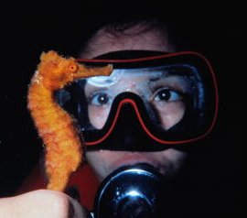
What are the cases of personal pronouns? The nominative case
Pronouns in the nominative case are used as subjects and as predicate nominatives.
Nominative Case Pronouns
 | Singular | Plural
First person | I | we
Second person | you | you
Third person | he, she, it | they
Subject
We went scuba diving.
Predicate nominative
Our instructor was she.

Slide 20
What are the cases of personal pronouns? The objective case
Pronouns in the objective case are used as direct objects, indirect objects, and objects of prepositions.
Objective case pronouns
First person | me, us
Second person | you, you
Third person | him, her, it, them
Direct object
Dad drove us to the store.
Indirect object
The clerk showed them the bicycle.
Object of preposition
The red ten-speed is perfect for her.

Slide 21
What are the cases of personal pronouns? The possessive case
Pronouns in the possessive case are used to show ownership or possession.
Possessive case pronouns
First person | my, mine, our, ours
Second person | your, yours
Third person | his, her, hers, its, their, theirs
My alarm clock is broken.
May I please borrow yours?

Slide 22
Regular comparison
Most one-syllable modifiers form the comparative form by adding –er and the superlative form by adding –est.
Some two-syllable modifiers form the comparative degree by adding –er and the superlative by adding –est. Others use more and most.
Positive
young
happy
Comparative
younger
happier
Superlative
youngest
happiest
Positive
wealthy
hazy
Comparative
wealthier
hazier
Superlative
wealthiest
haziest
If a modifier has three or more syllables, use more and most to form the comparative and superlative degrees.
Positive
beautifully
predictably
Comparative
more beautifully
more predictably
Superlative
most beautifully
most predictably

Slide 23
Irregular comparison
The comparative and superlative degrees of some common modifiers are irregular in form.
Positive | Comparative | Superlative
bad | worse | worst
badly
good | better | best
well
much | more | most
many
little | less | least

Slide 24
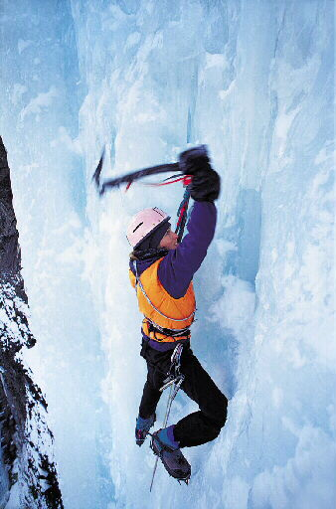
Double comparisons
Avoid double comparisons. Using both –er and more is incorrect. Using both –est and most is also incorrect.
INCORRECT
This banana is more riper than that one.
INCORRECT
That story was the most excitingest of all.

Slide 25
What is a dangling modifier?
How to spot a dangling modifier: Ask yourself, “Does it make sense for the phrase to modify the word or word group closest to the modifier?
Dangling modifier
?
Moving carefully, the rope was held tightly.
Was the rope moving carefully?
No, it doesn’t make sense for moving carefully to modify rope. Rope is not the subject of the participial phrase.
If the sentence doesn’t make sense, you probably have a dangling modifier.

Slide 26
How to fix dangling modifiers
Strategy 1: Revise the word group that follows the dangling modifier.
Dangling modifier
?
Fixed
To become a doctor, years of study are required.
To become a doctor, you must study for years.
Does to become a doctor sensibly modify years?
No. A logical subject—such as you—needs to follow the comma.
Strategy 2: Change the dangling modifier into a clause.
Dangling modifier
Fixed
Lost and thirsty, the trail was a welcome sight.
Because we were lost and thirsty, the trail was a welcome sight.
Changing the dangling modifier into an adverb clause makes the meaning clear. The adverb clause explains why the trail was a welcome sight.

Slide 27
What is a misplaced modifier?
A word, phrase, or clause that seems to modify the wrong word or word group in a sentence is called a misplaced modifier.
Misplaced modifiers are confusing.
misplaced modifier
Her dog sat as she waited for the bus patiently.
Verb
Verb
Who is sitting? The dog? The girl?
Who is waiting? The girl? The dog?

Slide 28
How to fix misplaced modifiers
Place modifying words, phrases, and clauses as near as possible to the words they modify.
Sandra saw a bird’s nest.
with two eggs
Where should these two phrases be placed in this sentence?
looking up
Looking up,
Sandra saw a bird’s nest
with two eggs.
Who was looking up? Sandra was.
What had two eggs? The nest did.

Slide 29
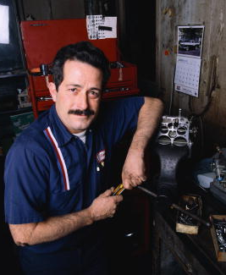
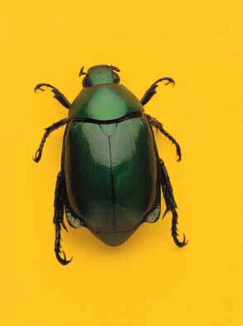
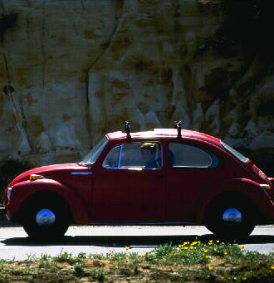
Why is capitalization important?
Suppose a friend sent you this text message.
meet me at ken’s garage at 5:30. bring the beetle.
Would you go to
Would you bring
or
or
Ken’s garage?
Ken’s Garage?
the beetle?
the Beetle?

Slide 30
Proper nouns/adjectives
Capitalize proper nouns.
A common noun names any one of a group of persons, places, things, or ideas. A proper noun names a particular person, place, thing, or idea.
Common Nouns | Proper Nouns
dog | Lassie, Spot
patriot | Patrick Henry
city | New Orleans
Capitalize proper adjectives.
A proper adjective is an adjective formed from a proper noun.
Proper Nouns | Proper Adjectives
Turkey | Turkish border
Thomas Jefferson | Jeffersonian ideals
Queen Elizabeth | Elizabethan drama

Slide 31
Do not capitalize the names of school subjects.
Exception: Do capitalize the names of language classes and courses that contain a number.
Capitalize a person’s title when the title comes before the name.
Capitalize a word showing a family relationship when the word is used before or in place of a person’s name.
Capitalize the first and last words and all important words in titles and subtitles.
Capitalize abbreviations if the words they stand for are capitalized.

Slide 32
Periods
The period is the most common end mark.
Periods are used to end
statements
Statements are also called declarative sentences.
indirect questions
Indirect question
I wondered what plant grows that fast.
Direct question
What plant grows that fast?
requests and mild commands
Requests and commands are imperative sentences.
Also, we use a period after most abbreviations.

Slide 33
Question marks and Exclamation Points
A direct question ends with a question mark.
Questions are also called interrogative sentences.
An exclamation ends with an exclamation point.
Exclamations are also called exclamatory sentences.
A strong command ends with an exclamation point.
Commands and requests are imperative sentences.
An interjection is often followed by an exclamation point.
Sometimes, an interjection is followed by a comma rather than an exclamation point.

Slide 34
Items in a series
Use commas to separate items in a series.
Words in a series
All my cousins, aunts, and uncles came to our family reunion.
Phrases in a series
The children played in the yard, at the playground, and by the pond.
Clauses in a series
Those who had flown to the reunion, who had driven many miles, or who had even taken time off from their jobs were glad that they had made the effort to be there.

Slide 35
Independent clauses
Use a comma before and, but, for, nor, or, so, or yet when it joins independent clauses.
Hector pressed the button, and the engine started.
She would never argue, nor would she complain to anyone.
Are you going to the football game, or do you have other plans for Saturday?

Slide 36
Interrupters
Use commas to set off elements that interrupt the sentence.
Nonessential clauses or phrases- A nonessential (or nonrestrictive) clause or phrase adds information that is not necessary to the main idea in the sentence
Eileen Murray, who is at the top of her class, wants to go to medical school.
Nonessential clause
Tim Ricardo, hoping to make the swim team, practiced every day.
Nonessential phrase

Slide 37
Introductory elements
Use a comma to set off certain introductory words, phrases, and clauses.
Yes, it’s my pet iguana.
After he sang, the audience applauded.
By the time I get home from school, I am ready for a snack.
Disappointed by the high prices, we made up a new gift list.

Slide 38
Conventional uses of commas
Use commas in certain conventional situations, such as dates, addresses, salutations and closings in letters, and certain titles and names.
Separate items in dates and addresses
After Friday, November 23, 2012, address all orders to Emeryville, CA 94608.
After the salutation of a personal letter
Dear Mr. Arpajian,
My dear Anna,
After the closing of any letter
Sincerely,
Yours very truly,

Slide 39
Semicolons between independent clauses
Remember: Use a semicolon to join independent clauses only if the clauses are closely related.
Josh wants to go to Spain; she wants to go swimming.
Incorrect
These two clauses aren’t closely related.
Josh wants to go to Spain. She wants to go swimming.
Correct
Josh wants to go to Spain; she wants to go to France.
A period is used since the two clauses are not closely related.
These two clauses are closely related. A semicolon can be used to join them.

Slide 40
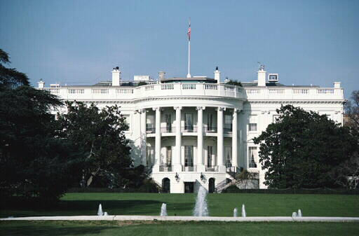
Colons to mean “note what follows”
Use a colon before a list of items, especially after expressions such as the following and as follows.
In Washington, D.C., we visited three important sites: the White House, the Washington Monument, and the Vietnam Veterans Memorial.
Please bring the following supplies: pencils, paper, compasses, rulers, scissors, tape, and protractors.
***Do not place a colon right after a verb.

Slide 41
Colons in conventional situations
Use a colon in certain conventional situations:
Between the hour and the minute in times
11:25 tomorrow morning
Between chapter and verse in Biblical references
Proverbs 3:3
Between a title and a subtitle
Mutts: America’s Dogs
After the salutation of a business letter
Dear Ms. Weinberg:

Slide 42
Direct quotations
Use quotation marks to enclose a direct quotation—a person’s exact words.
When an interrupting expression divides a direct quotation into two parts, place quotation marks around both parts of the quoted statement.
“I want to sit here,” Anna said, “not over there.”
A direct quotation can be set off from the rest of a sentence by a comma, a question mark, or an exclamation point, but not by a period.
“Your Julius Caesar project is due on the Ides of March,” Mr. Chen announced.
Comma
Question mark
“On what date does the Ides of March fall?” Tony asked.
Exclamation point
“That’s easy!” Dorothy exclaimed. “It’s March 15!”

Slide 43
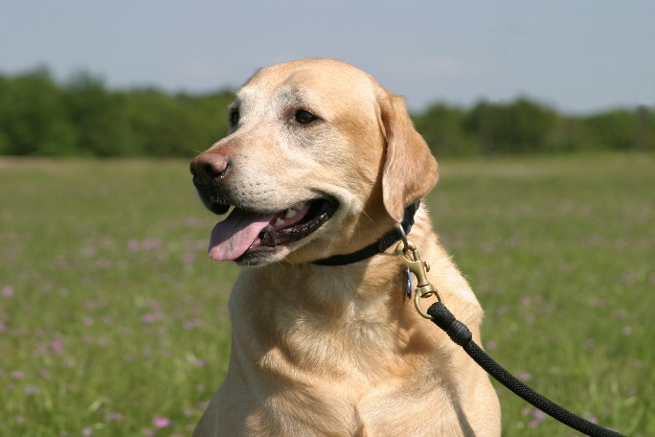
Dialogue, quoted passages, and quotations within quotations
When you write dialogue (conversation), begin a new paragraph every time the speaker changes.
“Do you want to go to the park today?” Mel asked.
“Sure,” said Sergio. “May I bring my dog, Rufus? He could use some exercise.”
“In about thirty minutes,” Mel answered.
“Sounds good to me. Meet me back here in about half an hour.”

Slide 44
Quotation marks for titles
Use quotation marks to enclose titles of short works such as short stories, poems, essays, articles, songs, and chapters and other parts of books and periodicals.
Poem
“Fire and Ice”
Essay
“Charley in Yellowstone”
Short story
“The Pit and the Pendulum”

Slide 45
Apostrophe: Possessive case Singular nouns and plural nouns
Singular nouns
Add an apostrophe and an s to form the possessive case of most singular nouns.
Sam’s little brother
a good night’s sleep
the duck’s beak
Plural nouns
If a plural noun ends in s, just add an apostrophe.
the ducks’ beaks
the Garzas’ car
Proper names
If a proper name ends in s, add only an apostrophe if adding another s would make the name awkward to pronounce.
Ms. Rawlings’ class

Slide 46
Apostrophe: Possessive case
Most possessive personal pronouns have two forms.
In the possessive case, indefinite pronouns need an apostrophe and an s.
my | mine
your | yours
his, her, its | his, hers, its
our | ours
their | theirs
all | each | most | one
another | either | much | other
any | everyone | neither | several
anybody | everything | nobody | some
anyone | few | none | somebody
anything | many | no one | something
both | more | nothing | such
These forms are used before nouns.
These forms stand alone.
Do not put an apostrophe in any of these pronouns.

Slide 47
Contractions
An apostrophe shows where letters, words, or numerals have been omitted from a contraction.
we have
we’ve
of the clock
o’clock
Plurals
In most cases, do not use an apostrophe to form the plural of a noun.
house
houses
To prevent confusion, a few kinds of nouns do form plurals by adding an apostrophe and an s.
lowercase letters
p’s and q’s
symbols
@’s
#’s
certain capital letters
A’s
I’s
numerals
1’s
2’s
some words that are referred to as words
Replace all the and’s with or’s.

