Slide 1
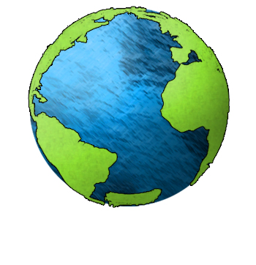
Essential Question:
What is the composition
of the Earth’s
oceans and
where are
they located?
Standard:
S6E3c. Describe the composition, location, and subsurface topography of the world’s oceans.
Notes:
Instructional Approach(s): The teacher should introduce the essential question for the lesson and the standard that aligns to the essential question.

Slide 2
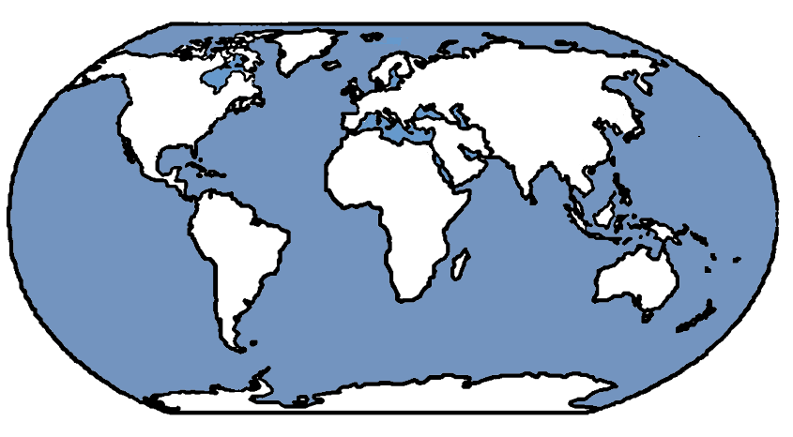
Location of the
Earth’s Oceans
Arctic Ocean
North
America
Europe
Asia
Atlantic
Ocean
Let’s Start with the Continents
Now the
Oceans
Pacific
Ocean
Africa
Pacific
Ocean
South
America
Indian
Ocean
Australia
Southern Ocean
Antarctica
Notes:
Instructional Approach(s): The teacher should ask students to first label the continents on the map in their notes. When ready, click the mouse to go over the continents when ready. The teacher can ask for volunteers or call on specific students to identify the name of the continent prior to showing the answer. The order when clicked: North America, South America, Africa, Europe, Asia, Australia, Antarctica. Once the continents have been labeled, the students should do the oceans. Follow the same strategy. When clicked, the order of the Oceans is as follows: Pacific Ocean, Atlantic Ocean, Arctic Ocean, Indian Ocean, Pacific Ocean again, and the Southern Ocean. The teacher should walk around and make sure that all students have identified both continents and oceans on their notes.

Slide 3
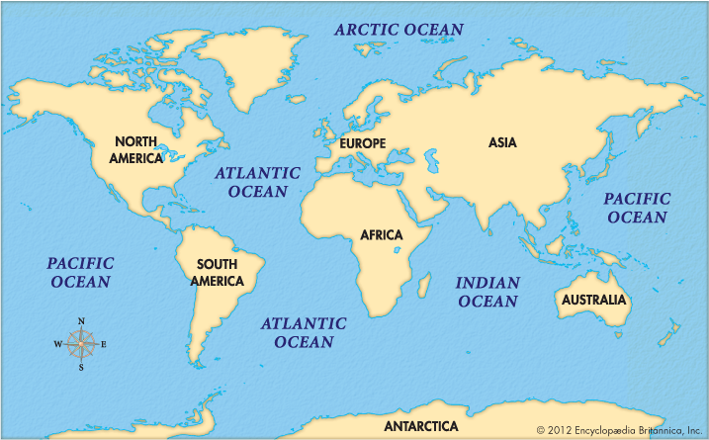
Location of the
Earth’s Oceans
Notes:
Instructional Approach(s): The teacher should use the slide to ensure that students have the correct answers identified on their notes. *Note: the Southern Ocean is not identified on this map

Slide 4
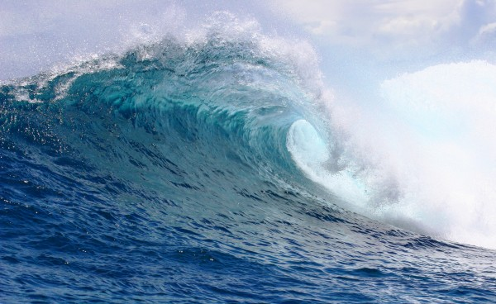
Chemical Composition of Ocean Water
Notes:
Instructional Approach(s): The teacher should use the slide as a transition into the next part of the lesson, the chemical composition of ocean water

Slide 5
What does the word composition mean?
What are some synonyms?
Structure
Make-up
Parts
Pieces
Content
Components
Notes:
Instructional Approach(s): The teacher should pose the question on the slide to the class. The teacher can either ask for volunteers or call on specific students to answer the question. When ready, click the mouse to reveal some synonyms for composition.

Slide 6


With a partner, select one of the following foods and describe its composition:
Notes:
Instructional Approach(s): Have students turn to a partner and discuss the question on the slide. Partners can be determined by the students or the teacher can provide more specific directions such as turn to the person directly in front/behind you or to the right/left of you, etc. It may be necessary to have a group of three if you have an uneven number of students. Do not allow more than 30 seconds to 1 minute of discussion time. The teacher should be walking around listening and redirecting discussions as needed. The teacher can briefly discuss student responses.

Slide 7
What percent of ocean water is salt?
Notes:
Instructional Approach(s): The teacher should pose the question to the class and gather a few student responses

Slide 8
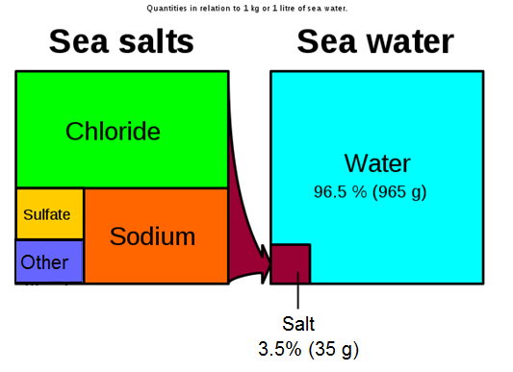
Chemical Composition of Ocean Water
Notes:
Instructional Approach(s): The teacher should present the information on the slide while the students record the information on their notes.

Slide 9
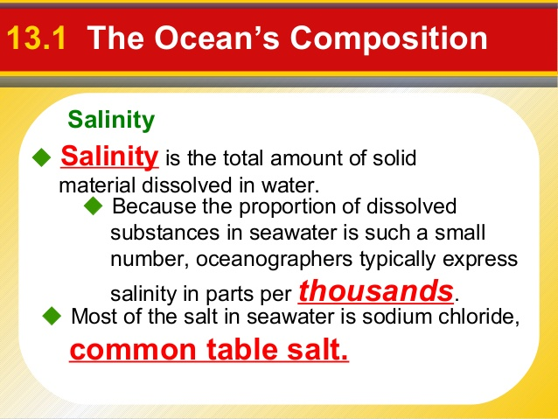
Notes:
Instructional Approach(s): The teacher should present the information on the slide while the students record the important information on their notes.

Slide 10

By some estimates, if the salt in the ocean could be removed and spread evenly over the Earth's land surface it would form a layer more than 500 feet (166 meters) thick, about the height of a 40-story office building (NOAA).
But, where did all this salt come from?
Notes:
Instructional Approach(s): The teacher should present the information on the slide.

Slide 11
From precipitation to the land to the rivers to the sea…
The rain that falls on the land contains some dissolved carbon dioxide from the surrounding air. This causes the rainwater to be slightly acidic.
The rain physically breaks down the rock and the acids chemically break down the rocks. Rain then carries the dissolved salts and minerals along as it flows. The salts in the runoff are carried to the streams and rivers and then to the ocean. http://www.classzone.com/books/earth_science/terc/content/visualizations/es1303/es1303page01.cfm?chapter_no=visualization
Many of the dissolved salts are used by organisms in the ocean and are removed from the water. Others are not used up and are left for long periods of time where their concentrations increase over time.
Notes:
Instructional Approach(s): The teacher should present the information on the slide while the students record the important information on their notes.

Slide 12
Salt from below…
Hydrothermal vents are recently-discovered features on the ocean seafloor that contribute dissolved minerals to the oceans.
These vents are the “exit points” on the ocean floor from which sea water that has seeped into the rocks of the oceanic crust has become hotter, has dissolved some of the minerals from the crust, and then flows back into the ocean.
http://www.youtube.com/watch?v=D69hGvCsWgA&list=PL88CB33C02CCF3D39&index=1
Notes:
Instructional Approach(s): The teacher should present the information on the slide while the students record the important information on their notes.

Slide 13
Eruption of Volcanoes Underwater…
Similar to the previous process, during an underwater volcano eruption, seawater reacts with hot rock and some minerals are dissolved into the sea water.
http://www.youtube.com/watch?v=U51cY6iod3U&index=5&list=PL88CB33C02CCF3D39
Notes:
Instructional Approach(s): The teacher should present the information on the slide while the students record the important information on their notes.

Slide 14
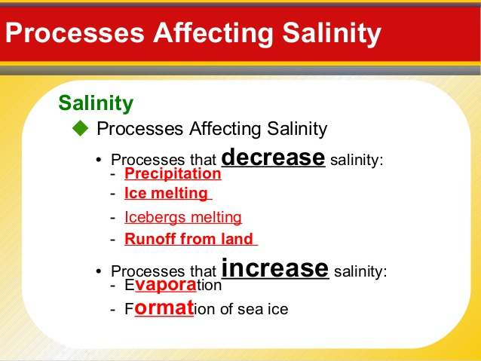

Slide 15
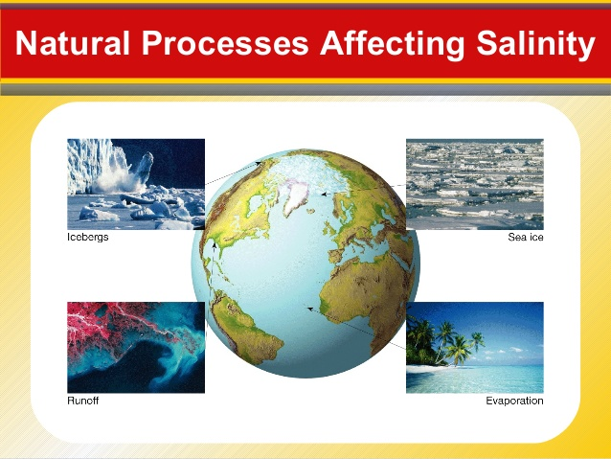

Slide 16
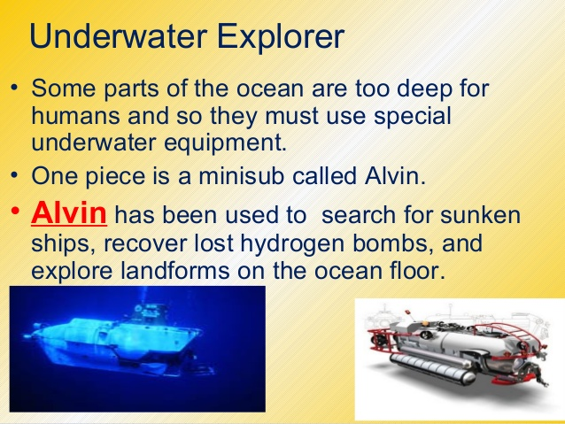

Slide 17
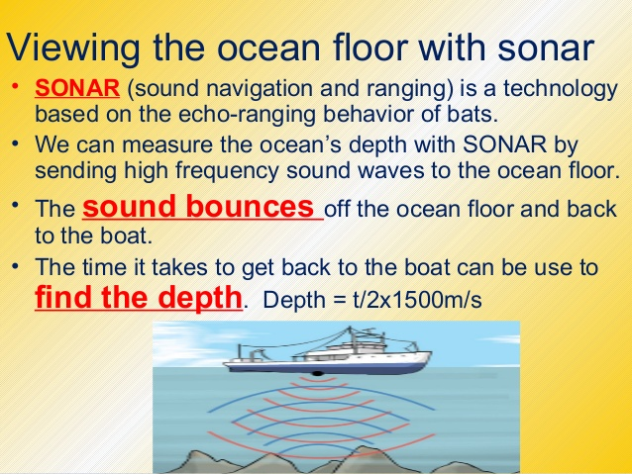

Slide 18
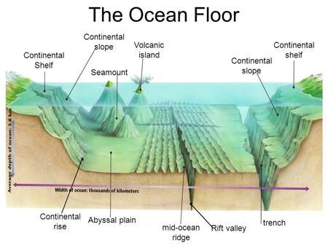

Slide 19
Continental Shelf
A gradually sloping area that edges each continent. It can range from a few kilometers to 1,300 kilometers.
Notes:
Instructional Approach(s): The teacher should present the information on the slide while the students record the important information on their notes.

Slide 20
Continental Slope
The gradual drop off from the continental shelf that leads to the deep ocean floor. It reminds me of the transition from the shallow end to the deep end in a pool.
Notes:
Instructional Approach(s): The teacher should present the information on the slide while the students record the important information on their notes.

Slide 21
Continental Rise
The gently sloping base of the continental slope.
Notes:
Instructional Approach(s): The teacher should present the information on the slide while the students record the important information on their notes.

Slide 22
Abyssal Plains
Relatively flat layer covered in a thick layer of sediment at the base of the continental rise.
Notes:
Instructional Approach(s): The teacher should present the information on the slide while the students record the important information on their notes.

Slide 23
Seamount
Seamounts are cone shaped undersea mountains of volcanic origins. The Hawaiian islands began as seamounts.
Notes:
Instructional Approach(s): The teacher should present the information on the slide while the students record the important information on their notes.

Slide 24
Volcanic Islands
Volcanic islands are mountains of volcanic origins that have broken the surface of the water. An example are the Hawaiian Islands.
Notes:
Instructional Approach(s): The teacher should present the information on the slide while the students record the important information on their notes.

Slide 25
Rift Valley
The deep undersea valley at the mid-ocean ridge.
Notes:
Instructional Approach(s): The teacher should present the information on the slide while the students record the important information on their notes.

Slide 26
Trench
These are deep canyons caused at subduction zones in the ocean.
Notes:
Instructional Approach(s): The teacher should present the information on the slide while the students record the important information on their notes.

Slide 27
Mid-Ocean Ridge
The underwater mountain chain the winds through the ocean where divergent plate boundaries pull apart.
Notes:
Instructional Approach(s): The teacher should present the information on the slide while the students record the important information on their notes.

