Slide 1
Essential Question:
How does unequal heating and the Earth’s rotation affect wind patterns?
Standards:
S6E4a. Demonstrate that land and water absorb and lose heat at different rates and explain the resulting effects on weather patterns.
S6E4b. Relate unequal heating of land and water surfaces to form large global wind systems…
S6E2c. Relate the tilt of the earth to the distribution of sunlight throughout the year and its effect on climate.
Notes:
Instructional Approach(s): The teacher should introduce the essential question and the standards that align to the essential question

Slide 2
Activating Strategy:
Watch one of the videos below then discuss with a partner what causes wind.
https://www.youtube.com/watch?v=6E9q0BFX_-I
https://www.youtube.com/watch?v=QO9_lP6rbrk
Notes:
Instructional Approach(s): The teacher should show the video and have students get with a partner to discuss the causes of wind. Partners can be determined by the students or the teacher can provide more specific directions such as turn to the person directly in front/behind you or to the right/left of you, etc. It may be necessary to have a group of three if you have an uneven number of students. Do not allow more than 30 seconds to 1 minute of discussion time. The teacher should be walking around listening and redirecting discussions as needed. The teacher can briefly discuss student responses.

Slide 3
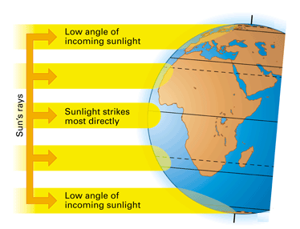
In previous lessons, you learned that the uneven heating of Earth’s surface by the Sun causes some areas to be warmer than others.
http://www.atmosedu.com/meteor/Animations/43_Angle%20of%20Sun/43.html
Notes:
Instructional Approach(s): The teacher should present the information on the slide. Use the animation to illustrate the unequal heating of the earth’s surface.

Slide 4
The Earth is tilted on it’s axis as it revolves around the sun causing the sun to hit the earth at different angles.
Notes:
Instructional Approach(s): The teacher should present the information on the slide.

Slide 5
This uneven heating of land forms wind systems.
Notes:
Instructional Approach(s): The teacher should present the information on the slide.

Slide 6
Wind is caused by differences in air pressure. Areas of high pressure move to areas of low pressure.
Air pressure is related to density. Let’s review density.
Notes:
Instructional Approach(s): The teacher should present the information on the slide while the students record the important information on their notes.

Slide 7
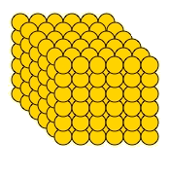
Which one has greater density? Greater pressure?
Greater Density
Greater Pressure
Lower Density
Lower Pressure
Notes:
Instructional Approach(s): The teacher should use the slide to review density.

Slide 8
We will consider Density and Pressure to be the same.
What about temperature? What did you learn about temperature and density?
Notes:
Instructional Approach(s): The teacher should pose the question to the class and ask for student responses. Remind students that higher temperature means lower density and vice versa.

Slide 9
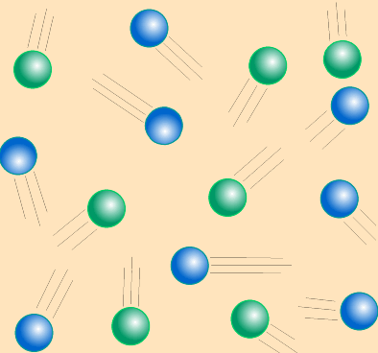
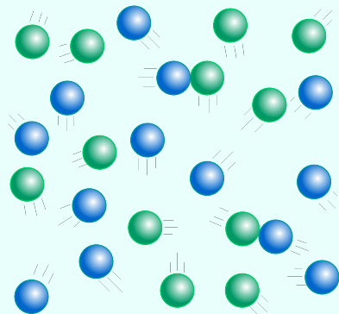
Look at the images below. Identify which image has: Higher Temperature, Higher Density, Higher Pressure.
Higher Temperature
Lower Temperature
Lower Density
Higher Density
Lower Pressure
Higher Pressure
Notes:
Instructional Approach(s): The teacher should use the slide to review the relationship between temperature, density, and pressure.

Slide 10
Temperature, Density and Pressure
Density increases,
Pressure increases
Temperature increases
Temperature decreases
Density decreases,
Pressure decreases
Notes:
Instructional Approach(s): The teacher should present the information on the slide while the students record the important information on their notes.

Slide 11
Wind is caused by differences in air pressure. Areas of high pressure move to areas of low pressure.
Let’s apply these concepts back to wind.
Notes:
Instructional Approach(s): The teacher should present the information on the slide.

Slide 12
In which direction would the wind move below.
Higher Temperature
Lower Temperature
Lower Density
Higher Density
Lower Pressure
Higher Pressure
Notes:
Instructional Approach(s): The teacher should pose the question to the class. The teacher can call on specific students, ask for volunteers, or ask students to discuss it with an elbow partner and then discuss with the class.

Slide 13
Why?
Higher Temperature
Lower Temperature
Lower Density
Higher Density
Lower Pressure
Higher Pressure
Notes:
Instructional Approach(s): The teacher should present the information on the slide. The particles are more crowded in the lower temperature (colder) area and want to spread out

Slide 14
Think of it this way…matter naturally wants to move from where it is crowded to where it is less crowded. This concept is true for all of science.
Higher Temperature
Lower Temperature
Higher Density
Lower Density
Lower Pressure
Higher Pressure
Notes:
Instructional Approach(s): The teacher should present the information on the slide. Ask the students why the word naturally is underlined. If given the choice, matter will move from high pressure, high density to low pressure, low density. However, there are times when matter is forced to stay the same or move in the opposite direction. They will learn this concept in 7th grade science in cells.

Slide 15
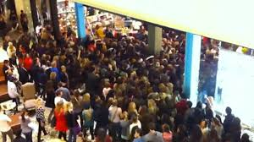
Particles naturally want to move from where they are more crowded to where they are less crowded.
Notes:
Instructional Approach(s): The teacher should use the slide to reinforce the movement of particles.

Slide 16
Which areas of the earth have air that is low pressure (low density)? Why? What about high pressure (high density)?
Notes:
Instructional Approach(s): The teacher should discuss the question with the class. Students should record the answers on their notes.

Slide 17
Distributed Summarizing:
Turn to a seat partner and describe how wind moves. Together discuss the following question: What makes wind travel at faster speeds?
Notes:
Instructional Approach(s): Have students turn to a partner and discuss the question on the slide. Partners can be determined by the students or the teacher can provide more specific directions such as turn to the person directly in front/behind you or to the right/left of you, etc. It may be necessary to have a group of three if you have an uneven number of students. Do not allow more than 30 seconds to 1 minute of discussion time. The teacher should be walking around listening and redirecting discussions as needed. The teacher can briefly discuss student responses. Answer: The greater the difference in density (pressure) between areas, the faster the wind will blow.

Slide 18
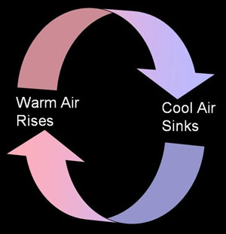
Differences in density and pressure cause wind and air movement. The movement of air occurs in convection currents.
Convection currents are simply the transfer of heat by the circulation or movement of the heated parts of a liquid or gas.
Notes:
Instructional Approach(s): The teacher should present the information on the slide while the students record the important information on their notes.

Slide 19
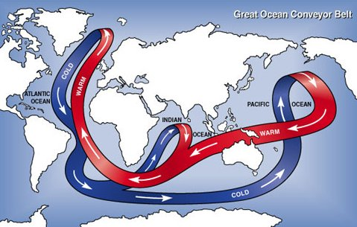
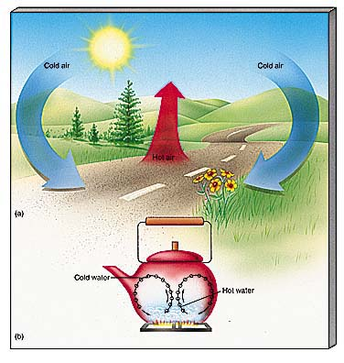
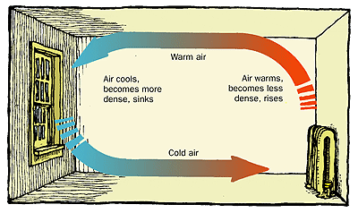
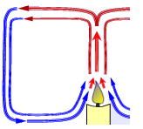
Everyday Examples of Convection Currents
http://www.healthyheating.com/Definitions/heat-transfer-convection.htm#.VD7SIfmjOSo
Notes:
Instructional Approach(s): The teacher should use the images and link on the slide to illustrate examples of convection currents. Remind students that in the water cycle, warm air rises, cools and condenses.

Slide 20
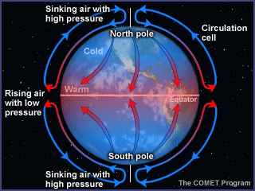
Large Convection Currents are formed because of the temperature differences between the equator and the poles. This produces global wind systems.
Notes:
Instructional Approach(s): The teacher should present the information on the slide while the students record the important information on their notes.

Slide 21
The sinking of cold, dense air and the rising of warm, less dense air do not explain everything about wind. What other factor have we discussed previously that affects the direction of winds on the earth’s surface?
Notes:
Instructional Approach(s): The teacher should present the information on the slide and pose the question to the class.

Slide 22
Surface winds and surface currents are affected by the rotation of the Earth (the Coriolis Effect)
Because Earth rotates toward the east, winds appear to curve to the right in the northern hemisphere and to the left in the southern hemisphere
Notes:
Instructional Approach(s): The teacher should present the information on the slide while the students record the important information on their notes.

Slide 23
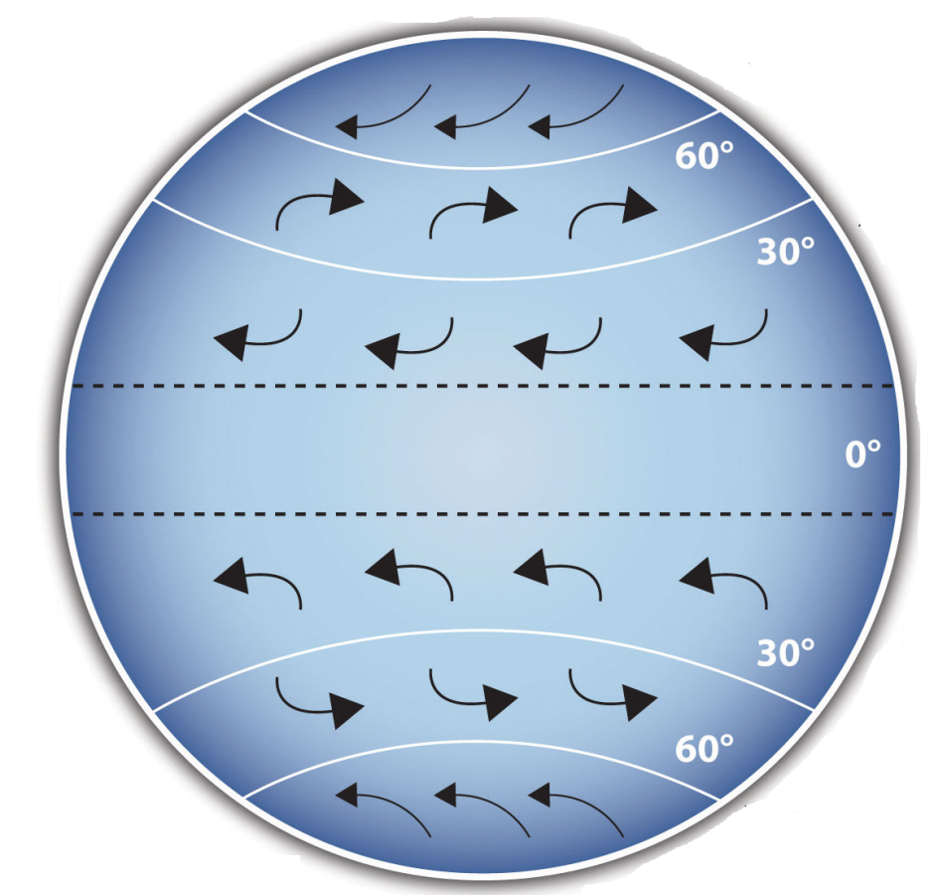
The effect of the earth’s rotation (Coriolis Effect) on Winds
http://www.classzone.com/books/earth_science/terc/content/visualizations/es1904/es1904page01.cfm?chapter_no=visualization
http://www.classzone.com/books/earth_science/terc/content/visualizations/es1905/es1905page01.cfm?chapter_no=visualization
Notes:
Instructional Approach(s): The teacher should present the information on the slide to illustrate the Coriolis Effect.

Slide 24
The flow of air caused by unequal heating of the Earth’s surface and the rotation of the Earth (Coriolis Effect) creates distinct wind patterns on Earth’s surface.
These wind systems not only influence the weather, they also determine when and where ships and planes travel most efficiently.
Notes:
Instructional Approach(s): The teacher should present the information on the slide while the students record the important information on their notes.

Slide 25
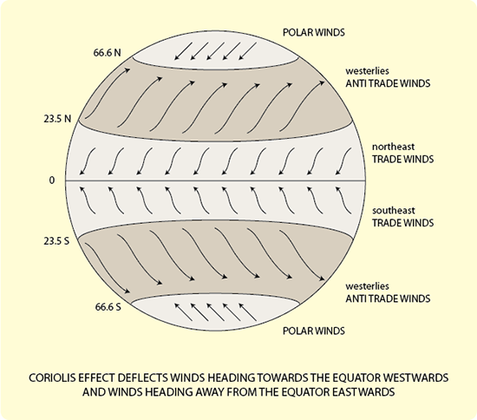
Below is a diagram showing the global wind patterns that distribute heat and moisture around the globe.
Notes:
Instructional Approach(s): The teacher should present the information on the slide. The students should draw arrows indicating the direction of wind on their own diagram in their notes.

Slide 26
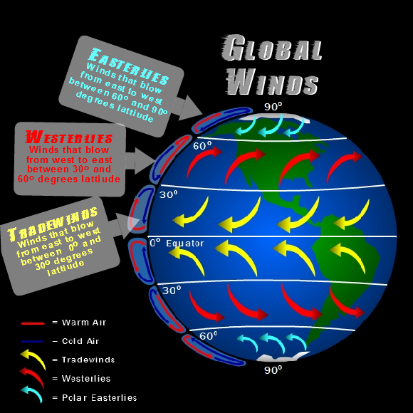
Notes:
Instructional Approach(s): The teacher should use the image on the diagram to illustrate the direction of winds.

Slide 27
Distributed Summarizing:
Turn to a seat partner and describe the factors that influence global wind patterns.
Notes:
Instructional Approach(s): Have students turn to a partner and discuss the question on the slide. Partners can be determined by the students or the teacher can provide more specific directions such as turn to the person directly in front/behind you or to the right/left of you, etc. It may be necessary to have a group of three if you have an uneven number of students. Do not allow more than 30 seconds to 1 minute of discussion time. The teacher should be walking around listening and redirecting discussions as needed. The teacher can briefly discuss student responses.

Slide 28
Global wind systems determine the major weather patterns for the entire planet.
Smaller wind systems affect local weather. Two such wind systems are sea breezes and land breezes.
Notes:
Instructional Approach(s): The teacher should present the information on the slide while the students record the important information on their notes.

Slide 29
Look at the temperatures of the land and the sea in this diagram. Which direction would the wind blow? Why?
High
Pressure
65°F
85°F
Low Pressure
Notes:
Instructional Approach(s): The teacher should present the information on the slide. The teacher can call on students to respond or ask for student responses. When ready, click the mouse to reveal the answers.

Slide 30
A sea breeze occurs when wind is moving from the sea towards land.
High
Pressure
65°F
85°F
Low Pressure
Notes:
Instructional Approach(s): The teacher should present the information on the slide.

Slide 31
Land heats up and cools down faster than water. How does this affect wind?
Notes:
Instructional Approach(s): The teacher should present the information on the slide.

Slide 32
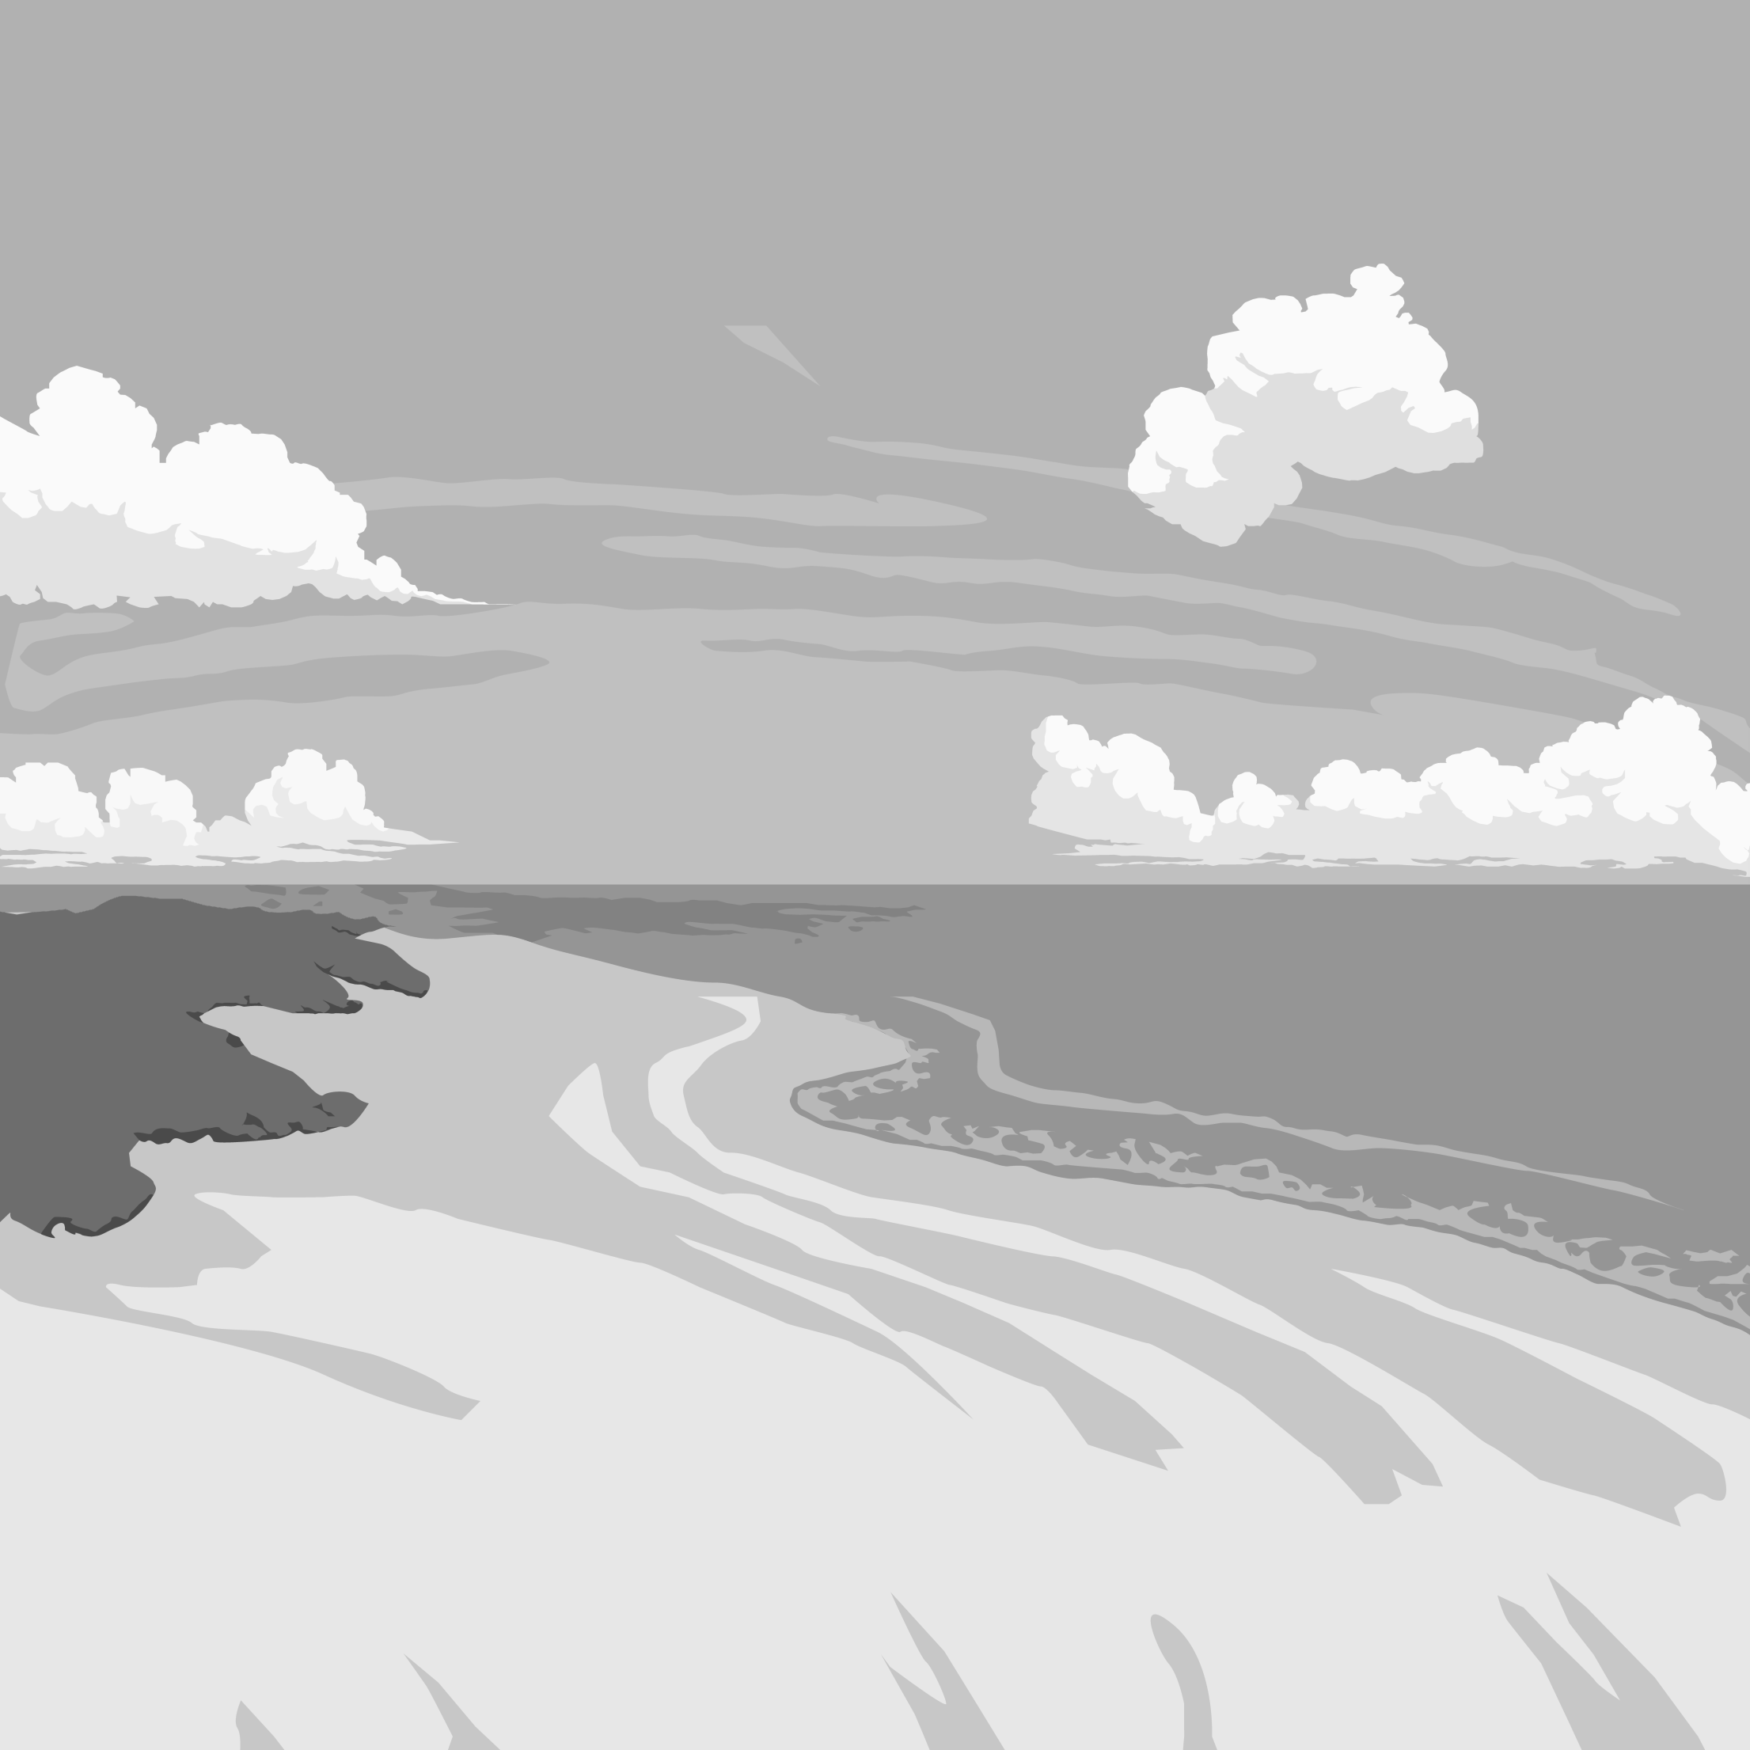
At night when the earth’s surface is no longer being heated by the sun, the land cools much more rapidly than ocean water. What happens to the wind?
Low
Pressure
65°F
55°F
High Pressure
Notes:
Instructional Approach(s): The teacher should present the information on the slide. The teacher can call on students to respond or ask for student responses. When ready, click the mouse to reveal the answers.

Slide 33
A land breeze occurs when wind is moving from the land to the sea.
Low
Pressure
65°F
55°F
High Pressure
Notes:
Instructional Approach(s): The teacher should present the information on the slide.

Slide 34
How do sea breezes and land breezes affect local weather?
http://www.nc-climate.ncsu.edu/edu/k12/.breezes
Notes:
Instructional Approach(s): The teacher should present the information on the slide.

Slide 35
Sea Breeze and Land Breeze
https://www.youtube.com/watch?v=ZQV72Yzmjyc
http://www.classzone.com/books/earth_science/terc/content/visualizations/es1903/es1903page01.cfm?chapter_no=visualization
Notes:
Instructional Approach(s): The teacher should use the links to illustrate sea and land breezes

Slide 36
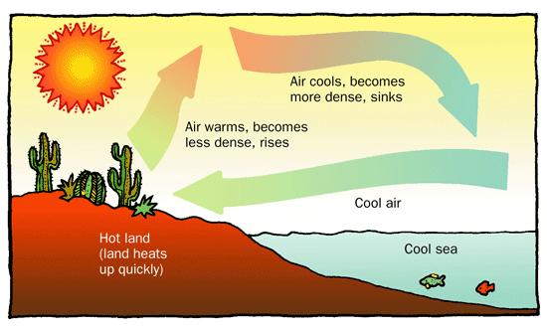
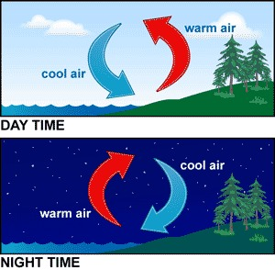
Sea
Breeze
Land
Breeze
Notes:
Instructional Approach(s): The teacher should use the images to illustrate sea and land breezes

Slide 37
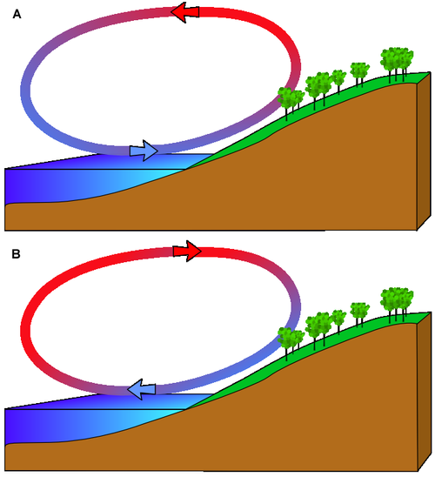
Identify which diagram illustrates a Sea Breeze and a Land Breeze. Explain why. Include high and low air pressure in your explanation.
Notes:
Instructional Approach(s): The teacher can have students answer the questions individually or with a partner.

Slide 38
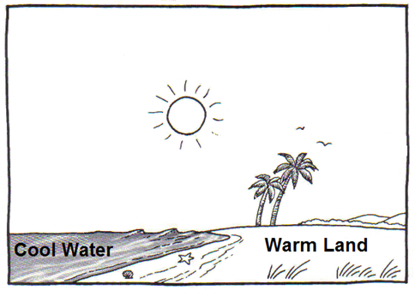
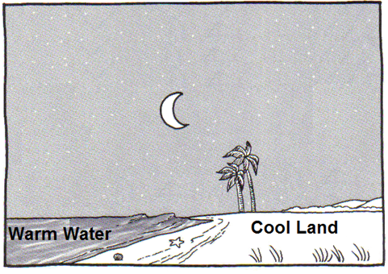
Label and draw the following in the diagrams on your notes: sea breeze, land breeze, high pressure, low pressure, arrows showing the direction of the wind.
Notes:
Instructional Approach(s): The students should label the diagrams on their notes. Click to the next slide to show the answers.

Slide 39
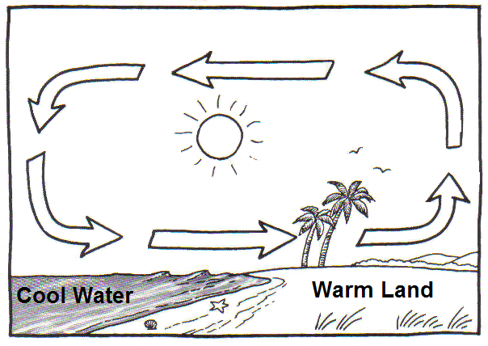
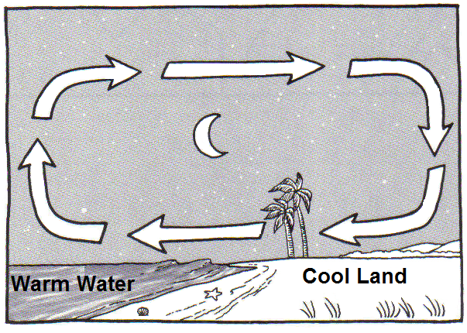
High Pressure
Land Breeze
Low Pressure
Sea Breeze
Low Pressure
High Pressure
Notes:
Instructional Approach(s): The teacher should use the slide to ensure students have the correct answers on their notes.

Slide 40
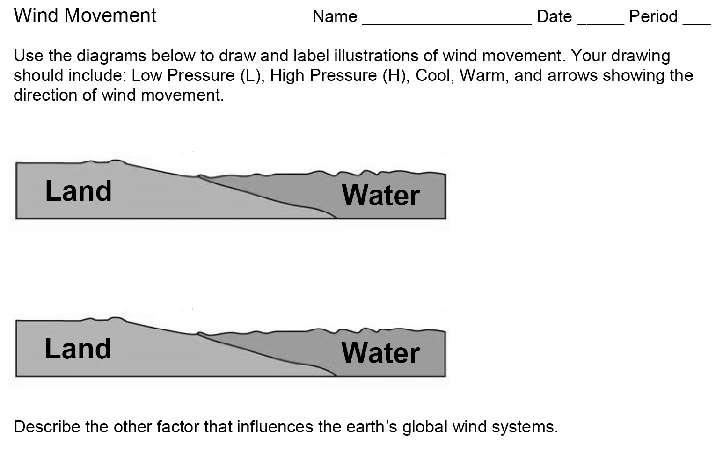
Summarizing Strategy:
Notes:
Instructional Approach(s): Each student should complete the summarizer. The teacher should use the summarizer to determine the level of student mastery and if differentiation is needed.

