Slide 1
Other than the sun, planets, and moon, what other objects are found in the Solar System?
Notes:
Instructional Approach(s): The teacher should ask the students the question on the ppt slide. Give students 1 minute or less to provide examples of other objects in the solar system.

Slide 2
In this lesson, we are going to be comparing comets, meteoroids, and asteroids which are found in the Solar System.
Notes:
Instructional Approach(s): The teacher should read the slide to the class.

Slide 3
Essential Question:
What is the difference between a comet, meteoroid, and asteroid?
Standard S6E1f. Describe the characteristics of comets, asteroids, and meteors.
Notes:
Instructional Approach(s): The teacher should introduce the essential question and the standard that aligns to the essential question.

Slide 4
Comets
http://www.creationscience.com/onlinebook/Comets.html

Slide 5
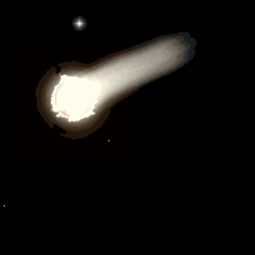

Slide 6
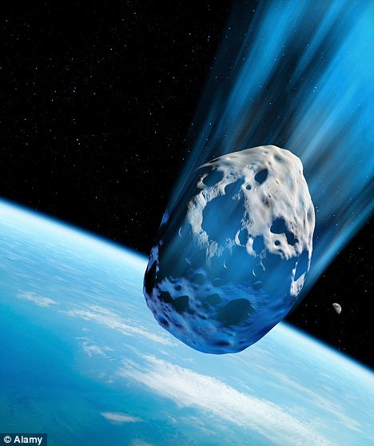
Comets
Comets are composed of dust and rock mixed with frozen water, methane, and ammonia
Comets are considered to be like a large, dirty snowball
Notes:
Instructional Approach(s): The teacher should present the characteristics of a comet while the students record the important information on their notes.

Slide 7
Comets
Comets travel around the sun in elliptical orbits
http://www.classzone.com/books/earth_science/terc/content/visualizations/es2706/es2706page01.cfm?chapter_no=visualization
Notes:
Instructional Approach(s): The teacher should present the characteristic of a comet while the students record the information on their notes. The teacher should show the animation of a comet traveling in the solar system to reinforce the concepts.

Slide 8
Comets
When a comet nears the sun, some of it melts and forms a long tail (gases in the comet are vaporized by the sun.)
A comets tail always points away from the Sun.
When a comet moves farther away from the sun, the tail disappears.
http://www.windows2universe.org/comets/comet_model_interactive.html
Notes:
Instructional Approach(s): The teacher should present the characteristics of a comet while the students record the information on their notes. The teacher should show the animations of a comet traveling in the solar system to reinforce the concepts.

Slide 9
After a comet has passed close to the Sun many times, it breaks apart. The small pieces from the comet spread out.
These pieces of dust and rock, along with those coming from other sources, are called Meteoroids.
Notes:
Instructional Approach(s): The teacher should present the information on the slide.

Slide 10
Meteoroid, Meteor, Meteorite?
The difference is just based on where the rock is located when you are describing it.
Notes:
Instructional Approach(s): The teacher should present the information on the slide.

Slide 11

Meteoroid is a “space rock” that is still in space
Meteor is a meteoroid that burns up in the earth’s atmosphere
(Shooting Star)
Meteorite is a meteoroid that hits
the earth’s surface
Notes:
Instructional Approach(s): The teacher should present the information on the slide while the students record the important information on their notes. Possibly do the Meteor Burnout demonstration linked on the resource page.

Slide 12
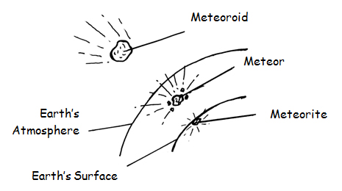
Notes:
Instructional Approach(s): The teacher should use the image on the slide to reinforce the difference between a meteoroid, meteor, and meteorite.

Slide 13
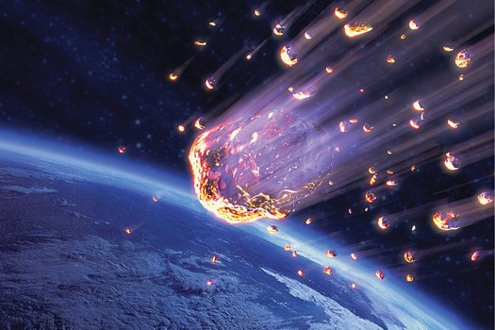
A Meteor is considered harmless even though it can be viewed from earth at times.
Notes:
Instructional Approach(s): The teacher should present the information on the slide while the students record any important information on their notes.

Slide 14
Distributed Summarizing
On your notes sheet, explain the difference between a comet, meteoroid, meteorite and meteor.
When instructed, turn to an elbow partner and share
your answer.
Notes:
Instructional Approach(s): The students should answer the distributed summarizing question on the bottom of their notes comparing a comet, meteoroid, and a meteor. After 1-2 minutes, the teacher should instruct students to share their answer with another student close to them (without getting out of their seat).

Slide 15
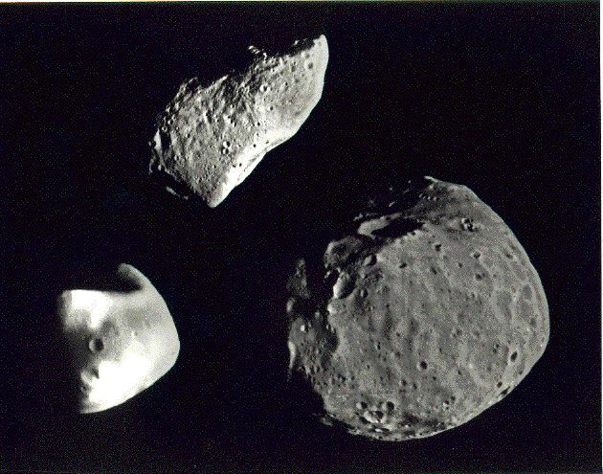
Asteroids
Notes:
Instructional Approach(s): Introduce Asteroids

Slide 16
Asteroid
A piece of rock similar to the material formed into planets.
An Asteroid is smaller than a
planet but larger than a meteoroid
Notes:
Instructional Approach(s): The teacher should present the characteristics of an asteroid while the students record important information on their notes.

Slide 17
Asteroid
Most asteroids are located in an area between the orbits of Mars and Jupiter called the Asteroid Belt.
Why are they located there?
The gravity of Jupiter might have kept a planet from forming in the area
Notes:
Instructional Approach(s): The teacher should present the characteristics of an asteroid while the students record important information on their notes.

Slide 18
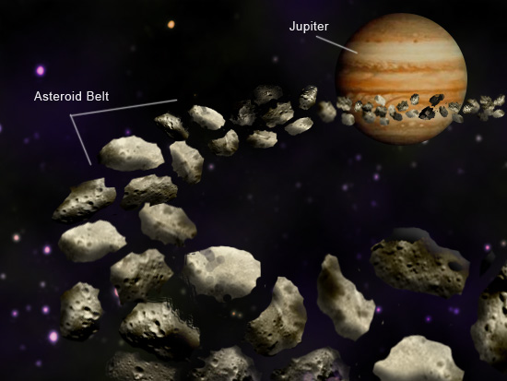
Notes:
Instructional Approach(s): The teacher should use the image to reinforce the location of asteroids.

Slide 19
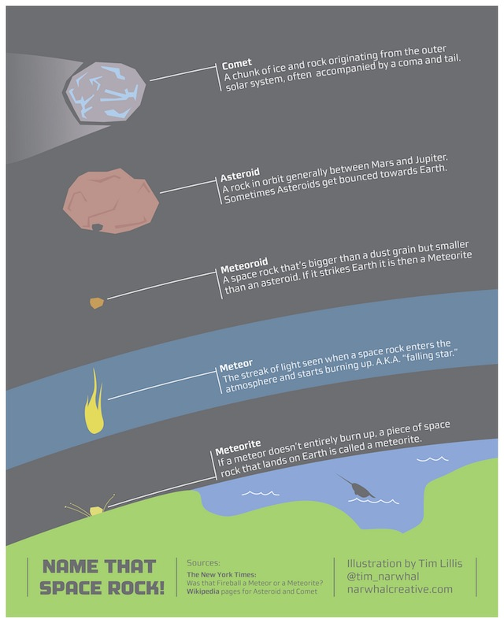
Notes:
Instructional Approach(s): The teacher should use the image to reinforce the characteristics of a comet, asteroid, and a meteor.

Slide 20
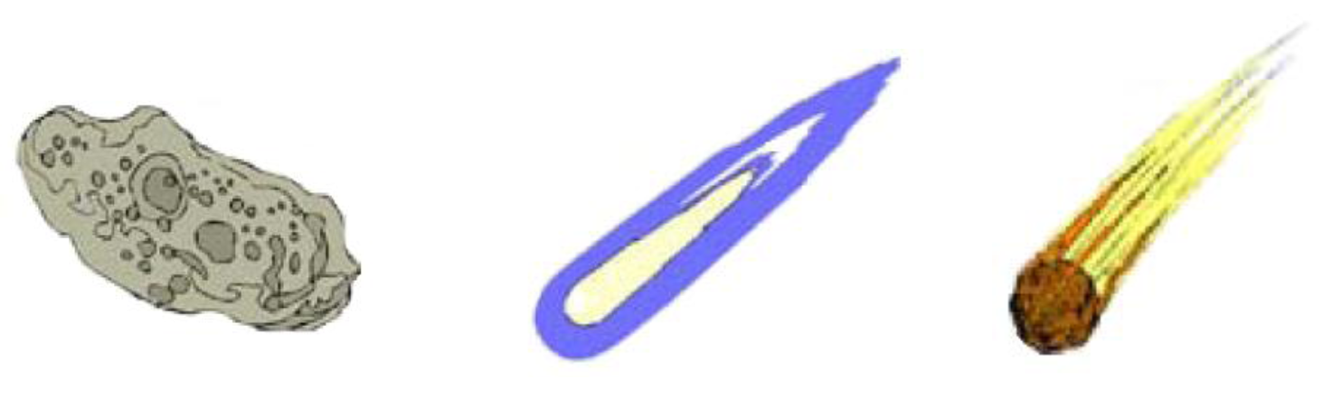
Comet, Meteor or Asteroid?
Explain how you know.
Notes:
Instructional Approach(s): Give students the images at the beginning and have them tape or glue the image underneath the correct object name OR after going through the characteristics of each object, have students cut out the pictures and then match them to the correct object. Once the teacher checks the student’s matches, the student can then tape or glue the image underneath the correct object name.

