Slide 1
¡Bienvenidos a la clase de Español 2! Señora Sinclair Room 336
1. Por favor, find the seat number that corresponds to the number on your popsicle stick given to you at the door.
2. Put the popsicle stick at the top right hand corner of your desk.
3. Clear off your desk except for only a pencil, your schedule and your popsicle stick in the top right hand corner.
4. Wait quietly and patiently for further instructions.
5. Happy first day of school! I’m very happy to see you all!

Slide 2
¡Hola! Lee las instrucciones abajo
1. Please take one of each paper from the back table. 1. Haz Ahora 2. Hoja de Participación
2. Take a seat in your seat your were assigned yesterday. **If you do not remember there is a roster on the green clipboard on the back table with your seat number next to it**
3. Write your name on each of the papers
4. Wait quietly for further instructions.
*** If you have extra credit materials out them on your desk in the top right hand corner. ***
Gracias, Sra. Sinclair

Slide 3
Expectations & Procedures
Señora Sinclair

Slide 4
What is the first thing I do when I enter our classroom?
1. Be seated by the time the bell rings start working on the Haz Ahora
2. The questions/activity will always be written on the whiteboard and/or posted on the smart board.
3. Each Haz Ahora sheet will be taken up every two weeks or when it is full (front and back) for a classwork grade.
4. To receive full credit you must include 3 things
The date
Question written completely under (pregunta)
Your original answer written under (respuesta) written in a complete phrase.
5. I will randomly select people(victimas) or you may volunteer (voluntarios) to give their individual responses for participation points.

Slide 5
Haz Ahora 8.9.18
¿Cómo te llamas?
¿Cuántos años tienes?

Slide 6
Haz Ahora 8.10.18
¿Qué te gusta hacer?

Slide 7
Hoja de Participación
1. ¡Puntos de participación! For every time you are called on to participate I will sign your hoja de participación.
2. This paper should be out next to your Haz Ahora so begin each class with participation if you share your response to the Haz Ahora.
3. This will be taken up at the end of each 9 weeks for a grade. The grade is based on a range. The person with the most signatures will get a 100% and start the range.
4. The lowest grade you can get is a 70%
For example:
Raul has the most with 75 Signatures
75-65 = 100%
64-55=95%
54-45=90%
44-35=85%
34-25=80%
24-15=75%
14-0 = 70%

Slide 8
Absent? What did we do while I was gone?
If you were absent for any reason, it is your responsibilty to:
1. Check your class’ absent folder located on the back table, any work you missed will be in there with your name on it. You have up to 3 days to turn in your missing work.
2nd Anaranjado
3rd Azul
4th Rojo
5th Morado
6th Amarillo
7th Verde
2. It is your responsibility to copy the question from the Haz Ahora from days missed and write your own response to each. These will still be taken for a grade when we turn in our Haz Ahora’s bi weekly writing ABSENT on the days missed will result in lost points.
3. All vocabulary sheets, PowerPoints and assignments are also posted on canvas for you to access at home.

Slide 9
No tengo lápiz o Boligrafo, no tengo nada!
Collateral system:
If you don’t have a pencil I will gladly loan you one of mine for a token of collateral.
What does collateral mean? I accept cell phones, binders, chargers, jewelry, books and pretty much anything besides shoes… I don’t want your smelly sneakers under my desk. ☺ gracias.
I have extra paper on the back table for you to use as you may need.

Slide 10
Quiz/Test corrections
1. After every test/quiz we always have a chance to correct what we missed.
2. My promise is to always stay on top of grades and have them graded and in infinite campus within 48 hours of the assignment. Granted, life happens but I will ALWAYS try my best to have grades as up to date as possible. I know what it’s like to want to know what you made on that big test!
3. Upon returning the assessment, we always correct our errores in red pens, I will provide them. These corrections are to be done INDIVIDUALLY with my assistance only. Not your neighbor’s test who made a 100 and you’re just copying their answers. THIS WILL NOT HELP YOU.
4. Occasionally I will provide the opportunity to earn points back after corrections are made.
5. Once corrections are made we turn in our corrected tests to the back table so I can keep them for future reference or tutoring. Your grade will not be put in infinite campus until I have your corrected assessment.
6. I do not do retakes on tests or quizzes except for IPA’s (integrated performance assessments) to give you a second chance to “level up”

Slide 11
Quizzes & Tests
1. Quizzes are typically geared towards address a specific function like grammar or vocabulary or sometimes both and I promise to ALWAYS give AT LEAST a week’s notice for all assessments. You will find these dates on the white board underneath the Haz Ahora.
2. Grammar is not English to Spanish translation we always use clues to talk about the word instead of matching.
For example: es blanca, la pones en el cereal y café, para desayuno.
3. For tests, we have a listening section, multiple choice, short answer, reading comprehension and essay and occasionally a speaking portion done individually with me.

Slide 12
IPA’s (Integrate Performance Assessments)
1. IPA’s are a way to assess your current proficiency level and bring together everything we have learned each nine weeks. These are always cumulative.
2. These are not graded based on grammar or vocabulary uses but rather how you perform in each of the areas of language acquisition (reading, writing, listening and speaking)
3. Interpretive listening and reading comprehension , Interpersonal speaking will be done with me by simulating a casual conversation, presentational writing by identifying a topic and writing a personal response.
Novice Low 60-70%
Novice Mid 71-79%
Novice High 80-89%
Intermediate Low 90-100%

Slide 14
Basta ya con los examenes! Seguimos con los juegos!
1. Los juegos y boletos
2. We are always having fun and playing fun games to learn the language!
3. I will award los boletos to the team that wins the game. Or give 1st, 2nd and 3rd place on quiz.izz or Kahoot. Please write your name on the back of the tickets and they go in to the weekly raffle.
4. If you win the raffle, you can choose between 4 bonus points that I keep up with and are cumulative. You just tell me where to add them and I will put it in the gradebook. They can be applied to any assignment, test or quiz just not IPA’s.
5. You may also choose between chips or candy.
6. I do not give tickets to 2 team games.

Slide 15
Frases útiles
1. Spanish 2 means more Spanish ALL THE TIME!
2. My goal is to speak Spanish 90% of the time. This will help increase proficiency get that LEVEL UP!
3. If by any means we are confused there are some useful phrases we can resort to in cases of emergency. See big yellow poster

Slide 16
Tardies
1. 1st offense, point deducted from class dojo
2. 2nd offense, call home and point deducted from class dojo
3. 3rd offense, point deducted from class dojo and detention
4. 4th offense office referral.
5. 5th offense office referral.

Slide 17
Class Dojo/ Behavior Grade
1. Your behavior grade will be determined by points accumulated from class dojo.
2. You begin each week with 10 points. Each time an expectation or procedure is broken you lose 1 point for your name.
3. You have the opportunity to earn your points back if you go above and beyond in class and correct your mistake.
4. What are some skills you think should be noticed in our classroom?

Slide 18
Expectations!
1. Responsibility: What does it mean to be responsible in our classroom?
We are responsible for being prepared and on time ready to learn.
We are held responsible to be our seats, with our Haz Ahora and Participación out and are working when the bell rings.
C. No cell phones out and no food or drink in the classroom.
D. I am responsible for being prepared every day with an engaging lesson and getting your assessments back in a timely manner.

Slide 19
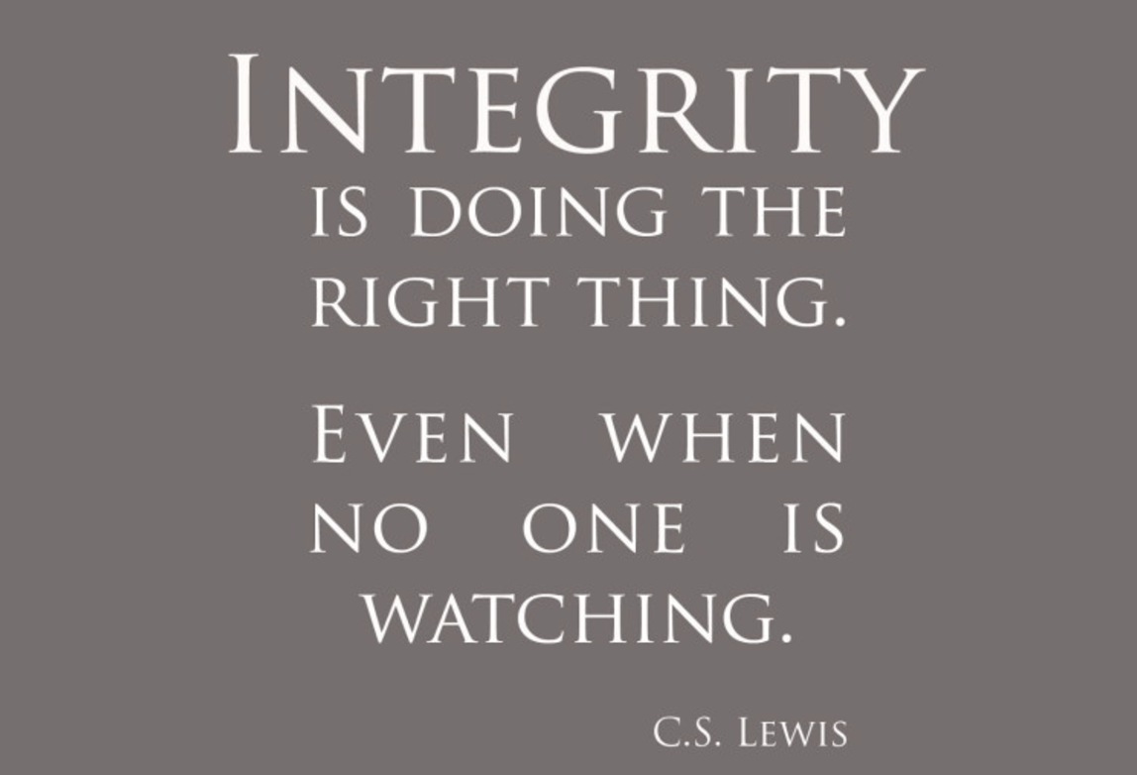
2. Integrity
What does integrity mean?
1. The quality of being honest and having strong moral principles; moral uprightness.
2. No cheating. I take cheating very seriously and cheating will result in a 0 with no chance of make up and a call home to inform parents and/or sports coaches of your dishonest and lack of integrity.
3. The use of a cell phone during a test or quiz shows lack of integrity and academic dishonesty. A cell phone is sight during a test or quiz will also result in a 0 and a call home and/or sport coach.

Slide 20
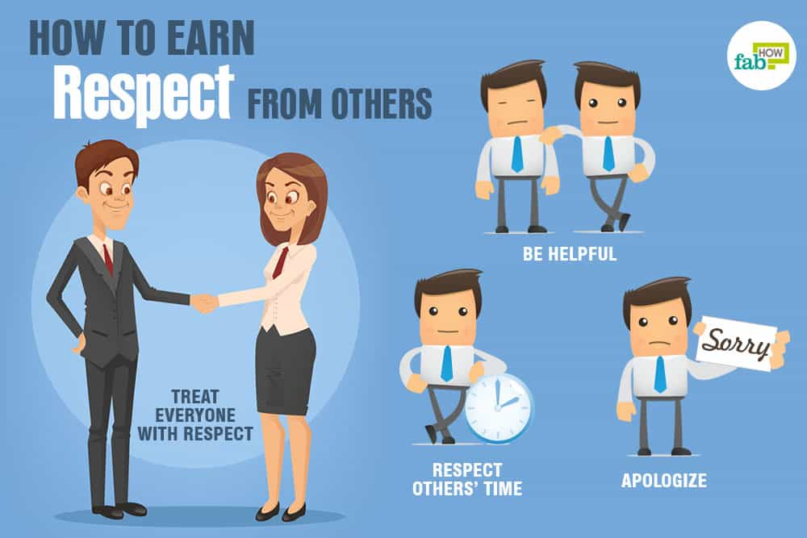
3. Respect
1. What is respect? What does respect look like to you? What does it mean to be a respectful classmate? Who do you respect?
2. Be respectful by refraining from any side conversations while I am talking and while other students are speaking to the class.
3. Be respectful by not bringing any food or drink inside the classroom. We all know your neighbor is going to ask for some of those flamin hot Cheetos…
4. Levanta la mano!
5. RESPECT YOURSELF! You are smart, kind and should be ready for success every day.

Slide 21
4. Productive
Are you productive with your class time? Or do you typically procrastinate?
1. Always use your time wisely and be productive when given class time to complete an assignment.
2. Be seated before the bell rings and be working on Haz Ahora or (warm-up).
3. No getting up and roaming around the classroom.
4. ALWAYS DO YOUR BEST!!!

Slide 22
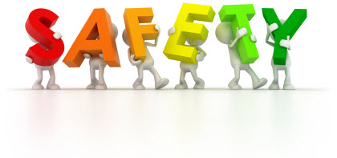
5.
Do you feel safe in your school environment? In our classroom? What would make you feel safer at school?
1. I want you to feel safe in my classroom. You all are my first priority here at Shaw and when someone knocks at the door I am the only one to answer the door unless instructed otherwise.
2. No one is to leave the classroom without asking me, no one is to leave during the 1st 10 and last 10 minutes of class. You must sign out on the back table and you are given 6 minutes to go and come back from the restroom.
3. No bookbags in our classroom. Only string bags are allowed. This is a serious safety precaution.

Slide 23
6. Attentive
1. Students are expected to be attentive at all times of instruction, in Spanish 2 90% of the instruction is in Spanish.
2. No cell phones, talking or getting up during lessons unless otherwise instructed.
3. Being attentive will ensure you are aware of all instructions and guarantee understanding of all expectations and goals of the lessons.
4. Participation, I will be randomly selecting a popsicle stick with a number on it, that number corresponds to a certain desk. If your number is called be prepared to answer said question.

Slide 24
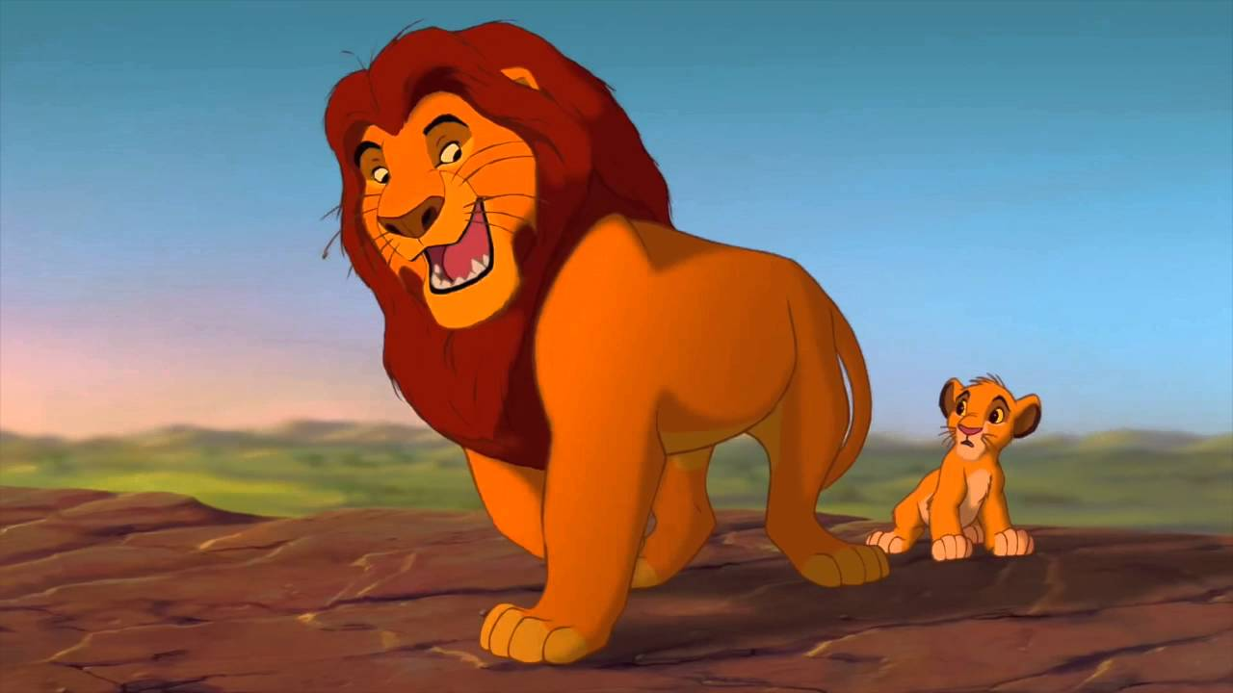
Attención
Yo: Clase, clase
Ustedes: Sí, sí
Yo: ¿Qué pasa?
Ustedes: ¿Qué pasa, mufasa?
When you hear me say either of these, STOP what youre doing and respond with your part. And listen to instructions.
Lets practice!

Slide 25
Estrellas!
At the end of each month I will choose 1 young lady and 1 young man from each class to be featured on the board on the back wall.
Parents will be contacted to notify of your spectacular effort in class and exemplary behavior.
Always remember to reach for the stars!

Slide 26
¡Hola! Haz ahora 8.13.18
1. ¿Cómo eres físicamente? ¿De personalidad?
2. Por favor, agarra un “syllabus” aquí.

Slide 27
Remind 101
In the message text:
@spanshaw___
To: 81010

Slide 28
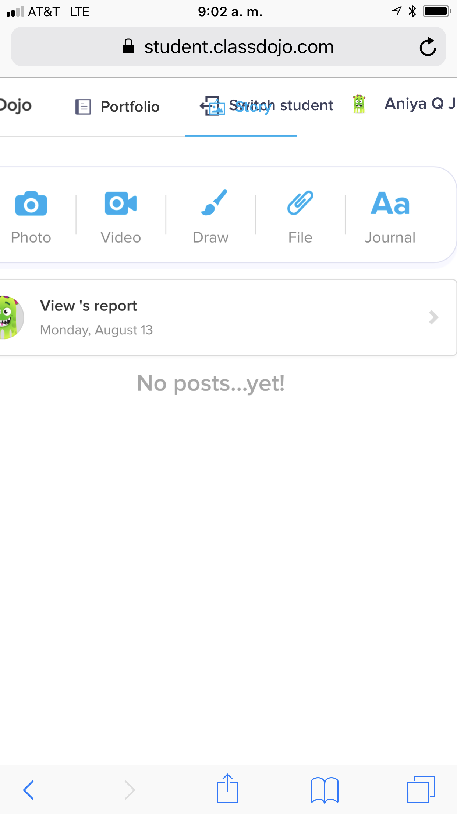
Class dojo
1. Scan the QR code on the paper choose your name from the roster
2. Go to your story
2. Take a picture of yourself and add it to class dojo story.
3. Write a journal entry about the following prompt.
“What is your biggest dream? Where do you see yourself in 10 years, professionally, in education and overall accomplishments?
Also, self-assess your Spanish proficiency level where do you think you are currently and what is your goal proficiency level for the end of the year?

