Slide 2
Welcome to the 2018-2019 School Year
MRS. HILL: ELA

Slide 3
ALL ABOUT ME (Mrs. Hill)
Hometown: Albany, Ga
Birthday: September 02
Favorite Colors: Pink, Turquoise, and Chocolate
Interesting fact: I sometime get “only child syndrome”

Slide 4
Fun Facts about Mrs. Hill
I enjoy reading and writing. A couple of my favorite books are To Kill a Mockingbird by Harper Lee and Bud, not Buddy by Christopher Curtis.
I enjoy writing poetry and blogging.
I love Instagram, Pinterest, and shopping on Amazon.
I love the Icey Girl & Co., they have the best shaved ice.

Slide 5
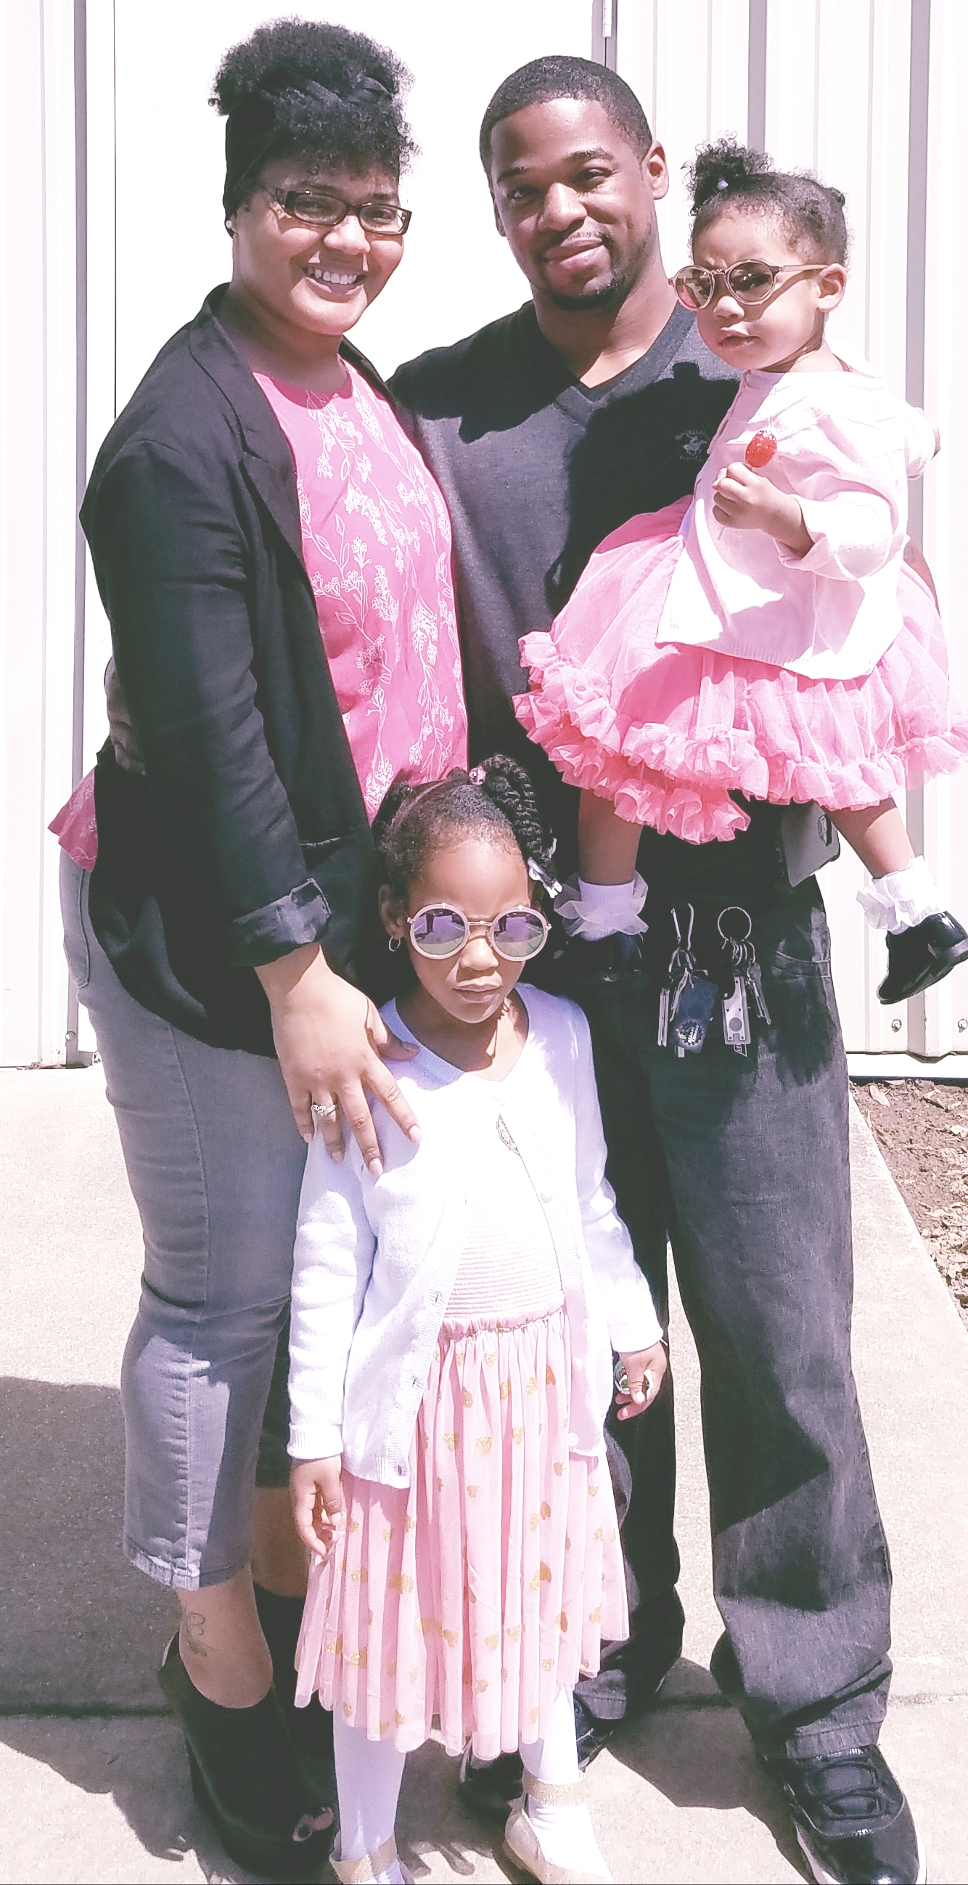
There’s More…
I have been married for 5 years
I have two daughters, Ariah 4 & Nichole 2.
My husband and I are foodies, we love visiting restaurants and trying new foods.

Slide 6
Rules and Procedures
Rule: A rule is a regulation that lets you know what is allowable and what is not.
Example: Gum is not allowed at school.
Procedure: A procedure is a process or a way of doing things.
Example: Completed classwork should be placed in the trays hanging under the board

Slide 7
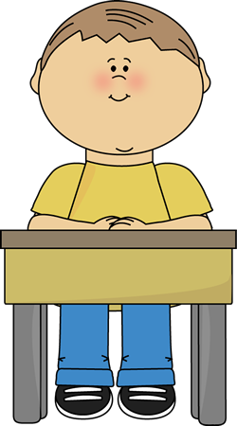
CLASSROOM PROCEDURES
1. Form a line outside the classroom and wait quietly until you are asked to enter.
2. When told to enter the room, please do so quietly and go directly to your seat.

Slide 8
WHAT DO I DO AFTER I SIT DOWN?
Get out your ELA Binder and complete the “Smart Start” listed on the board in the appropriate section. Note: You should use the same sheet of the paper for the entire week. If you are absent, put the date and put absent. We will go over how to head your paper later.
Get out any homework(if applicable) and put in the center of table. Note: Make sure your name is on the assignment.
3. Write down the homework for the day and/or week. If you finish before we go over the smart start, remain in your seat quietly. If you have a book, read it.

Slide 9
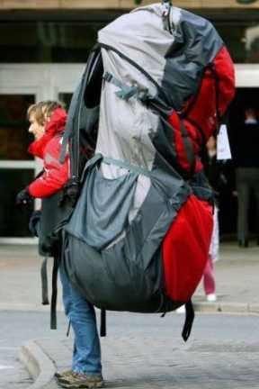
WHAT ABOUT MY PERSONAL ITEMS?
If you must bring a personal item (bag/purse), it should be placed UNDER your chair, NOT beside your chair.
**Note: NO BOOKBAGS OR BOOKBAG PURSES ALLOWED!

Slide 10
CAN I SHARPEN MY PENCIL???
You may sharpen your pencil during independent work or at the beginning of class ONLY. *Note: You may not sharpen your pencil during instruction because it is disruptive. Do not ask to sharpen your pencil during independent work.
When sharpening your pencil, do not take a tour of the room. Go directly to the sharpener and back to your seat with as little disruption as possible.
Also, pencils and sharpeners are on the student shelf in the back of the room. If pencils are not returned, they will not be provided. ☺

Slide 11
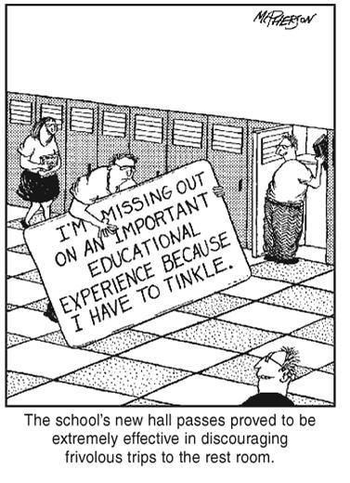
I NEED TO USE THE RESTROOM!!
Hold up three fingers if you need to use the restroom. DO NOT shout it out to be disruptive.
When given permission, put your name and time on the sign-out sheet on the table near the door.
Take a pass and please hurry back.
Note: Please utilize time between classes for restroom.

Slide 12
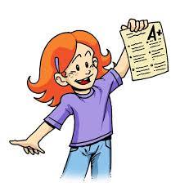
HOW DO I TURN IN MY WORK?
All assignments will be collected on the date they are due. Please have your completed assignment on your desk ready to be collected/checked at the beginning of the period.
Homework will typically be collected during the smart start. Class assignments will typically be turned in at the colored cart in your class drawer labeled IN.

Slide 13
How should I get my make-up work if I am absent?
When you return, check the make-up folder for your class in the folders on the wall near the door. If you were absent more than one day, you will need to speak with me after everyone has started their Smart Start. I do not always remember to place make-up work in the folder; therefore you should ALWAYS ask your peers what we did the day before, and you may also email me and check CANVAS.
I will not track you down for missing work, it is your responsibility to make sure you complete the work and turn it into your class inbox with the word “ABSENT” at the top before turning it in.

Slide 14
What if I finish my assignments early?
1. Complete any homework assignments or missing work for my class.
2. Practice your handwriting or write a story and draw an illustration.
3. Read a book. (You may go to the media center or sign a book out from the class library). *This is the best use of your time.

Slide 15
Where do I find homework assignments?
Your homework assignment will be listed on the whiteboard in the front of the class.
Homework assignments will also be listed on CANVAS.
You should exchange phone numbers with a classmate so you have someone to speak with about assignments.
If you have questions, you can email me.

Slide 16
What if I miss a test?
If you are absent and miss a test, you will make it up the next class period that you are present during ILT, or before/after school. It is your responsibility to coordinate the day and time to make up your tests.

Slide 17
CLASS IS ENDING, WHAT NOW?
Before leaving the room, you must make sure you CLEAN up your desk and surrounding area and push in your chair.
Do not run for the door when the bell rings. The bell DOES NOT dismiss you; I DO.

Slide 18
What do I do if there is an emergency drill?
In the event of an emergency drill, you will hear an alarm. When the alarm sounds, wait for me to give you the following instructions.
Stand up and exit the room in an orderly fashion.
Proceed to the back door and exit it to the bus loop in a straight line while remaining QUIET.
When the all-clear signal is given, return to class in an orderly fashion.

Slide 19
What do I do if there is a lockdown drill?
If you are in the hallway or restroom, immediately enter a nearby classroom. It does not matter if it is your assigned class or not. Get to safety immediately!
If you are in a classroom, the teacher will immediately lock the door. You should sit quietly on the floor the back of the room. There should be NO NOISE to indicate the room is occupied.
The door is not to be opened for ANY reason. If the fire alarm should happen to go off, you should stay in the classroom.
Remember, get to safety, make no noise, and stay put!

Slide 20
What happens when there is another adult enters the room?
If another adult enters the room, you should continue to work and make sure you are on your best behavior.
Remember, the standard you are being taught is always on the board at the front of the room. If someone asks you what we are covering for the day, explain it to them. If you are not sure, use the standard on the board.
Be on your BEST behavior. Remember, if you embarrass me, then I will embarrass you!

Slide 21
How do I head my Papers?
Smart Start
Week 1
Name
Name
Date
Date
Class Period
Class Period
Title of Assignment
August 08, 2018
August 09, 2018

Slide 22
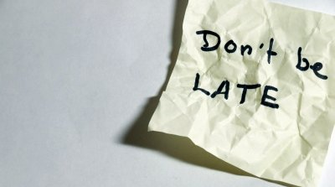
CLASSROOM RULES
BE ON TIME! Class is important. Your presence is essential to your success! Being tardy is NOT acceptable. Be at your assigned class and in your seat before the tardy bell.

Slide 23
RESPECT THE TEACHER(S)
Respecting the teacher includes raising your hand, doing what you’re asked, refraining from talking back, respecting all of the materials, and doing your best on each assignment.

Slide 24
RESPECT YOUR PEERS
Respecting your classmates means that you do not distract others from their learning. Disturbances can include; throwing things, being rude, tapping, or doing anything that may disrupters.

Slide 25
NO CELL PHONES OR ELECTRONICS
Phones and electronics are NOT allowed in class unless you have my permission to use them for an assignment. Make sure that any phones or electronics are silenced and put away. If I see them or hear them, I will take them away.

Slide 26
KEEP YO SELF TO YO SELF
Do not push, trip, kick, or physically touch others. Your purpose in class is to learn.
Do not throw or kick objects around the room or at another student.

Slide 27
CLOSING
We will be reviewing the procedures and rules for the entire week to make sure that everyone has a clear understanding of the expectations.
We promise to work hard alongside you this year, challenge you, encourage you, and believe in you every step of the way!

Slide 28
QUESTIONS???

