Slide 1
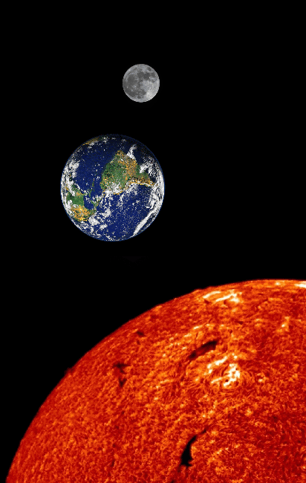
Essential Question:
How does the position of the sun, earth, and moon affect each other?
S6E2a. Demonstrate the phases of the moon by showing the alignment of the earth, moon, and sun.
S6E2b. Explain the alignment of the earth, moon, and sun during solar and lunar eclipses.
Notes:
Instructional Approach(s): The teacher should introduce the essential question and the standards aligned to the essential question.

Slide 2
Activating Strategy
In your own words, describe why the moon looks different throughout the month.
Notes:
Instructional Approach(s): The teacher may want to do this as a Think, Pair, Share in which students first answer the question alone, then pair with another student to discuss, and then share some ideas with the class.

Slide 3
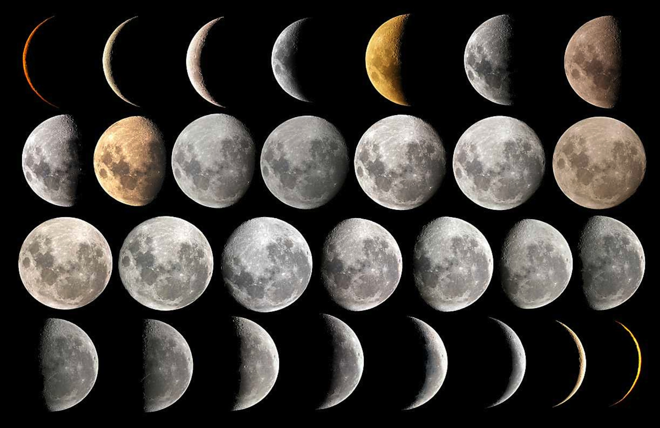
Phases of the Moon
Notes:
Instructional Approach(s): Introduce Phases of the Moon

Slide 4
Facts about Phases of the Moon
The moon changes in position in the sky each day. It also changes in appearance from a full moon to a thin crescent. These changes are called phases.
The moon orbits the Earth once in about 28 days, which changes the part of the moon lighted by the sun and how much of that part can be seen from the Earth – phases of the moon.
The moon’s light comes from the sun, and the sunlight is reflected off the moon’s surface.
Notes:
Instructional Approach(s): The teacher presents the information on the slide while the students “describe the changes that occur in the moon known as phases” and “why the moon looks lit” on their notes.

Slide 5
Facts about Phases of the Moon
The moon’s phases are caused by the part of the moon that reflects the sun and seen from our position on earth.
The same side of the moon always faces the earth because the moon turns on its axis at the same rate as it revolves around the earth.
The moon can be seen during the day during several of the moon’s phases. The time and length of day that the moon can be seen varies with the phase of the moon.
Notes:
Instructional Approach(s): The teacher will present the information from the slide while the students record “what causes moon phases”, “why is the same side of the moon always facing the Earth”, and “can the moon be seen during the day? Explain” on their notes.

Slide 6
Why we see Phases….
http://ww2.valdosta.edu/~cbarnbau/astro_demos/frameset_moon.html
Notes:
Instructional Approach(s): The teacher will show the students an animation illustrating why we see phases

Slide 7
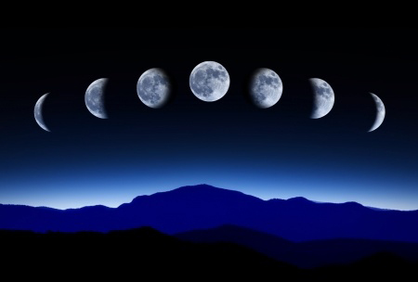
Phases of the Moon

Slide 8
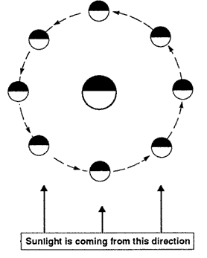


Earth
Moon
Side reflecting sunlight
What does this symbol represent?
Dark side away from sun
Notes:
Instructional Approach(s): The teacher should go over the general diagram that will be used on the Phases of the Moon Notes. The teacher may want students to identify somewhere on the map the “dark side away from the sun” and the “side reflecting sunlight”

Slide 9
Use the Phases of the Moon Notes on the back of your handout.
Notes:
Instructional Approach(s): Give each student a Phases of the Moon Notes handout to use during the lesson.

Slide 10
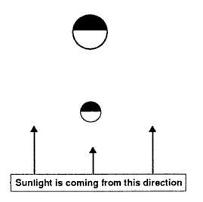

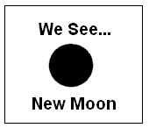
Position of the Sun, Moon, and Earth
Moon
Earth
What We See from Earth…
1.
Notes:
Instructional Approach(s): The teacher will present the slide and students will draw and identify the type of moon phase seen when the Sun, Moon, and Earth are in the positions shown. Before showing the answer, the teacher may want to question students to see if they can determine how much of the moon will be seen.

Slide 11
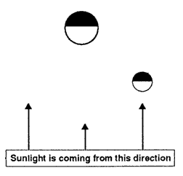
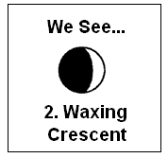
Position of the Sun, Moon, and Earth
Moon
Earth
What We See from Earth…
Notes:
Instructional Approach(s): The teacher will present the slide and students will draw and identify the type of moon phase seen when the Sun, Moon, and Earth are in the positions shown. Before showing the answer, the teacher may want to question students to see if they can determine how much of the moon will be seen.

Slide 12
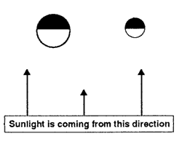
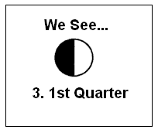
Position of the Sun, Moon, and Earth
Moon
Earth
What We See from Earth…
Notes:
Instructional Approach(s): The teacher will present the slide and students will draw and identify the type of moon phase seen when the Sun, Moon, and Earth are in the positions shown. Before showing the answer, the teacher may want to question students to see if they can determine how much of the moon will be seen.

Slide 13
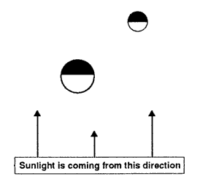
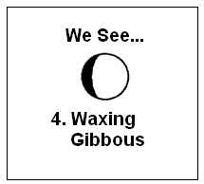
Position of the Sun, Moon, and Earth
Moon
Earth
What We See from Earth…
Notes:
Instructional Approach(s): The teacher will present the slide and students will draw and identify the type of moon phase seen when the Sun, Moon, and Earth are in the positions shown. Before showing the answer, the teacher may want to question students to see if they can determine how much of the moon will be seen.

Slide 14
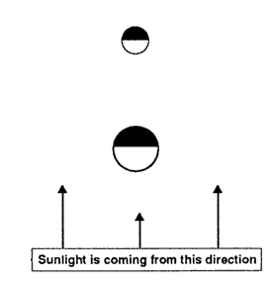
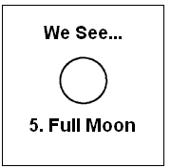
Position of the Sun, Moon, and Earth
Moon
Earth
What We See from Earth…
Notes:
Instructional Approach(s): The teacher will present the slide and students will draw and identify the type of moon phase seen when the Sun, Moon, and Earth are in the positions shown. Before showing the answer, the teacher may want to question students to see if they can determine how much of the moon will be seen.

Slide 15
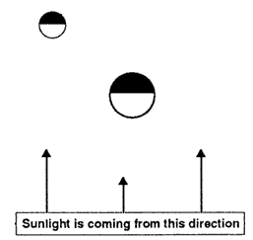
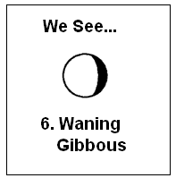
Position of the Sun, Moon, and Earth
Earth
Moon
What We See from Earth…
Notes:
Instructional Approach(s): The teacher will present the slide and students will draw and identify the type of moon phase seen when the Sun, Moon, and Earth are in the positions shown. Before showing the answer, the teacher may want to question students to see if they can determine how much of the moon will be seen.

Slide 16
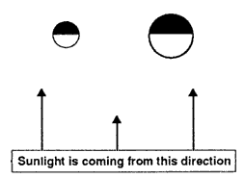
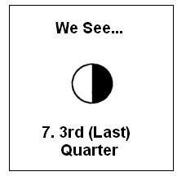
Position of the Sun, Moon, and Earth
Earth
Moon
What We See from Earth…
Notes:
Instructional Approach(s): The teacher will present the slide and students will draw and identify the type of moon phase seen when the Sun, Moon, and Earth are in the positions shown. Before showing the answer, the teacher may want to question students to see if they can determine how much of the moon will be seen.

Slide 17
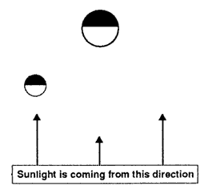
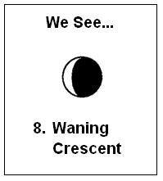
Position of the Sun, Moon, and Earth
Earth
Moon
What We See from Earth…
Notes:
Instructional Approach(s): The teacher will present the slide and students will draw and identify the type of moon phase seen when the Sun, Moon, and Earth are in the positions shown. Before showing the answer, the teacher may want to question students to see if they can determine how much of the moon will be seen.

Slide 18
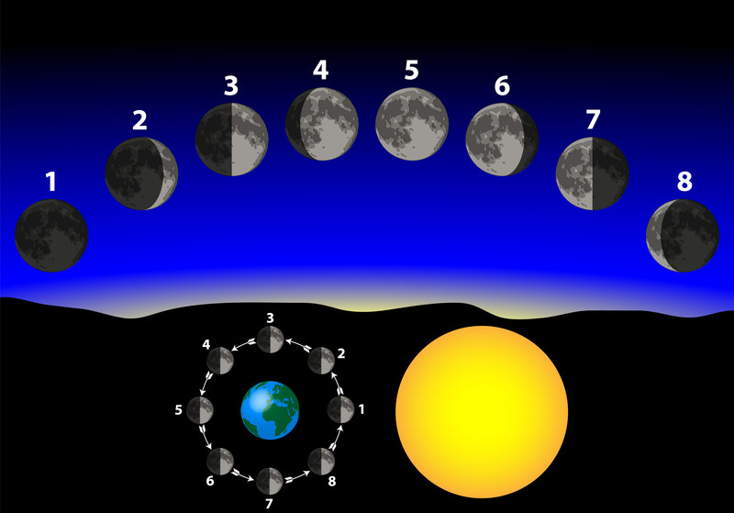
Other diagrams of Phase Changes
Notes:
Instructional Approach(s): The teacher can use the diagram to illustrate other ways to view the phases of the moon

Slide 19
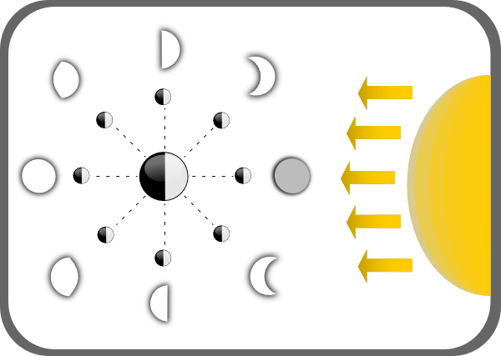
Other diagrams of Phase Changes
Notes:
Instructional Approach(s): The teacher can use the diagram to illustrate other ways to view the phases of the moon

Slide 20
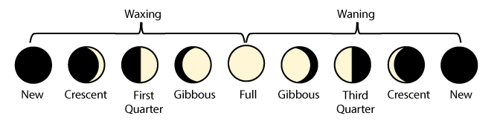
Phase Names Provide Clues
Waxing means to increase in size or grow larger.
In moon phases, what is increasing in size?
Waning means to decrease in size or grow smaller.
In moon phases, what is decreasing in size?
Notes:
Instructional Approach(s): The teacher will present the first text box for “waxing” and pose the question to the class, “what is increasing in size?” Give students a chance to answer and if needed, let students discuss it briefly (30 seconds or less) with an elbow partner. Based on the diagram, the students should conclude that the amount of the moon reflecting the sun (amount lit) is increasing. Pull up the next text box and do the same. This time it should take less time for the students to answer the question. The amount of the moon reflecting the sun’s light (amount of the moon lit) is decreasing in size. The teacher may want students to record this information on their phases of the moon diagram.

Slide 21
Animations of Moon Phases
http://web.archive.org/web/20060514142413/http://www.ioncmaste.ca/homepage/resources/web_resources/CSA_Astro9/files/multimedia/unit3/phases_moon/phases_moon.swf
http://www.harcourtschool.com/activity/moon_phases/
http://astro.unl.edu/naap/lps/animations/lps.html
http://astro.unl.edu/classaction/animations/lunarcycles/lunarphasequizzer.html
http://ww2.valdosta.edu/~cbarnbau/astro_demos/frameset_moon.html
Notes:
Instructional Approach(s): The teacher will select a few of the animations to show to the class to demonstrate moon phases

Slide 22
  Phases of the
  Moon Rap

Slide 23
Phenonema
What causes the moon to turn red?
Write you answer in your science journal.
https://www.youtube.com/watch?v=lcRp1jKJmJU\
Notes:
Instructional Approach(s): The teacher may want to do this as a Think, Pair, Share in which students first answer the question alone, then pair with another student to discuss, and then share some ideas with the class.

Slide 24
Activating Strategy:
What is an eclipse?
Why do we not have an eclipse every month?
Notes:
Instructional Approach(s): The teacher should pose the questions to the class. The teacher may opt to have students discuss the questions with a partner. An eclipse is the total or partial blocking of light of one object by another object. We do not have solar and lunar eclipses every month because the Earth’s orbit around the sun is not in the same plane as the moon’s orbit around the Earth. Do not spend more than 2-3 minutes on the activating strategy. If students are struggling with the answers, let them know that by the end of the lesson, they should have a better understanding of eclipses and move into the lesson.

Slide 25
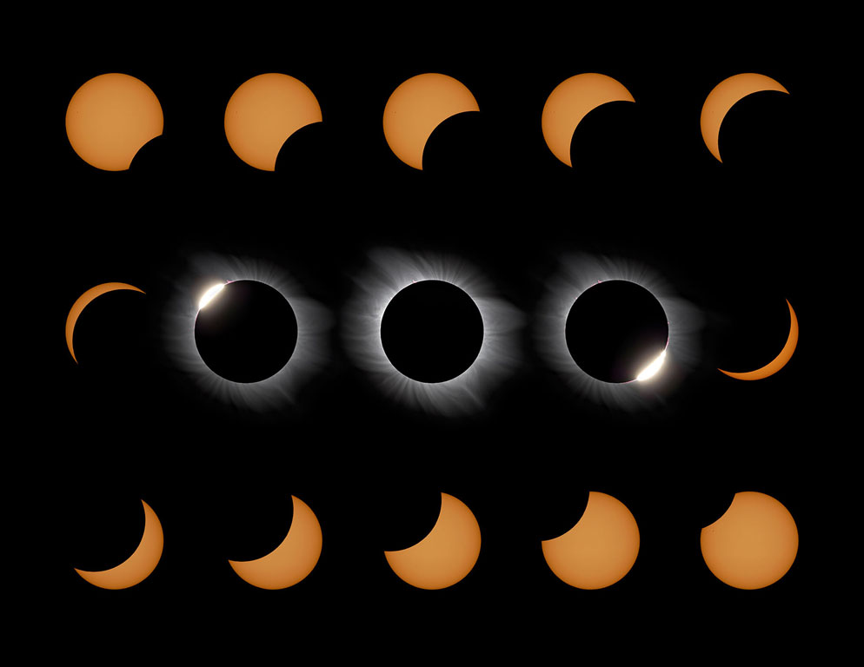
Eclipses

Slide 26
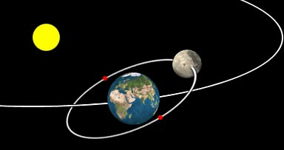
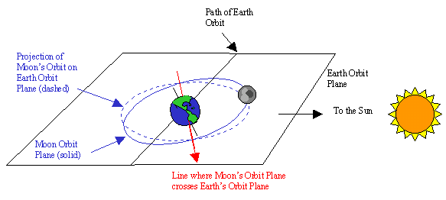
Notes:
Instructional Approach(s): The teacher should use the diagrams to demonstrate that the Earth’s orbit plane is different from the moon’s orbit plane; therefore, the moon is not always in the position to cause eclipses.

Slide 27
Use the Eclipse Notes
Notes:
Instructional Approach(s): The teacher should give each student an Eclipse Notes sheet and instruct the students to use the Notes sheet to record important information throughout the lesson.

Slide 28
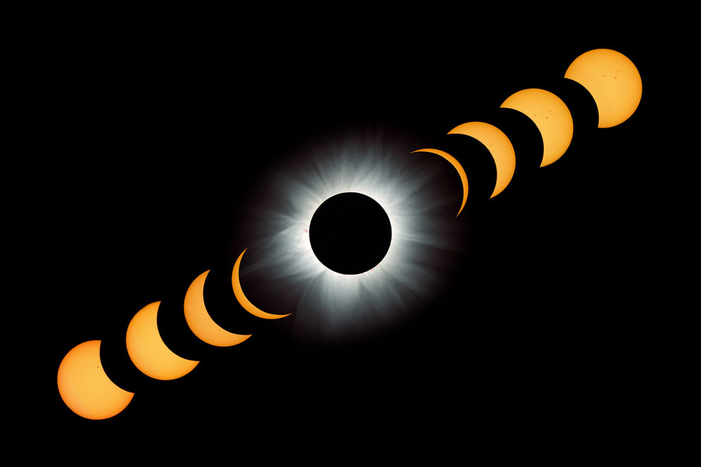
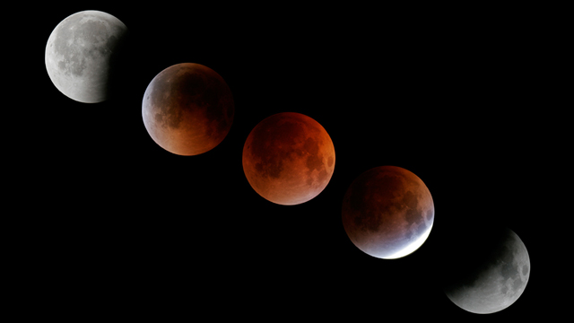
There are two types of Eclipses:
Solar
Eclipse
Lunar Eclipse
Notes:
Instructional Approach(s): The teacher should start off by reading the statement “there are two types of eclipses”. Ask the class or call on students to identify the two types of eclipses. Once students have responded, click to reveal the two eclipses.

Slide 29
Solar Eclipse
When its orbit around Earth takes the Moon directly between Earth and the Sun, the Moon blocks our view of the Sun in what we call a solar eclipse.
In short, the moon passes between the Earth and Sun causing the Earth to pass through the Moon’s shadow.
Depending on where you are on Earth, you may experience a total eclipse or a partial eclipse.
Notes:
Instructional Approach(s): The teacher should present the characteristics of a solar eclipse on the slide while the students describe a solar eclipse on their notes.

Slide 30
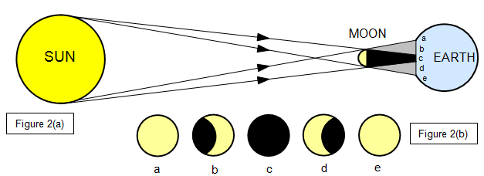
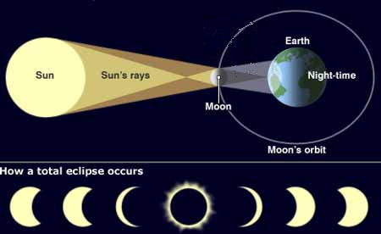
Diagrams of a Solar Eclipse
Notes:
Instructional Approach(s): The teacher should use the diagrams to illustrate the position of the Earth, Sun, and Moon during a solar eclipse. Be sure to discuss how and why only parts of the Earth experience the total and partial solar eclipse.

Slide 31
Animations of a Solar Eclipse
http://ww2.valdosta.edu/~cbarnbau/astro_demos/frameset_moon.html
http://www.classzone.com/books/earth_science/terc/content/visualizations/es2505/es2505page01.cfm?chapter_no=visualization
Notes:
Instructional Approach(s): The teacher should show the animations of a solar eclipse to reinforce the concept.

Slide 32
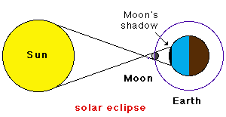
In the space provided on your notes, draw a simple diagram showing the position of the Sun, Moon, and Earth during a solar eclipse.
Notes:
Instructional Approach(s): Give the students a few minutes (no more than 2 minutes) to draw a simple diagram showing the position of the Sun, Moon, and Earth during a solar eclipse. The students may start out with just the positions shown. After a few minutes, click to show the simple diagram on the slide. You may want students to go back and illustrate the shadow part too.

Slide 33
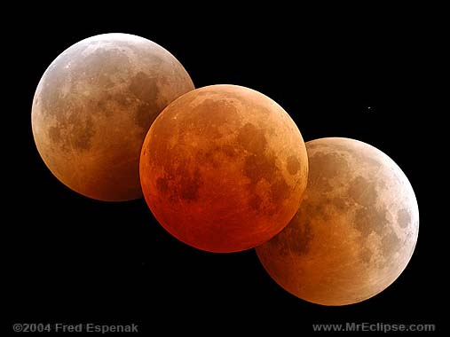
Lunar Eclipse

Slide 34
Lunar Eclipse
A Lunar Eclipse occurs when the moon passes through the Earth’s shadow.
Depending on where the moon crosses Earth’s shadow, the top or bottom will appear darker. The reddish color is from sunlight refracted by Earth’s atmosphere onto the moon.
Notes:
Instructional Approach(s): The teacher should present the characteristics of a lunar eclipse on the slide while the students describe a lunar eclipse on their notes.

Slide 35
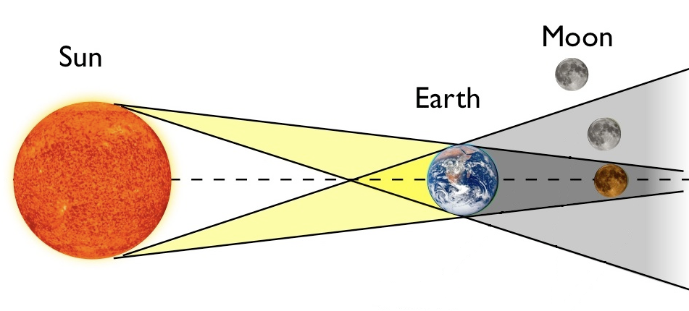
Lunar Eclipse
Notes:
Instructional Approach(s): The teacher should use the diagrams to illustrate the position of the Earth, Sun, and Moon during a lunar eclipse. Be sure to discuss how and why only parts of the Earth experience the total and partial lunar eclipse.

Slide 36
Video Clips and Animations of a Lunar Eclipse
http://www.neok12.com/video/Eclipse/zX027e52507b754877644063.htm
http://ww2.valdosta.edu/~cbarnbau/astro_demos/frameset_moon.html
http://ww2.valdosta.edu/~cbarnbau/astro_demos/frameset_moon.html
Notes:
Instructional Approach(s): The teacher should show the animations of a lunar eclipse to reinforce the concept.

Slide 37
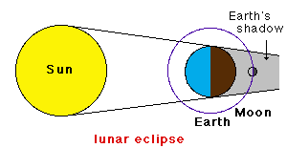
In the space provided on your notes, draw a simple diagram showing the position of the Sun, Moon, and Earth during a solar eclipse.
Notes:
Instructional Approach(s): Give the students a few minutes (no more than 2 minutes) to draw a simple diagram showing the position of the Sun, Moon, and Earth during a lunar eclipse. The students may start out with just the positions shown. After a few minutes, click to show the simple diagram on the slide. You may want students to go back and illustrate the shadow part too.

Slide 38
Distributed Summarizing
With an elbow partner, describe the difference between a solar eclipse and a lunar eclipse.
Notes:
Instructional Approach(s): The students should answer the distributed summarizing question with a partner. Partners can be determined by the students or the teacher can provide more specific directions such as turn to the person directly in front/behind you or to the right/left of you, etc. It may be necessary to have a group of three if you have an uneven number of students. Do not allow more than 1 minute of discussion time. The teacher should be walking around listening and redirecting discussions as needed. Once students have been given 2 minutes or less to discuss solar and lunar eclipses, click to the next slide.

Slide 39
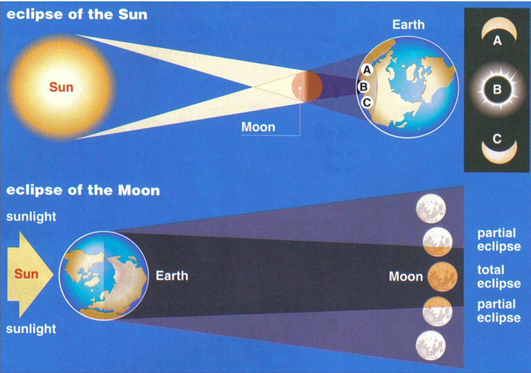
Lunar Eclipses happen when the Moon passes through Earth’s shadow, whereas solar eclipses happen when Earth passes through the Moon’s shadow.
Notes:
Instructional Approach(s): The teacher should use the slide to review the differences between a solar eclipse and a lunar eclipse.

