Slide 1
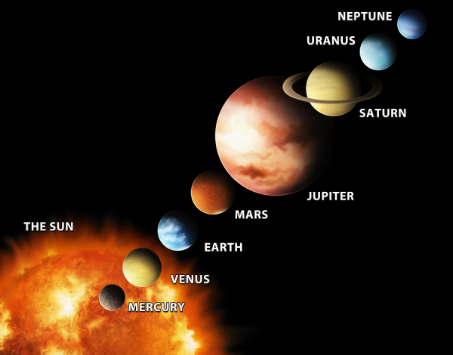
The Solar System

Slide 2
How does Earth compare to other planets in the solar system?
S6E1c. Compare and contrast planets in terms of: size relative to earth; surface and atmospheric features; relative distance from the sun; ability to support life
S6E1e. Explain that gravity is the force that governs the motion of the solar system
Notes:
Instructional Approach(s): The teacher should introduce the essential question and the standards aligned to the essential question.

Slide 3
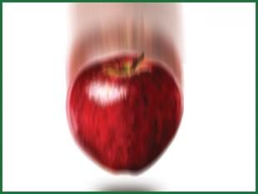
Gravity
The gravitational force of the Sun keeps planets in orbit around the Sun and controls the rest of the motion of the solar system.
The mass of an object and the distance between objects determine the force of gravity. Inertia and gravity work together.
The gravitational attractions of the planets, either individually or as a group are small because of the distances between the planets.
Notes:
Instructional Approach(s): The teacher can start by asking students “what is gravity?” and possibly “why is gravity important?”. Take 1-2 minutes to discuss gravity and then read through the information on the animated slide. Click on the word “Inertia” in the slide to go to a slide describing and providing images of inertia. Students should record important information on their notes.

Slide 4
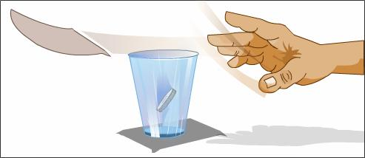
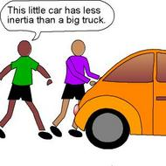
Inertia – the tendency of an object to resist being moved or, if the object is moving, to resist a change until an outside force acts on the object. [Back]

Slide 5
Distances between planets in the Solar System animation
http://www.classzone.com/books/earth_science/terc/content/visualizations/es2701/es2701page01.cfm?chapter_no=visualization
Notes:
Instructional Approach(s): Show the animation to students illustrating the distance between planets in the solar system. A possible teaching suggestion is to have students run in place as you are watching the video clip to further demonstrate distance.

Slide 6
Study Jams Video: Gravity & Inertia
Notes:
Instructional Approach(s): Show the short video on Gravity and Inertia

Slide 7
Turn to a seat partner and discuss the following: What would happen to the planets or any object in the universe if gravity did not exist?
Notes:
Instructional Approach(s): The students should turn to a seat partner (without getting out of their seat) to discuss What would happen to the planets or any object in the universe if gravity did not exist. Partners can be determined by the students or the teacher can provide more specific directions such as turn to the person directly in front/behind you or to the right/left of you, etc. It may be necessary to have a group of three if you have an uneven number of students. Do not allow more than 1 minute of discussion time. The teacher should be walking around listening and redirecting discussions as needed.

Slide 8
The Solar System
Revolution (revolve) is orbiting around another body
Planets in our solar system revolve around the sun in elliptical (oval) orbits. http://www.solarsystemscope.com/ http://lasp.colorado.edu/education/outerplanets/orbit_simulator/
The planets in our solar system differ in size, composition (rock or gas), surface and atmospheric conditions, and distance from the sun.
Notes:
Instructional Approach(s): The teacher should read the bulleted information to the class. After bullet two, the teacher should select one of the linked animations to show the planets revolving around the Sun. Students should record important information on their notes.

Slide 9
The Solar System
The planets are divided into two groups
The inner planets are smaller, closer to the sun, and have rocky surfaces (Mercury, Venus, Earth, Mars)
The outer planets are larger, farther from the sun and do not have solid surfaces (Jupiter, Saturn, Uranus, Neptune)
Notes:
Instructional Approach(s): The teacher should read the first bullet “the planets are divided into two groups”. Ask students if they know the two groups. If so, what is different about the two groups. If the students cannot quickly come up with the two groups of planets, go to the next two bullets. Students should record important information on their notes.

Slide 10
The Solar System
We will be examining the planets in the Solar System based on a few main characteristics:
Size relative to the earth
Surface features
Atmospheric features
Relative distance from the sun
Ability to support life
Other facts
Let’s make sure you understand the meaning of these characteristics
Notes:
Instructional Approach(s): The teacher will read the information on the slide. Point out to students that these are the specific characteristics mentioned in the state standards; therefore, they will be the focus even though there is a lot of interesting information about the planets to study.

Slide 11
Size Relative to Earth…
“Relative to” means the same as “in Comparison with.” Let’s look at some examples. Get with an elbow partner.
The size of your foot “Relative to” an elbow partner’s foot. [Hint: is it larger or smaller?]
The size of your science textbook “Relative to” the size of a library book or another book.
The size of your pencil “Relative to” the size of your elbow partner’s pencil.
Notes:
Instructional Approach(s): The students get with an elbow partner (without getting out of their seat) to discuss the three “relative to” statements. Partners can be determined by the students or the teacher can provide more specific directions such as turn to the person directly in front/behind you or to the right/left of you, etc. It may be necessary to have a group of three if you have an uneven number of students. Do not allow more than 1 minute of discussion time. The teacher should be walking around listening and redirecting discussions as needed. Discuss some of the responses as a class. The students should summarize “size relative to Earth” on their notes.

Slide 12
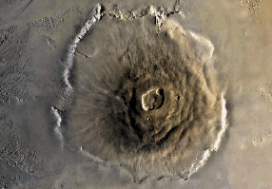
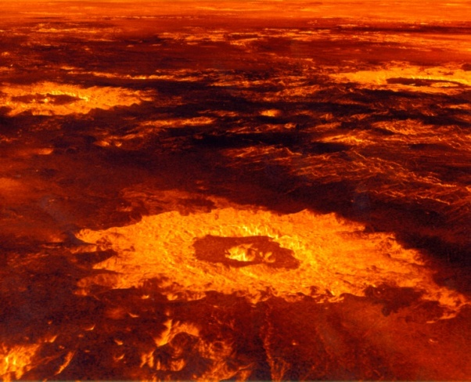
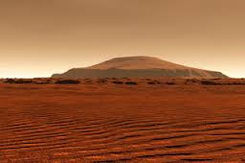
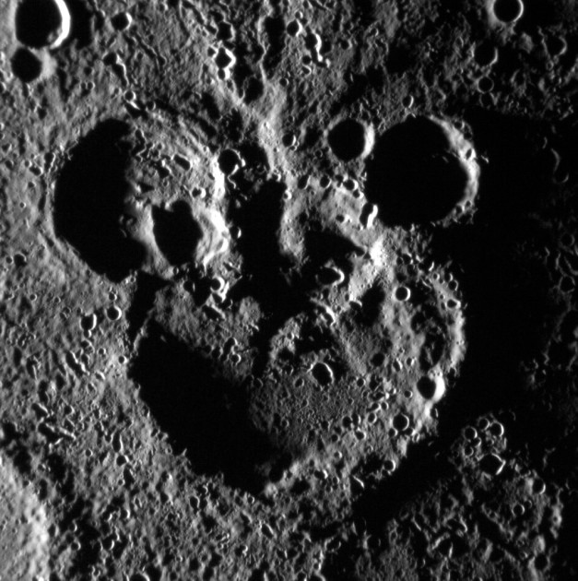
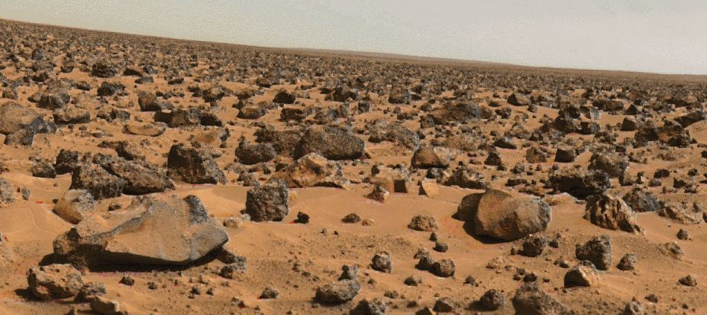
Surface features…
Notes:
Instructional Approach(s): The teacher should use the images on the slide to discuss some of the possible surface features of a planet. Ask students as a class or have them get with a partner to compare some of the possible features. Students should summarize “surface features” on their notes

Slide 13
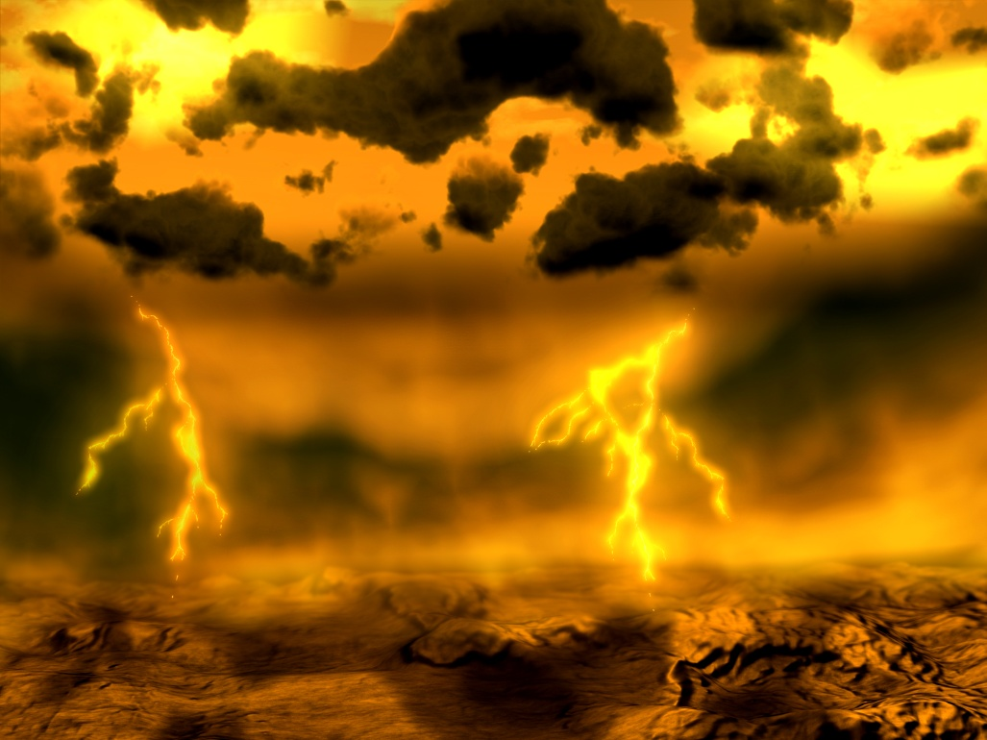
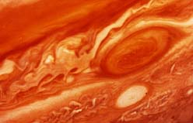
Atmospheric features…
Atmosphere is defined as the mass of gases surrounding a planet. Atmospheres can consist of many different gases. These gases cause different atmospheres on planets.
Notes:
Instructional Approach(s): The teacher should present the information from the slide to the class about the meaning of “atmospheric features”. Students should summarize atmospheric features on their notes.

Slide 14
Relative from the Sun…
“Relative to” means the same as “in Comparison with.” Let’s look at some examples. Get with an elbow partner.
The “Relative distance” of your classroom to the office of the school versus the “Relative distance” of the cafeteria to the office of the school. [Hint: is it longer or shorter?]
The “Relative distance” of your house to the mall versus the “Relative distance” of your house to Atlanta.
Notes:
Instructional Approach(s): The students get with an elbow partner (without getting out of their seat) to discuss the three “relative to” statements. Partners can be determined by the students or the teacher can provide more specific directions such as turn to the person directly in front/behind you or to the right/left of you, etc. It may be necessary to have a group of three if you have an uneven number of students. Do not allow more than 1 minute of discussion time. The teacher should be walking around listening and redirecting discussions as needed. Discuss some of the responses as a class. Students should summarize “relative distance from the Sun” on their notes.

Slide 15
Ability to Support Life…
Let’s look at some characteristics that scientists believe are necessary for life on a planet.
http://hubblesite.org/hubble_discoveries/discovering_planets_beyond/alien-atmospheres [look at earth not alien]
Notes:
Instructional Approach(s): The teacher should read the beginning of the slide and then click on the link to watch a tutorial on the characteristics necessary for life on a planet. Be sure to select Earth not alien at the bottom. Students should summarize “ability to support life” on their notes.

Slide 16
Turn to a different elbow partner and together identify the main characteristics that we will discuss about the planets in our solar system. Be prepared to share if called upon.
Notes:
Instructional Approach(s): The students get with an elbow partner (without getting out of their seat) to discuss the characteristics that will be discussed about each planet. Partners can be determined by the students or the teacher can provide more specific directions such as turn to the person directly in front/behind you or to the right/left of you, etc. It may be necessary to have a group of three if you have an uneven number of students. Do not allow more than 1 minute of discussion time. The teacher should be walking around listening and redirecting discussions as needed. Review the characteristics with the class (size relative to the Earth; surface features; atmospheric features; relative distance from the Sun; ability to support life)

Slide 17
Use the Planet Comparison Chart to take notes about each Planet in the Solar System.
Notes:
Instructional Approach(s): The teacher should give each student a Planet Comparison Chart to use for recording the important facts about the planets.

Slide 18
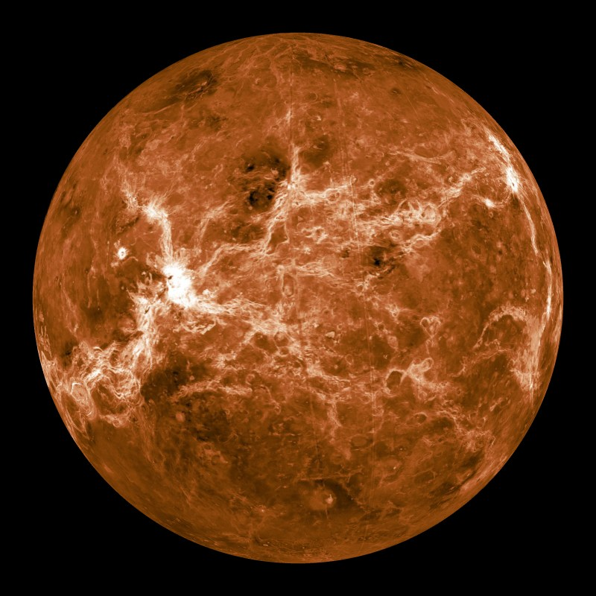
Mercury
Notes:
Instructional Approach(s): Introduce Mercury

Slide 19
Mercury
Size relative to earth: smaller than earth
Surface features: many craters and high cliffs
Atmospheric features: no atmosphere
Relative distance from the sun: closest planet to the Sun
It cannot support life
Other facts: Inner planet; has no moons; “earth-like” characteristics
Notes:
Instructional Approach(s): The teacher should read through each characteristic while the students record the information on the Planet Comparison Chart.

Slide 20
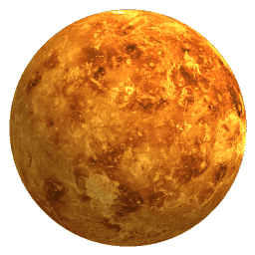
Venus
Notes:
Instructional Approach(s): Introduce Venus

Slide 21
Venus
Size relative to earth: Close to the earth’s size
Surface features: Hottest planet (can melt lead)
Atmospheric features: Contains Carbon dioxide (CO₂)
Relative distance from the sun: Second planet from the sun
It cannot support life
Other facts: Inner planet; sometimes called Earth’s twin because of its “earth-like” characteristics; a day is longer than a year due to its slow spin; spins clockwise; brightest object in the sky after the sun and moon
Notes:
Instructional Approach(s): The teacher should read through each characteristic while the students record the information on the Planet Comparison Chart.

Slide 22
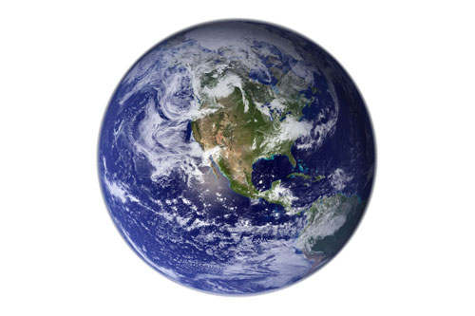
Earth
Notes:
Instructional Approach(s): Introduce Earth

Slide 23
Earth
Surface features: Has canyons, craters, mountains, volcanoes; more than 70% of the surface is covered by water
Atmospheric features: Contains Oxygen (O₂) and Nitrogen (N₂)
Relative distance from the sun: Third planet from the sun
Only planet known to support life
Other facts: Inner planet; Has one moon
Notes:
Instructional Approach(s): The teacher should read through each characteristic while the students record the information on the Planet Comparison Chart.

Slide 24
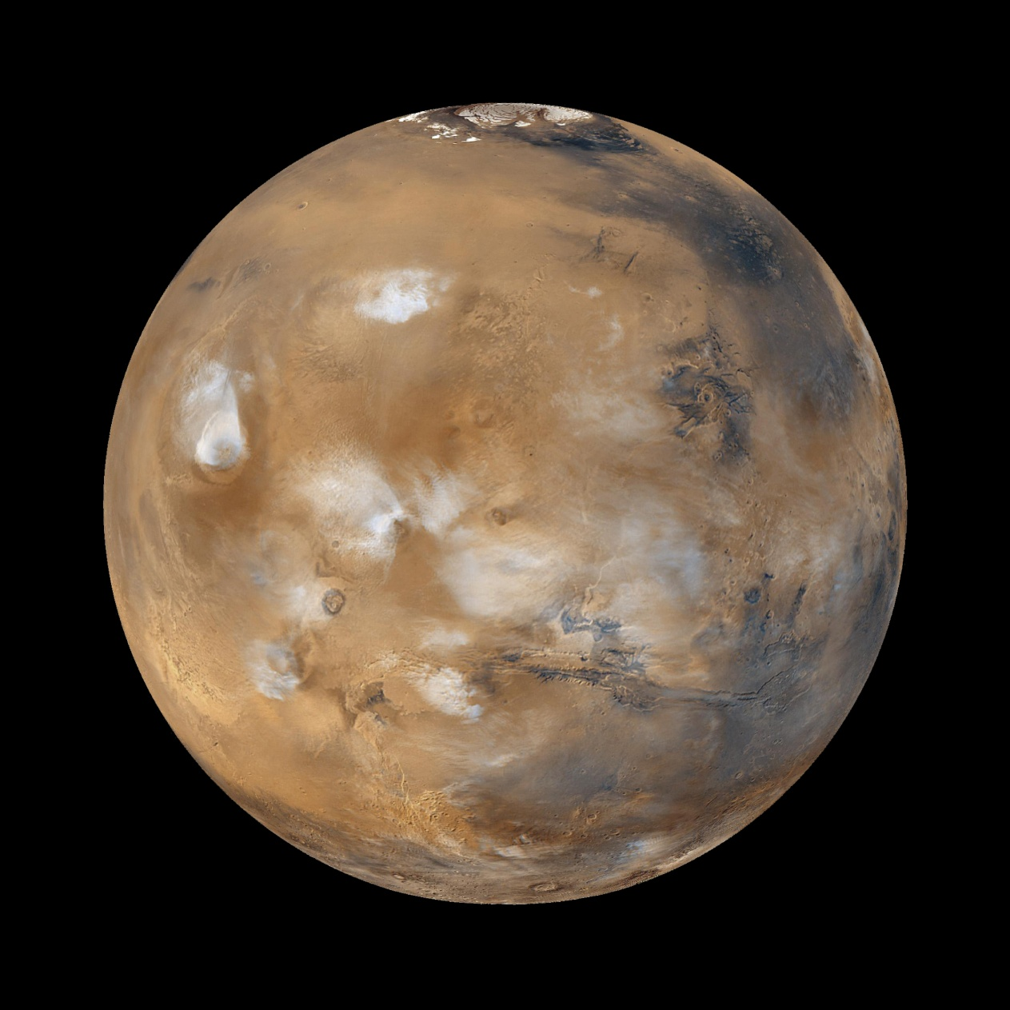
Mars
Notes:
Instructional Approach(s): Introduce Mars

Slide 25
Mars
Size relative to earth: Smaller in size than the earth
Surface features: “earth-like” characteristics; all water is frozen; once had active volcanoes
Atmospheric features: Thinner atmosphere than earth made mostly of carbon dioxide (CO₂)
Relative distance from the sun: Fourth planet from the Sun
It cannot support life
Other facts: Inner planet; called the red planet because of rusted soil; has severe dust storms at hurricane speed
Notes:
Instructional Approach(s): The teacher should read through each characteristic while the students record the information on the Planet Comparison Chart.

Slide 26
Study Jams Video: Inner Planets
Notes:
Instructional Approach(s): Students should watch the short video summarizing the Inner Planets.

Slide 27
Why are the first four planets generally grouped together? Turn to an elbow partner and discuss your answer. Be ready to respond.
Think, Pair, Share:
Notes:
Instructional Approach(s): Have students come up with an answer to the question “why are the first four planets generally grouped together?”. After 20-30 seconds, allow the students to get with a partner to compare their answers. The teacher should then call on one or two groups to share their response.

Slide 28
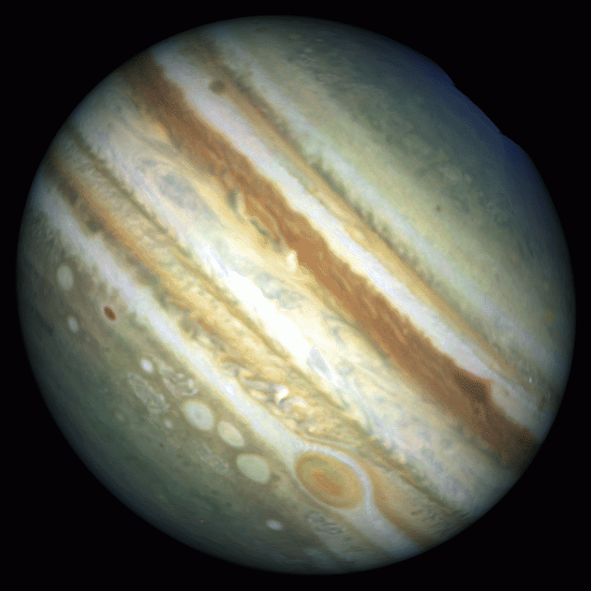
Jupiter
Notes:
Instructional Approach(s): Introduce Jupiter

Slide 29
Jupiter
Size relative to earth: Larger than the earth
Surface features: Gaseous planet
Atmospheric features: Contains mostly Hydrogen (H₂) and Helium (He)
Relative distance from the sun: Fifth planet from the Sun
It cannot support life
Other facts: Outer planet; largest planet; faint ring of dust; spins the fastest; has 63 moons; has a large red spot
Notes:
Instructional Approach(s): The teacher should read through each characteristic while the students record the information on the Planet Comparison Chart.

Slide 30
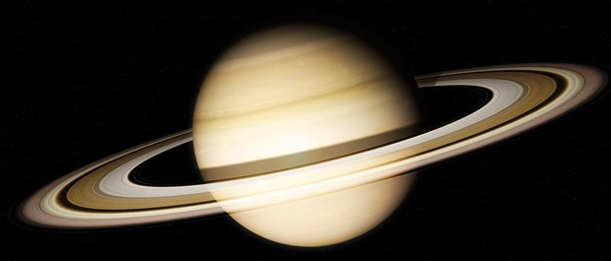
Saturn
Notes:
Instructional Approach(s): Introduce Saturn

Slide 31
Saturn
Size relative to earth: Larger than earth
Surface features: Surface is fluid; it is the least dense planet
Atmospheric features: Contains mostly Hydrogen (H₂) and Helium (He)
Relative distance from the sun: Sixth planet from the Sun
It cannot support life
Other facts: Outer planet; Gaseous planet; 1 year equals 29 ½ Earth years; Largest, most impressive ring system; Second largest planet in the solar system
Notes:
Instructional Approach(s): The teacher should read through each characteristic while the students record the information on the Planet Comparison Chart.

Slide 32
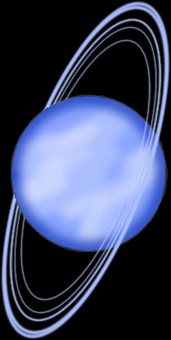
Uranus
Notes:
Instructional Approach(s): Introduce Uranus

Slide 33
Uranus
Size relative to earth: Larger than earth
Surface features: planet of ice and gas so it really does not have a surface (you would sink into the liquid icy center)
Atmospheric features: Contains mostly Hydrogen (H₂), Helium (He), and Methane (CH₄)
Relative distance from the sun: 7th planet from the Sun
It cannot support life
Other facts: Gaseous planet; Third largest planet; Tipped on its side
Notes:
Instructional Approach(s): The teacher should read through each characteristic while the students record the information on the Planet Comparison Chart.

Slide 34
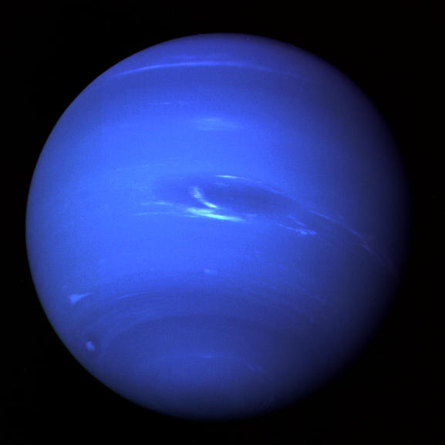
Neptune
Notes:
Instructional Approach(s): Introduce Neptune

Slide 35
Neptune
Size relative to earth: Larger than earth
Surface features: Coldest planet and has large storm systems like the Great Dark Spot; not a solid surface
Atmospheric features: Methane (CH₄)
Relative distance from the sun: 8th planet from the sun
It cannot support life
Other facts: Outer planet; Gaseous planet
Notes:
Instructional Approach(s): The teacher should read through each characteristic while the students record the information on the Planet Comparison Chart.

Slide 36
Study Jams Video: Outer Planets
Notes:
Instructional Approach(s): Students should watch the short video summarizing the Outer Planets.

Slide 37
Why are the last four planets generally grouped together? Turn to an elbow partner and discuss your answer. Be ready to respond.
Think, Pair, Share:
Notes:
Instructional Approach(s): Have students come up with an answer to the question “why are the last four planets generally grouped together?”. After 20-30 seconds, allow the students to get with a partner to compare their answers. The teacher should then call on one or two groups to share their response.

