Slide 1
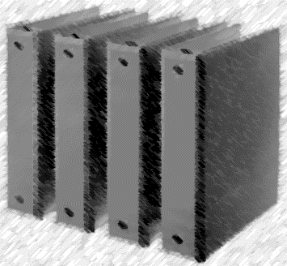
Take out supplies for Binder set-up!!

Slide 2
Mr. Lewis Binder
2018-19

Slide 3
LNB Rules:
Notebook MUST Be brought to class everyday!
Pages in notes section will include a “Table of Contents,” which must be numbered correctly.
Teacher will periodically check notebook to insure student organization and accuracy

Slide 4
Label your book:
Using a marker, write your name on the spine of your notebook.
If you need duct tape, let me know.
First and Last Name

Slide 5
Label your book:
If using the same binder, write first and last name on the front tab.
1
3
5
7

Slide 6
LNB Tabs:
Label 4 of your tabs:
Warm-ups
Vocabulary
Notes, 1st Semester
Notes, 2nd Semester
Put the unused tabs in the back of your binder.
They will be used for Other handouts.

Slide 7
Syllabus:
Place your syllabus in your binder before your tabs.

Slide 8
Warm-ups:
Your Warm-ups divider should be after the syllabus.
Include some paper.

Slide 9
Vocabulary:
Your vocabulary divider should be after your warm-ups. Include some paper.

Slide 10
Notes, 1st sem:
Your “Notes, 1st sem” divider should be after your vocabulary. Be sure to include some paper.

Slide 11
Table of Contents:
“Table of Contents”
Topic Page
Your Table of Contents page should be after your “Notes 1st sem” Divider.
1

Slide 12
Notes, 2nd sem:
Your “Notes, 2nd sem” divider should be after your “Notes, 1st Sem”. Be sure to include some paper.

Slide 13
Table of Contents:
“Table of Contents”
Topic Page
Your Table of Contents page should be after your “Notes 2nd sem” Divider.
1

Slide 14
Other Handouts:
Your “Other Handous” divider should be after your “Notes, 2nd Sem”. I will let you know what goes here!

Slide 15
Proper Order:
On Cover :
First and Last Name
Class Period
First and Last Name

Slide 16
Syllabus:
Syllabus

Slide 17
Warm-ups:
Warm-ups

Slide 18
Vocabulary:
Vocabulary

Slide 19
Notes, 1st Semester:
Notes, 1st Semester

Slide 20
Table of Contents:
“Table of Contents”
Topic Page
1

Slide 21
Notes, 2nd Semester:
Notes, ^{2nd} Semester

Slide 22
Table of Contents:
“Table of Contents”
Topic Page
1

Slide 23
Other handouts:
Other handouts

