Slide 1
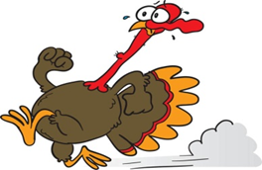
First Grade
Week of: 11/5-9/18
Teacher: Ms. Hill
Phone: 706-590-1267
E-mail: Hill.Carnedra.A@muscogee.k12.ga.us
Quick Important Info!
Please have students practice writing, spelling words and reading the sight words. This should be done nightly!
Please look at the dates to remember!
Tutoring will be starting next week. If you receive a form please fill it out and return as soon as possible.
Spelling List
Review all previous learned spelling words, vocabulary and sight words
What we’re working on…
Reading/Phonics/Writing: Review All previous learned skills
Math: Tens Frame number representation to 12
Science: Weather Study and Seasonal Changes
Social Studies: Revisit Ruby Bridges and continue reviewing B. Franklin and Lewis and Clark/Sacagawea
Dates to Remember:
Tyana B-day 11-9
Veteran’s Day Assembly- 11/9
Progress Report- 11/13
Thanksgiving Lunch 11/15
PTO Math Night-11/27
Jayleon B-day 11/27

