Slide 1
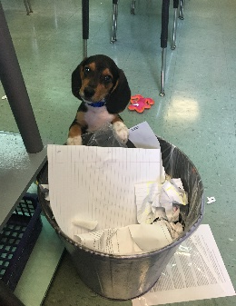
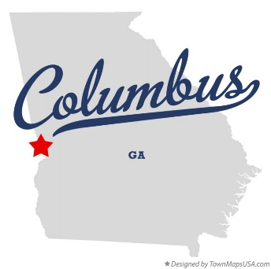
The Basics!
Hi! My Name is Ms. Jan Highnote! I will be your child’s 5th grade Science teacher for the 2017-2018 school year! This will be my 13th year teaching at Blanchard Elementary and my 20th year in MCSD. I am excited to make this my best year yet!
My Childhood!
I grew up in Columbus, GA where I attended Blanchard Elementary for Kindergarten through 6th grade. I then attended Arnold Junior High for 7th-8th grade before graduating from Shaw High School.
My Favorites!
My Education!
Food: I “try” to keep it healthy.
Movie: Comedy
Book: True Crime
Color: Pink or purple
Drink: Coffee or tea
Season: Fall
Sports: Football (Alabama)
Singer: Carrie Underwood
Hobby: My dogs
Subject: Math/Science
Store: Target
Candy: anything chocolate
Restaurant: The Loft or Smokey Bones
Things I like: Candles
I graduated with a Bachelors of Science in Early Childhood Education from Valdosta State University . I also received my Master’s and Specialist’s Degree in Elementary Education from Troy University.
Contact Me!
Email: Highnote.Janice.g@,muscogee.k12.ga.us
Personal Cell number: 706-888-4260
School Phone Number: 706-748-2461
You can also write a note.

