Slide 1
TEXTURE SPACE SHAPE
https://www.youtube.com/watch?v=44TTnTO443k
https://www.youtube.com/watch?v=5pwkZh8Ljug

Slide 2
TODAYS AGENDA 1.FINISH YOUR PROJECT 2.Resketch 8 wood samples from the texture sheet 3. Draw the 3 apples (smartboard)
https://www.youtube.com/watch?v=44TTnTO443k
https://www.youtube.com/watch?v=5pwkZh8Ljug

Slide 3
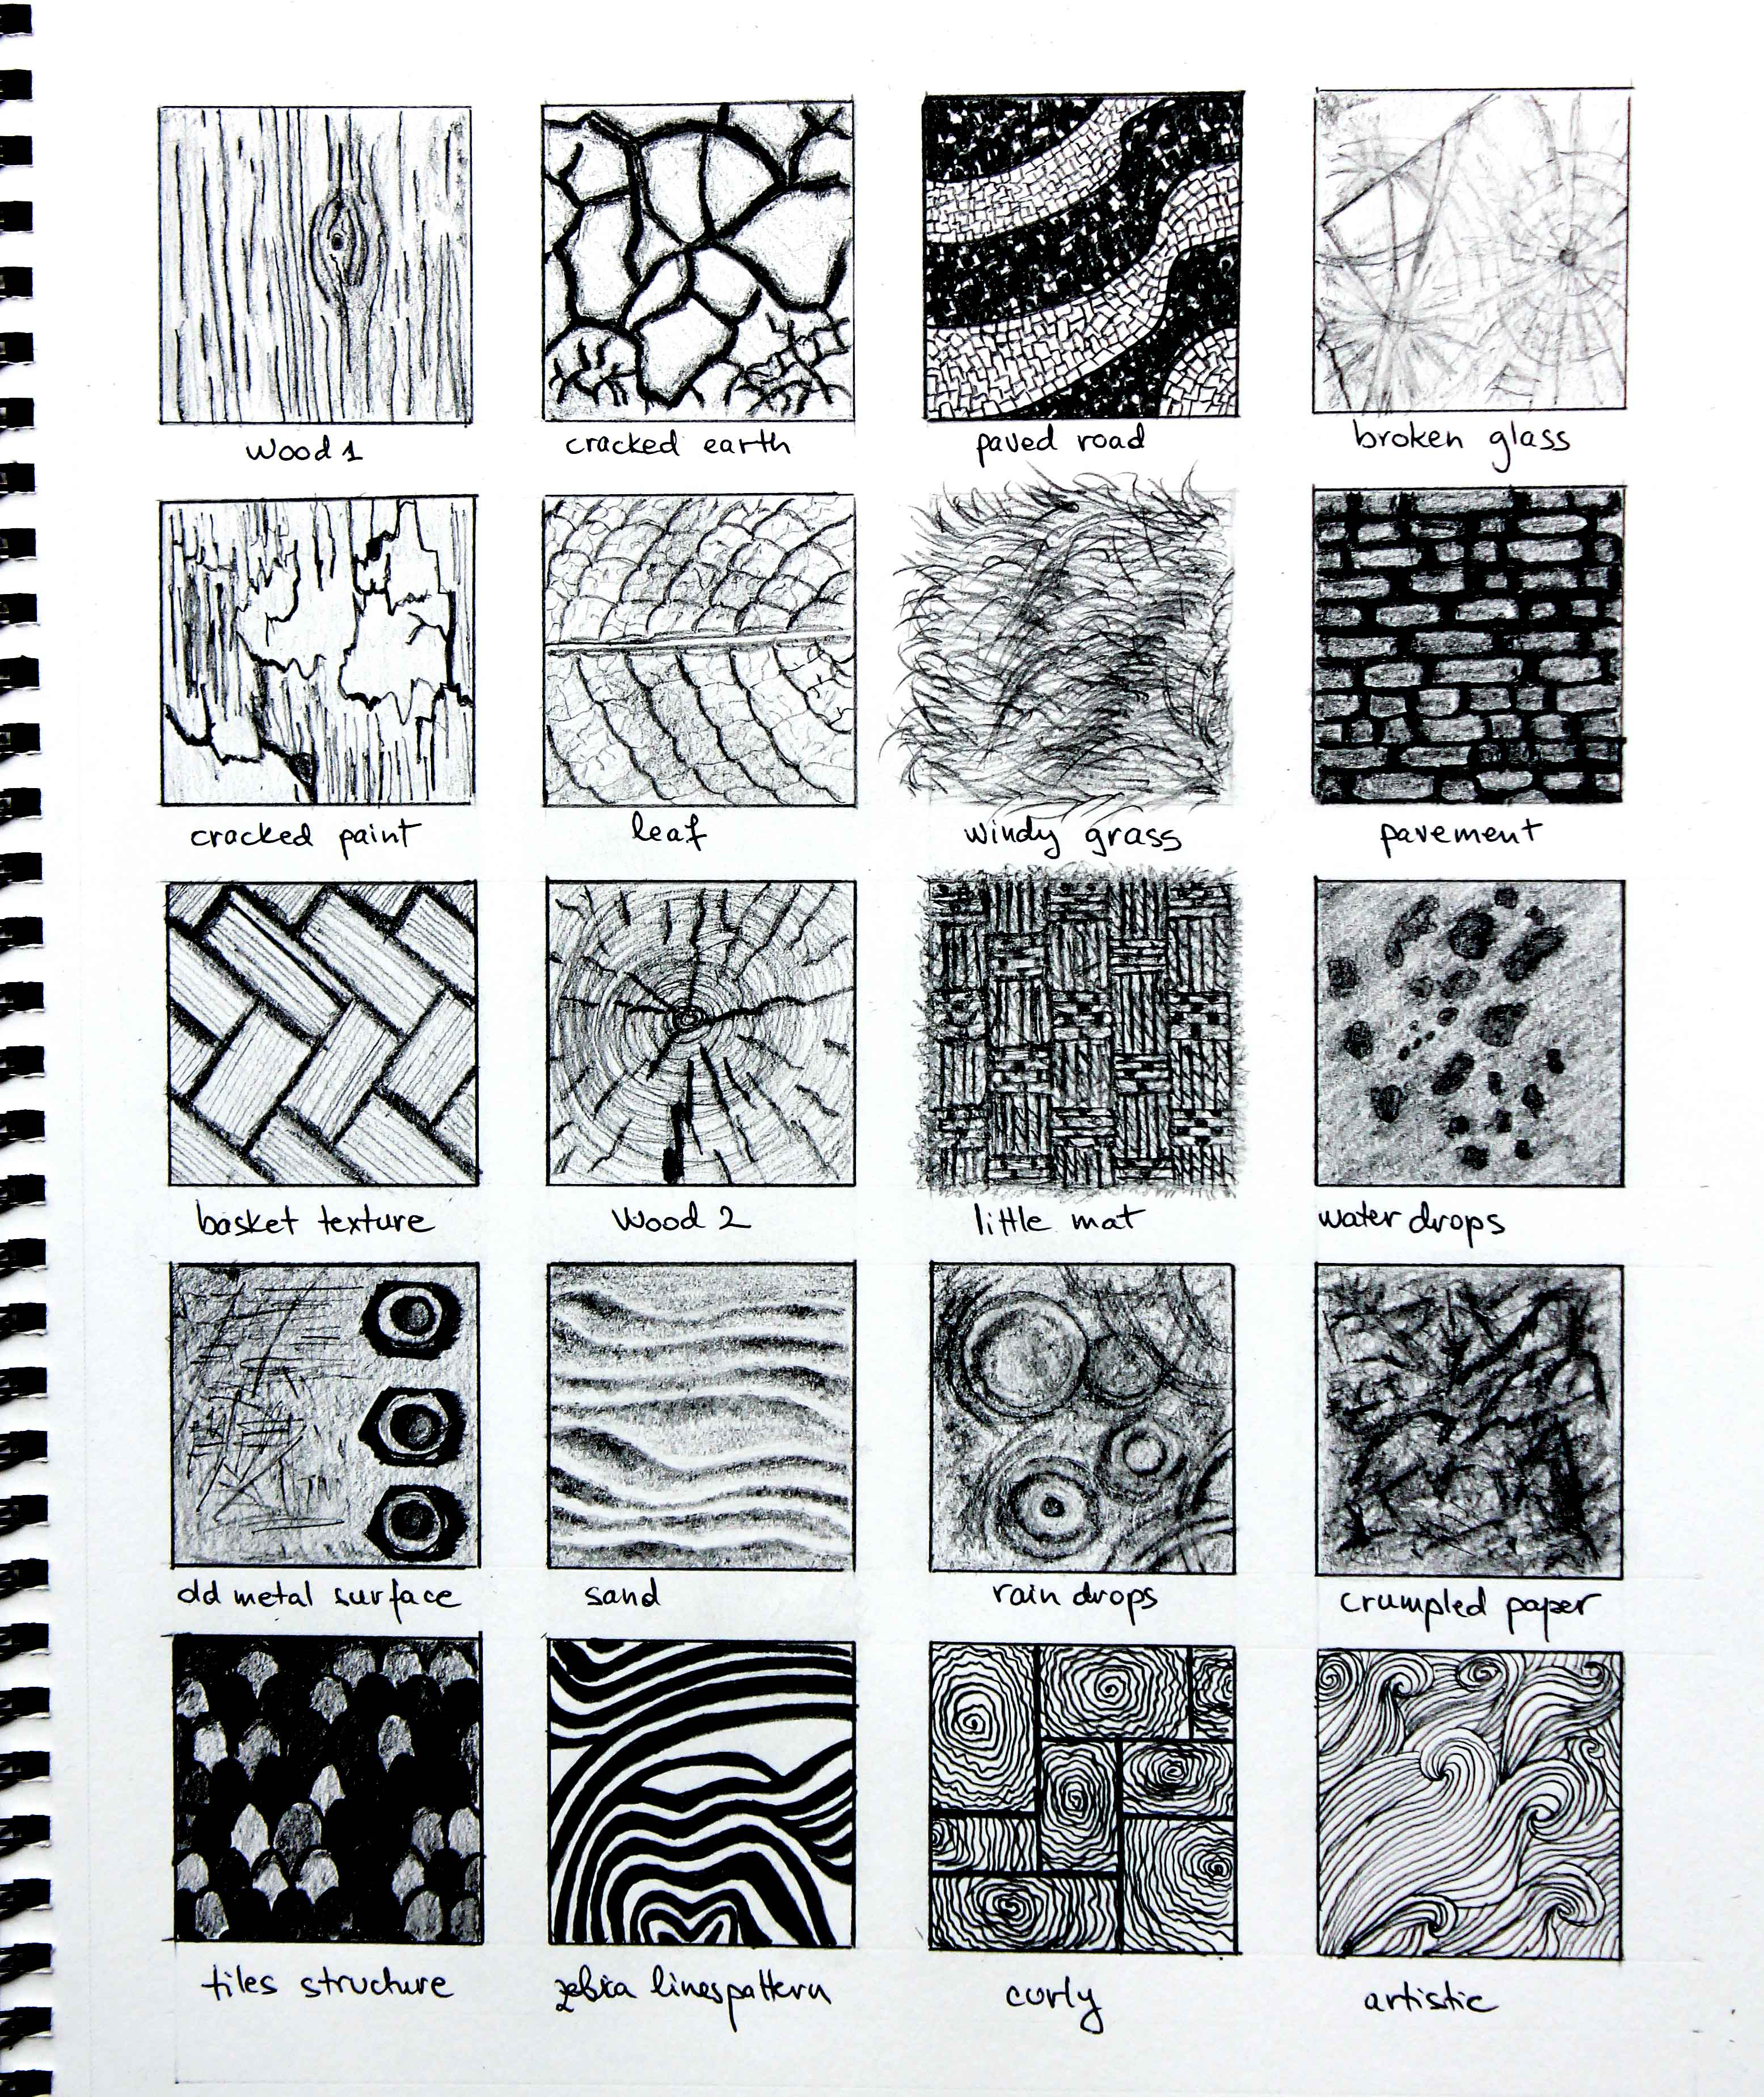
TEXTURE
TEXTURE

Slide 4
TEXTURE
TEXTURE

Slide 5
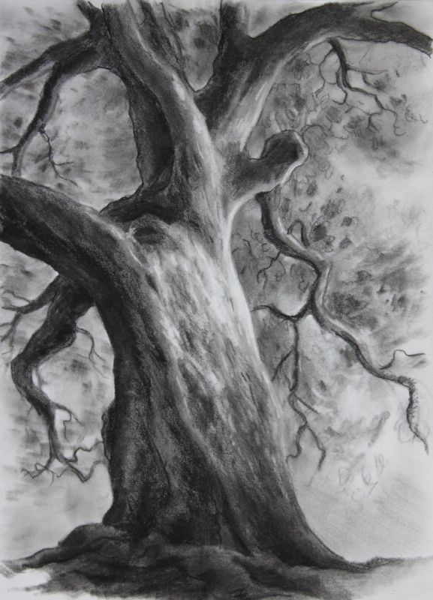
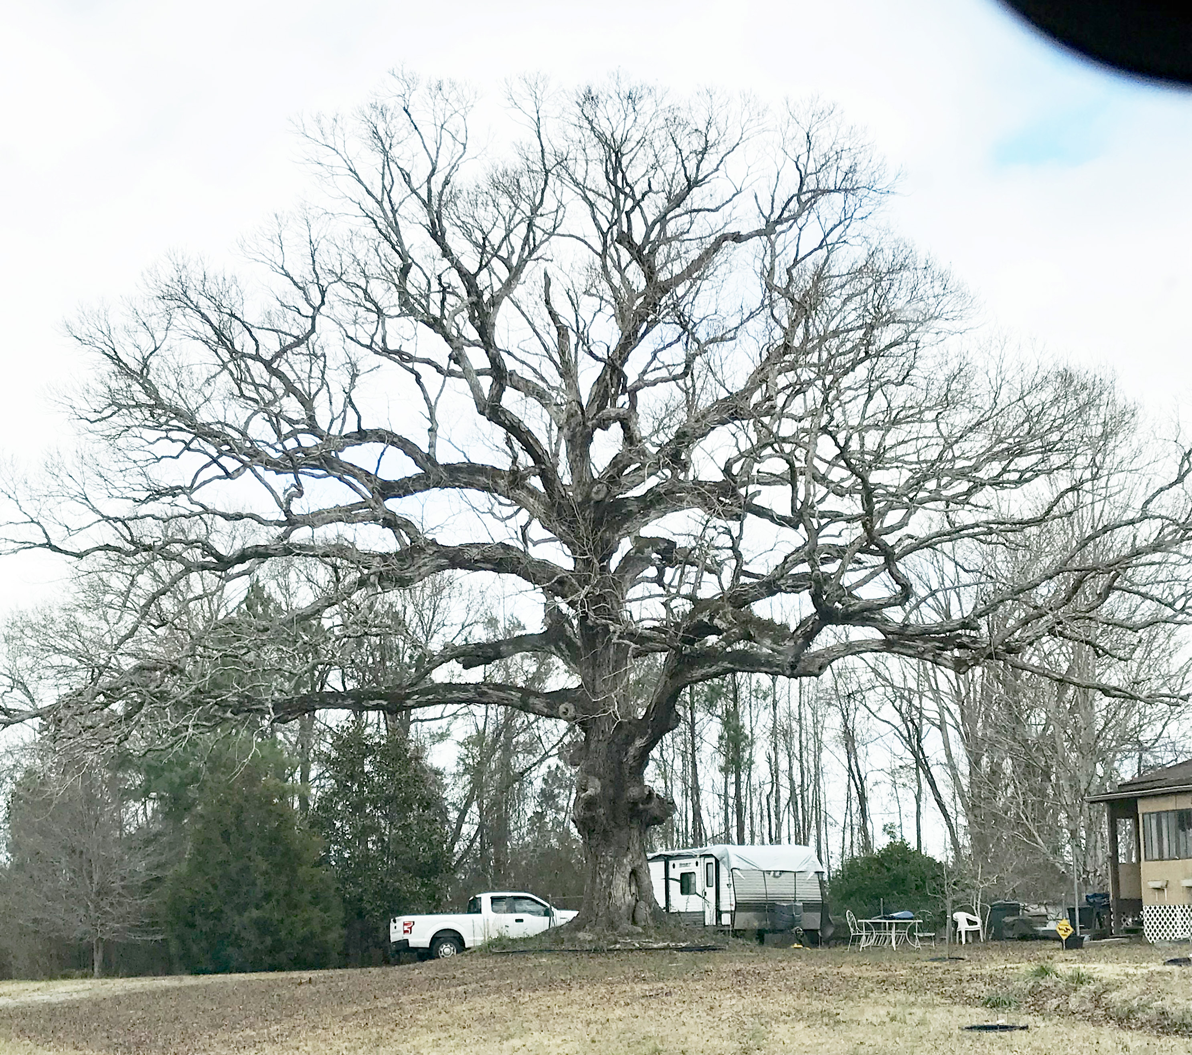
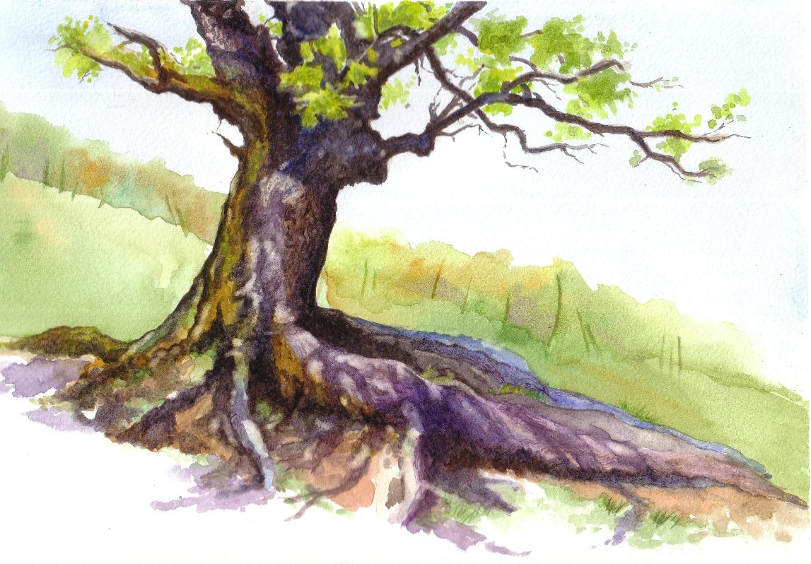
TEXTURE
TEXTURE

Slide 6
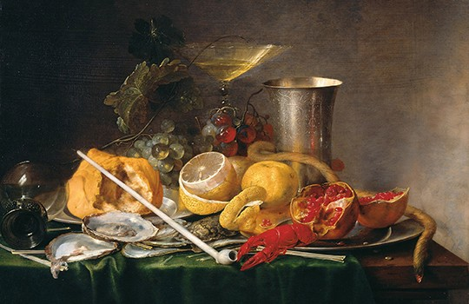
TEXTURE

Slide 7
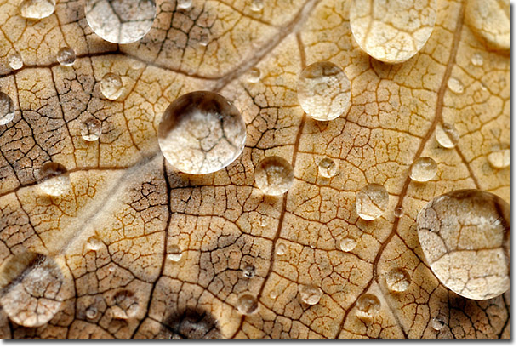
TEXTURE
TEXTURE

Slide 8
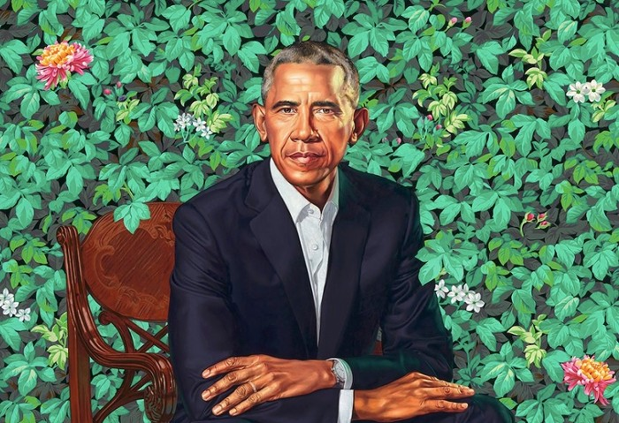

Slide 9
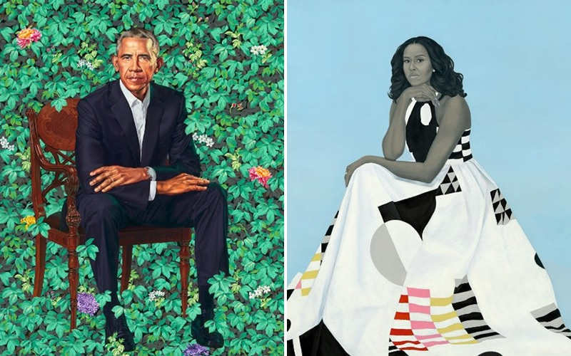

Slide 10
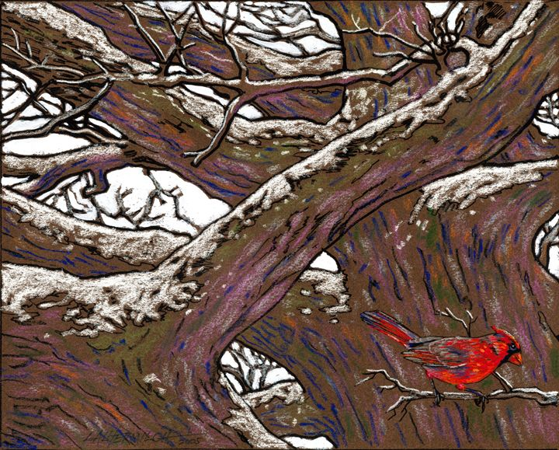

Slide 11
