Slide 1
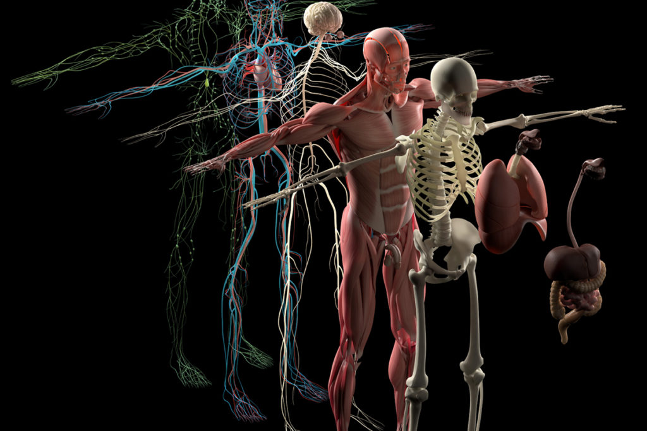
Human Body Systems

Slide 2
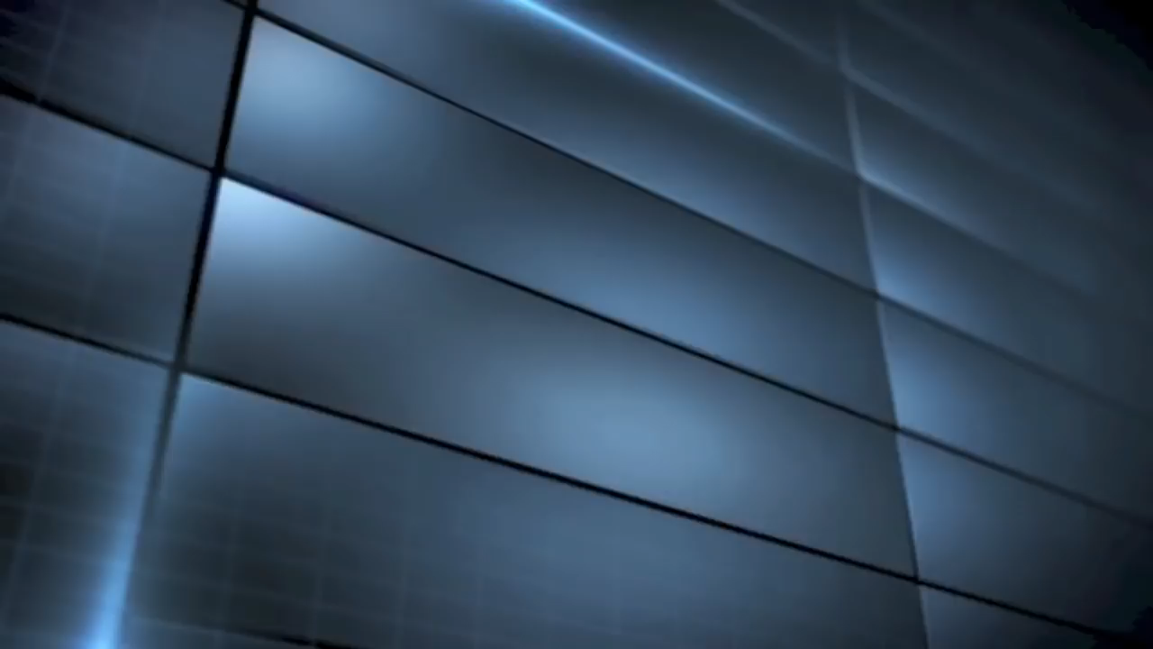
Welcome to Your Body!

Slide 3
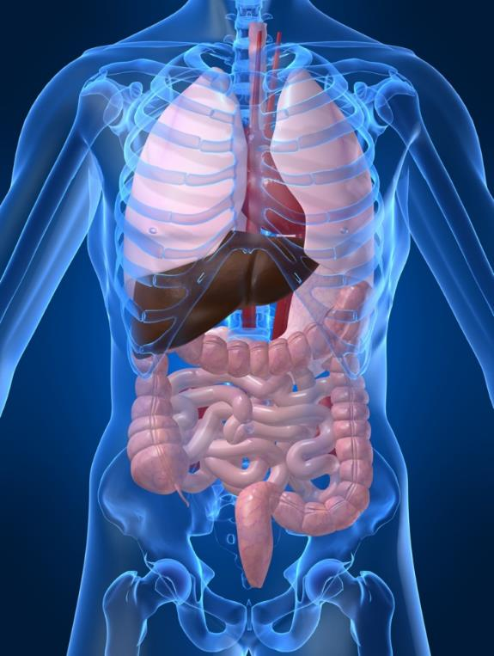
What do you know?
Let’s see how much you know about the human body! Take the Human Body Pre-Assessment and match the body system with its function. Then provide an example of organs found in each system.

Slide 4

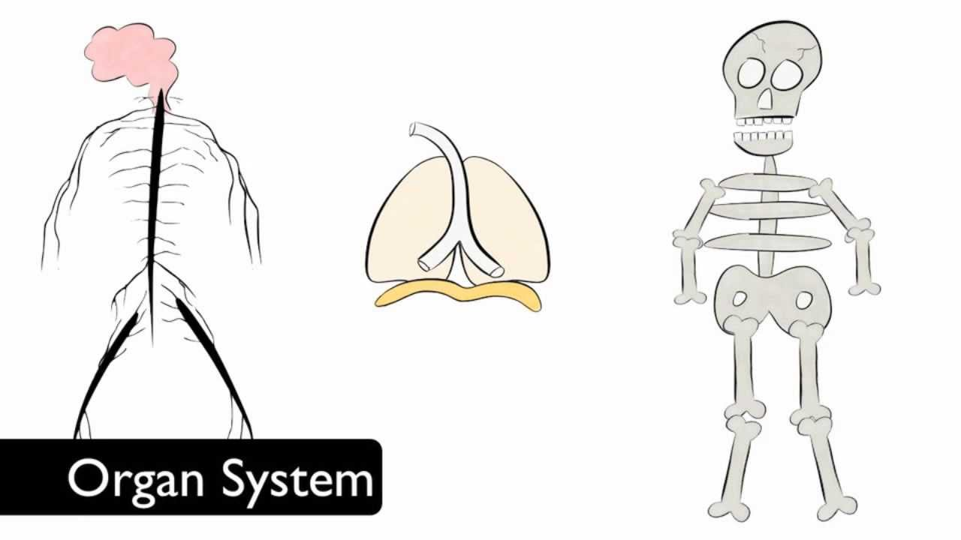
How to we ‘build’ an organism?
How do cells, tissues, organs, and organ systems explain the complexity of living things?

Slide 5
Facts about Cells
Cells are the smallest units in any organism and ALL living things are made of at least one cell.
Each cell (whether part of a unicellular or multicellular organism) performs all activities that characterize ‘life’.
Multicellular organisms are more complex than unicellular organisms.

Slide 6
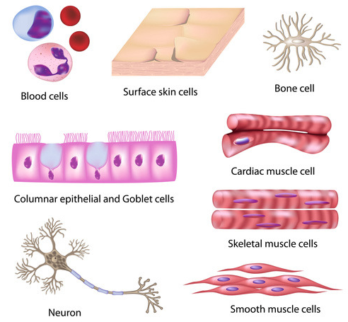
In more complex organisms, cells are not only specialized but group together to form tissue.
Tissue is a group of similar cells that are organized to do a specific job.

Slide 7
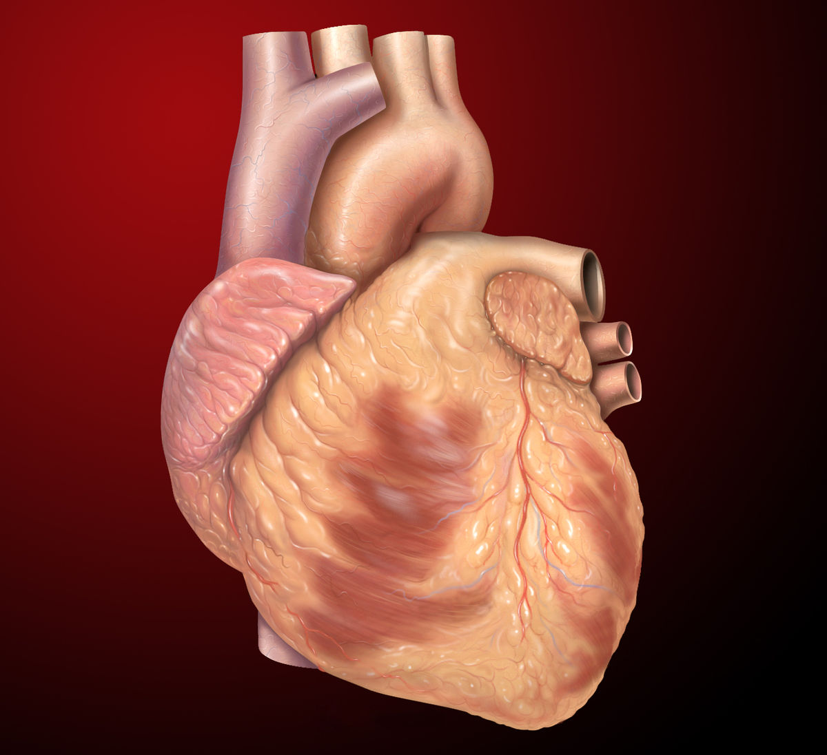
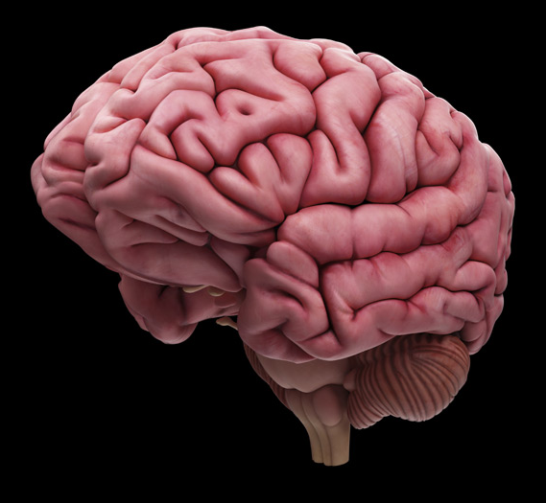
Different tissues working together to perform a particular function represent the next level of organization – the organ.

Slide 8
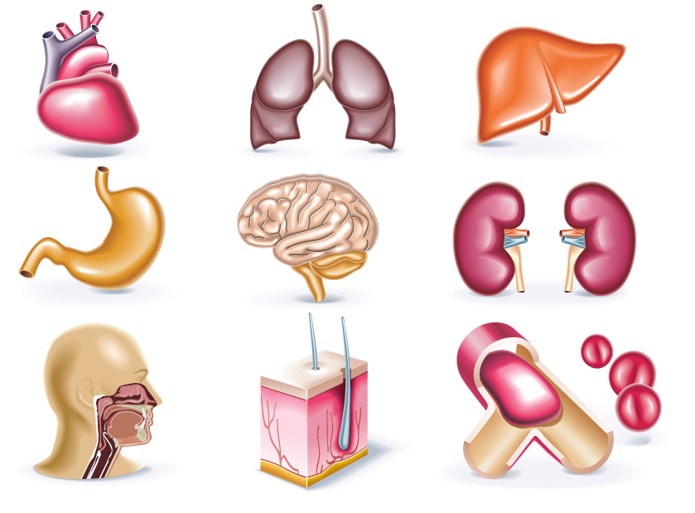

Slide 9
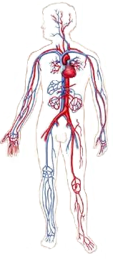
Different organs and tissues work together in an organ system.
An organism may have many - or only a few - organ systems.
The Circulatory
System

Slide 10
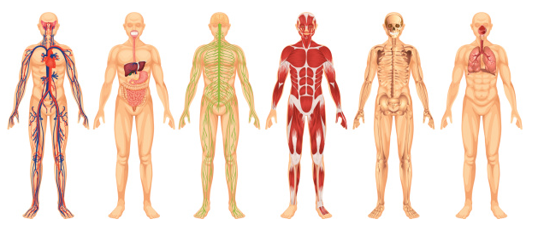
Other Organ Systems

Slide 11
The organism itself represents the highest level or organization.
If an organism is complex, it will consist of trillions of cells grouped into tissues, organs, and organ systems.
If an organism is simple, it meets its needs with a body made up of only a few types of specialized cells … or just one single cell!

Slide 12
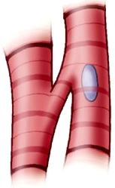
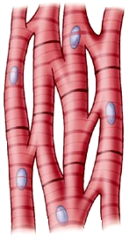
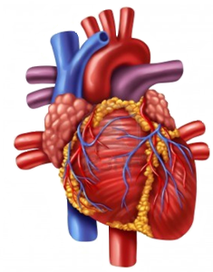

Cell
Tissue
Organ
Organ System
Organism

Slide 13
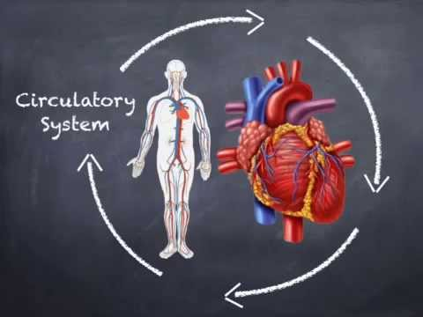
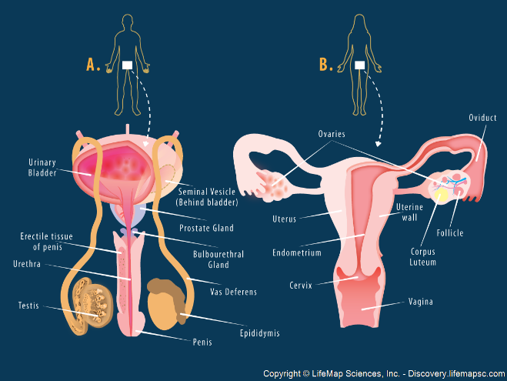
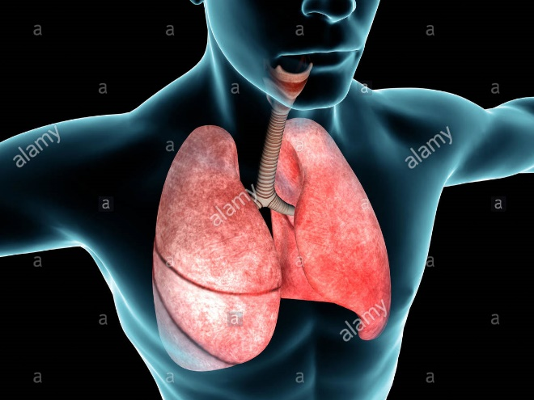
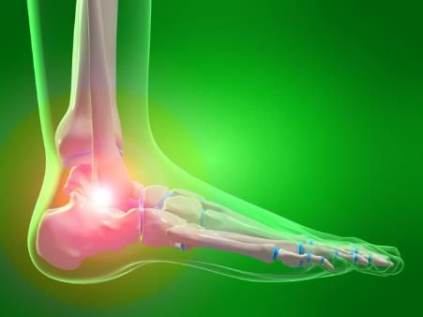
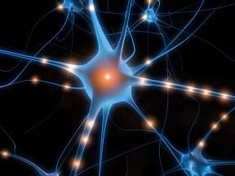
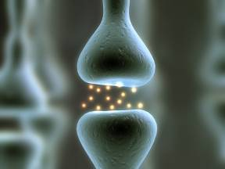
The Human Body: An Insider’s Look
Objective: To learn the systems of the body, their functions, and how they are related.

Slide 14
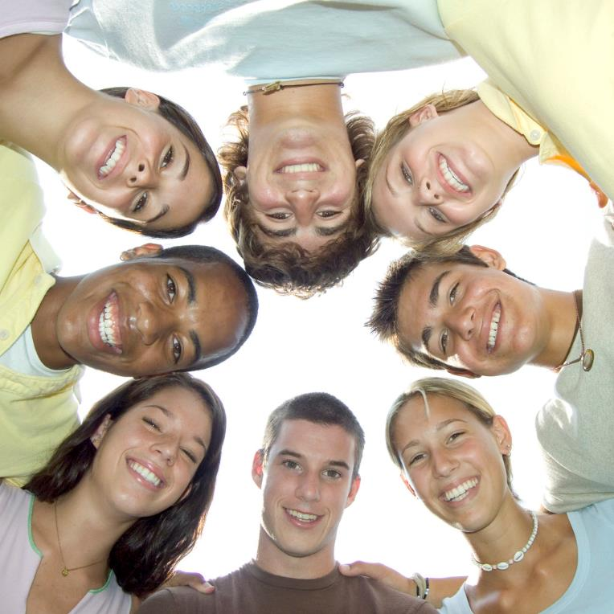
What’s this unit about? Well, it’s all about YOU! Take a few minutes to read the passage “The Human Body: An Insider’s Look.” When complete, answer the following questions on your sheet. Remember to use good reading strategies as you work!

Slide 15
How Did You Do? Check Your Work!
There are 11 systems of the body. List those systems and then come up with a mnemonic device to remember the 11 systems.
Remember, a mnemonic device uses the first letter of each word in a way that helps you to remember each word
The systems are:
Integumentary, Muscular, Skeletal, Cardiovascular/Circulatory, Respiratory, Lymphatic, Endocrine, Nervous, Excretory/Urinary, Digestive, Reproductive (Male/Female)
Here’s my example:
I Must Stop Collecting Ripe Lemons Each November Under Daily Rainshowers
What did YOU find?

Slide 16
How Did You Do? Check Your Work!
How are the circulatory, respiratory and lymphatic systems related to each other? Be specific.
During inhalation, oxygen enters the body and travels to the lungs where it diffuses into the bloodstream across the thin walls of the alveoli. Conversely, Carbon Dioxide diffuses out of the bloodstream into the alveoli to be exhaled out of the body. Once the oxygen enters the bloodstream, it is carried by red blood cells to all parts of the body through a network of tubes called arteries, veins and capillaries. Lymph vessels work closely with the cardiovascular system to collect excess fluid that may leak out of blood vessels and carries it through lymph nodes which filter the lymph fluid of debris/waste. The lymph is then rejoined with the bloodstream at intersections where lymph vessels and blood vessels connect.

Slide 17
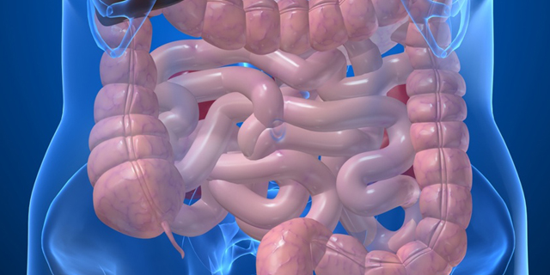
How Did You Do? Check Your Work!
The small intestine is over 30 feet in length! Why do you think the small intestine is so long (think about what its job is in the body before you write your answer)?
The length is important because it increases surface area for a greater amount of absorption of nutrients. Additionally, because it takes longer for digested food to travel through the small intestine, more nutrients are able to diffuse across the villi and into the bloodstream.

Slide 18
How Did You Do? Check Your Work!
You put your hand on a hot stove in your kitchen and immediately pull back your hand to avoid getting burned too badly. Where do you think the message will go first? Explain.
The message will travel to the spine first because the spine is responsible for reflexes. This allows the body to respond quickly without getting injured.
Name five other organs that are not listed in this reading and give their functions:
What Did YOU find?
What would happen if the skeletal system of your body was absent? Give at least three examples.
Organs would not have protection; body would be a gelatinous mass with no structure; red blood cells would not be manufactured; minerals would not have storage.

Slide 19
How Did You Do? Check Your Work!
Use the graphic organizer and the previous reading to identify each system and the associated organs/structures from the reading.
System Name | Organs and Structures identified from the Reading
Integumentary | Skin, Hair, Nails, epidermis, dermis, fatty layer, pores
Muscular | Bicep, Pectoral, Quadriceps
Skeletal | Sternum , radius, Patella
Respiratory | Trachea, Bronchi, Lungs
Circulatory | Heart, arteries, veins, capillaries, blood, aorta
Lymphatic | White Blood cell, Thymus, glands
Urinary/Excretory | Kidney, bladder, liver
Digestive | Esophagus, chyme, stomach, small intestine
Reproductive | Eggs, testes, sperm, egg
Endocrine | Hormones, thyroid, pituitary
Nervous | Brain, neuron, spinal cord

Slide 20
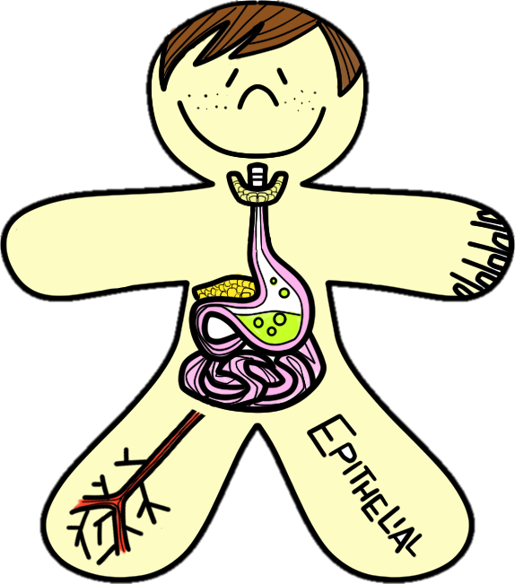
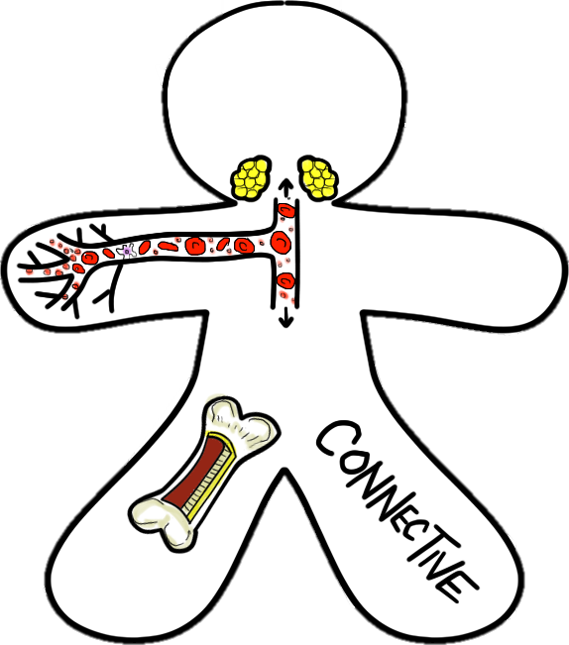
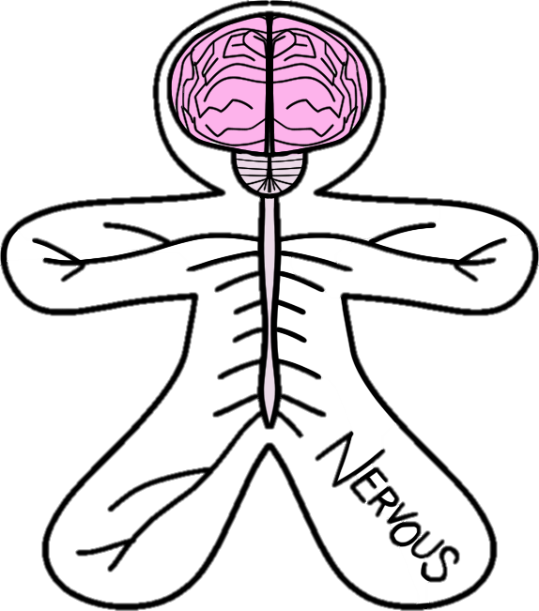
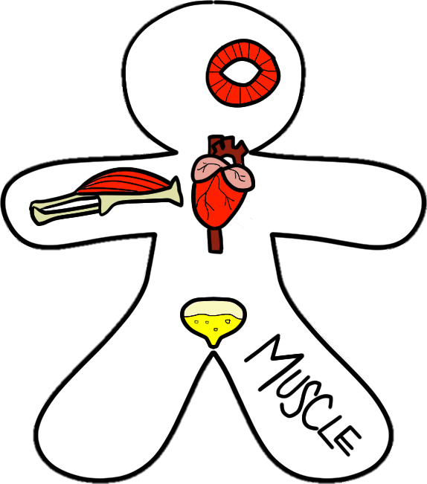
The Issue with Tissue
Objective: To identify the four types of tissue in the human body
Bell Work:
What is a tissue?
A group of similar cells that work together to perform a specific function
Notes:
On click, answers to bell work will appear.

Slide 21
There are FOUR types of tissue found within the human body:
EPITHELIAL
CONNECTIVE
NERVOUS
MUSCLE
As we go over each type of tissue, fill in your graphic organizer with the corresponding notes and color your Tissue Scienstructables accordingly.
Notes:
On click, answers to bell work will appear.

Slide 22
Epithelial Tissue:
Protects body, absorbs nutrients, filters blood & secretes
Types:
  Covering/lining: found on internal organs and outside of body
    EX: Skin, digestive tract, lymph vessels
  Glandular: secretes hormones and other fluids such as saliva, stomach acid, sweat
    EX: Thyroid, pancreas, and salivary, sweat and mammary glands

Slide 23
Connective Tissue:
Provide structure and support, cushions organs, stores nutrients
Types:
  Loose: scattered arrangement of cells in an extracellular matrix
    EX: Fat cells (adipose tissue), attaches skin to muscle
  Fibrous: densely packed cells arranged in bundles
    EX: tendons and ligaments
  Cartilage, bone, & blood are also connective tissues with unique properties that do not put them in the other types.

Slide 24
Nervous Tissue:
Carry impulses throughout the body
Composed of two types of cell:
  Neuron: basic unit of nervous system
    Composed of Cell body, dendrite and axon
  Glial cells: insulate and anchor neurons to blood vessels

Slide 25
Muscle Tissue:
Made of muscle fibers that relax and contract
Types:
  Skeletal: moves body
    EX: Biceps, triceps, Orbicularis oculi
  Smooth: controls involuntary muscle contractions
    EX: Stomach, intestines, blood vessels, bladder
  Cardiac: pumps blood to all body cells
    EX: Heart

Slide 26
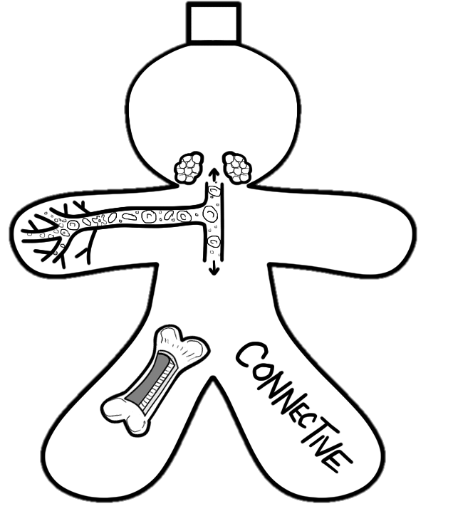
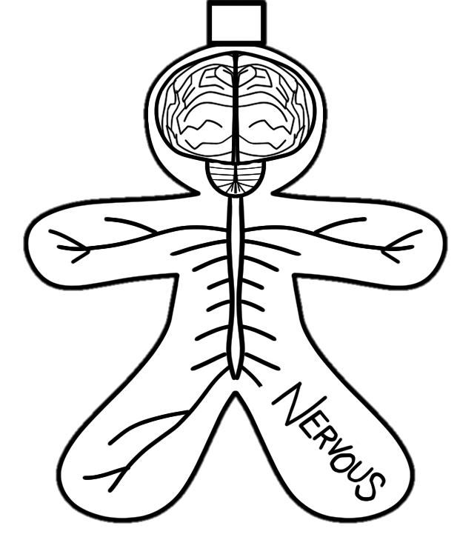
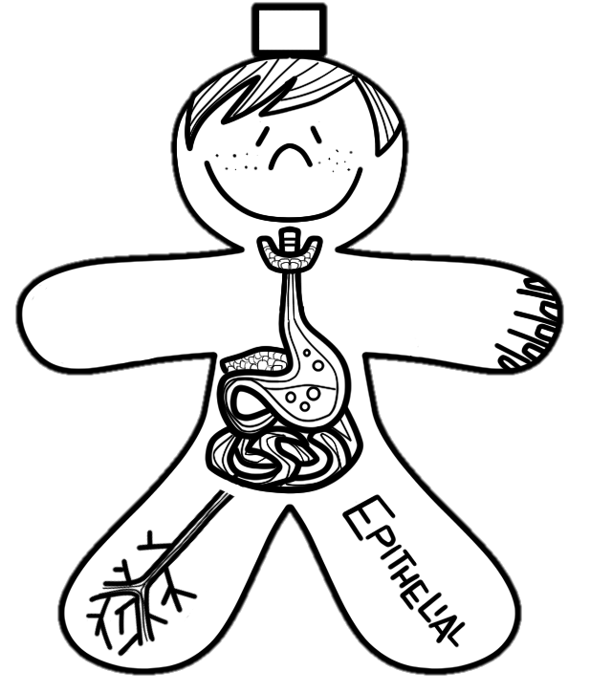
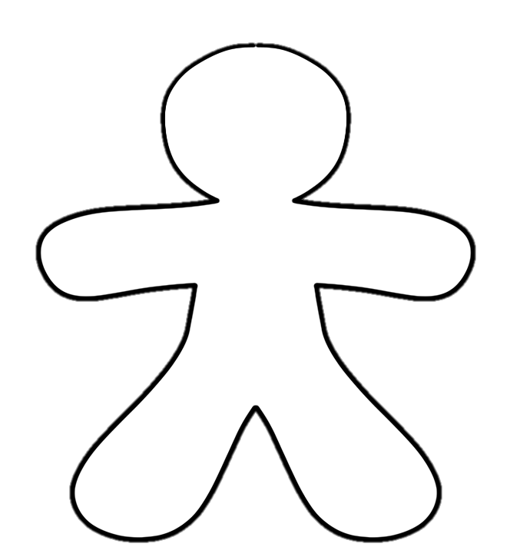
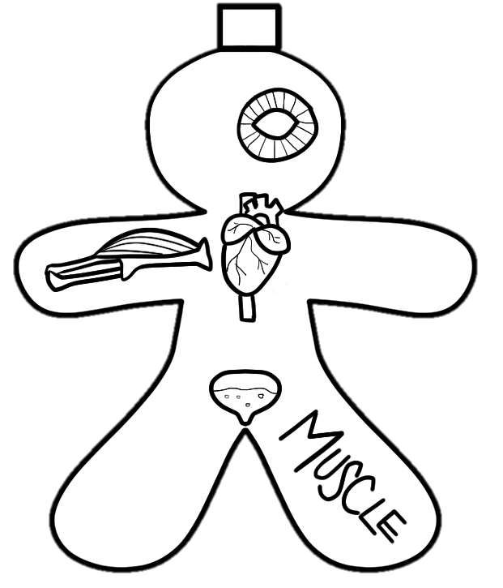
The Issue with Tissue
Now that you’ve learned about the four main types of tissue, color and cut out your Tissue Scienstructables and glue them by their tabs to the center body on your paper. You should be able to lift each one when finished so you can review the different types of tissues.
Notes:
On click, answers to bell work will appear.

Slide 27
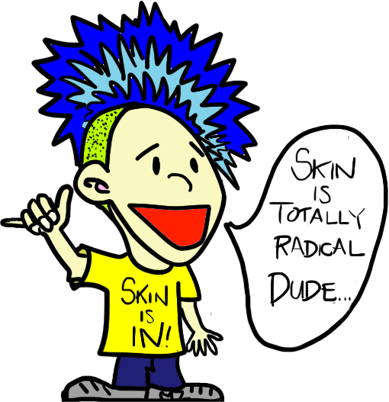
SKIN is IN!
Objective: To learn the structure and function of the Integumentary System
Bell Work:
On the surface of your fingers are unique little ridges, called fingerprints. What do you think is their purpose?
They provide your grip. Without them, things would just slide right out of your fingers!
Are any two sets of fingerprints alike? Explain.
Nope, not even identical twins have the same prints. Your prints are formed as a result of the swirling of fluid in the womb as you grow!
Notes:
On click, answers to bell work will appear.

Slide 28
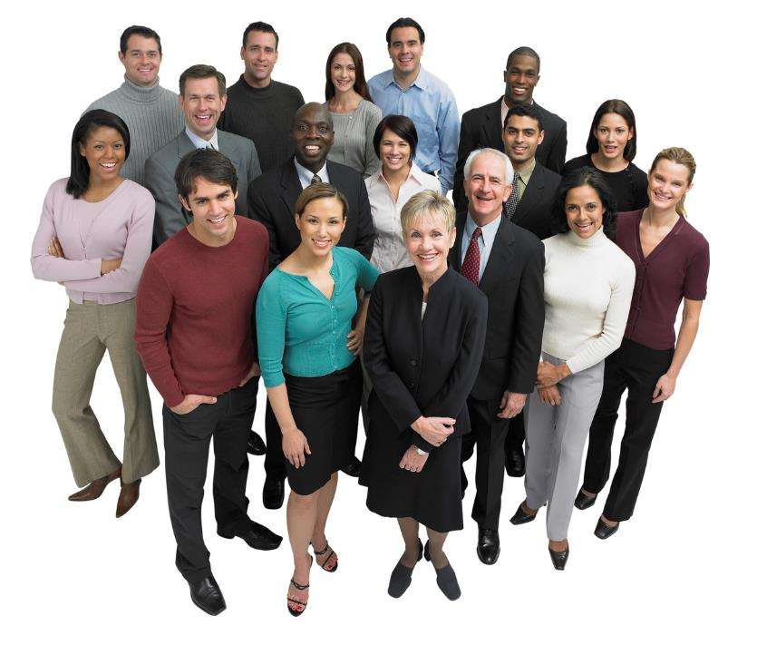
Made up of the hair, nails, and skin

Slide 29
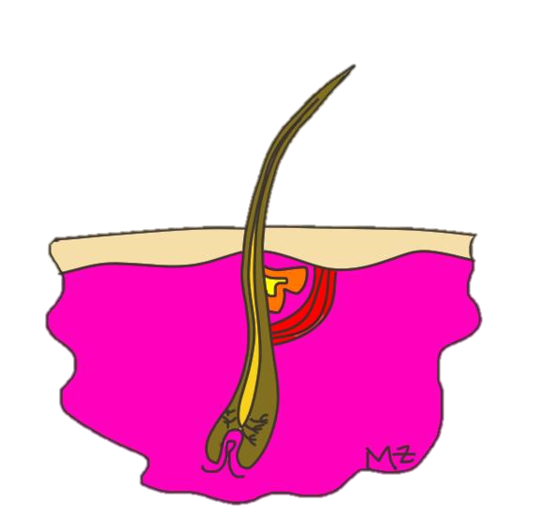
Hair:
Made of the protein “keratin,” grows from follicle
Found all over body except lips, palms and soles of feet
Functions in warmth, protection, and immune defense
Characteristic of mammals
Epidermis
Oil Gland
Hair Shaft
Muscle
Dermis
Follicle

Slide 30
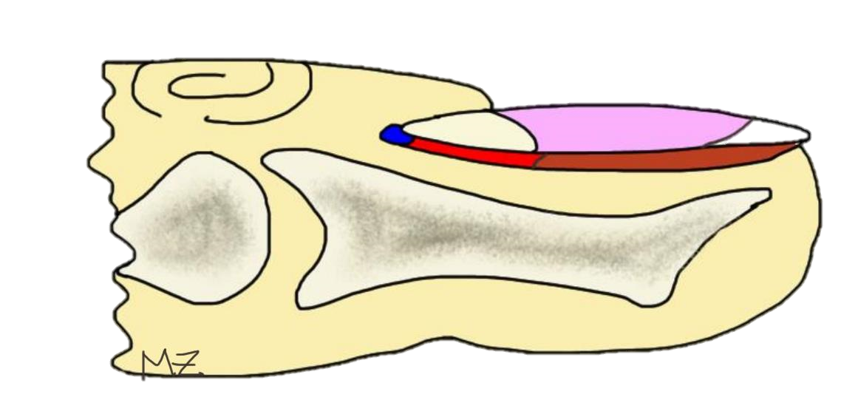
Nails:
Made of the protein “keratin,” grows from root
Found on fingers and toes (phalanges)
Functions in protection and as a tool for precise activities
Root
Lunula
Nail Plate
Free Margin
Matrix
Nail Bed

Slide 31
Skin:
Your skin is the largest organ of your body and is made up of three layers of tissue:
Epidermis: outer layer composed of epithelial cells
  Outermost cells are dead and rub off
  New cells are constantly made at the base/bottom of the epidermis.
  Melanocytes: cells produce melanin - pigment that protects your skin and gives it color
Dermis: the middle layer composed of connective tissue
  Contains blood vessels, nerve fibers, muscles, oil, sweat glands, and other structures.
Hypodermis (fatty layer): below the dermis - insulates body

Slide 32
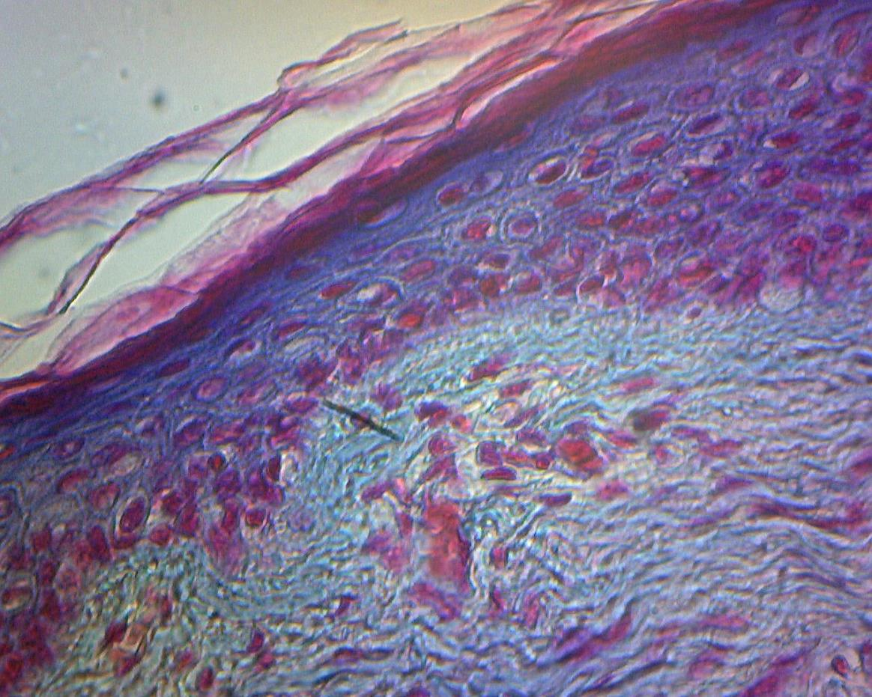
EPIDERMIS
DERMIS
Human Skin Cross-section magnified 100x

Slide 33
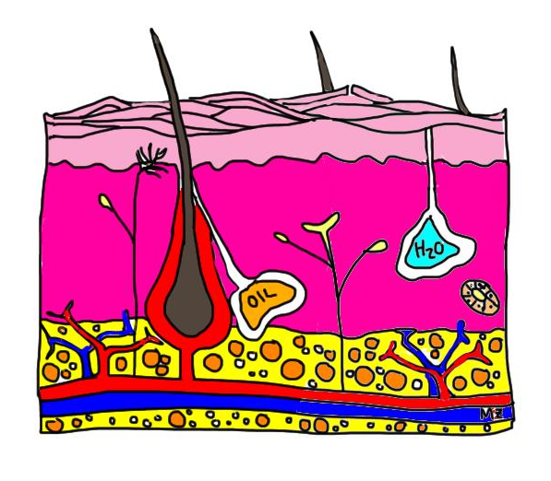
Skin Cross-section
Epidermis
Dermis
Hypodermis
Hair from hair follicle
Sweat Gland
Oil gland
Nerve
Blood Vessels
4
1
5
6
2
7
3
8

Slide 34
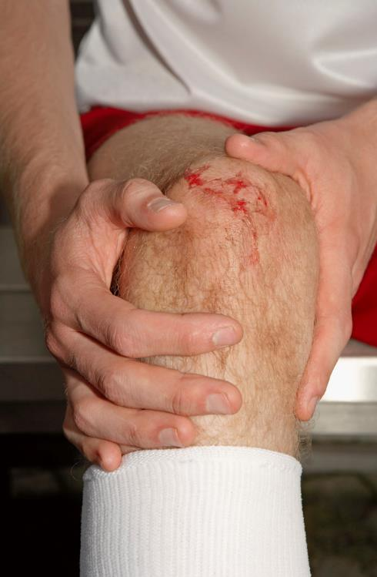
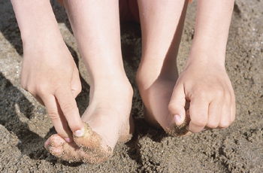
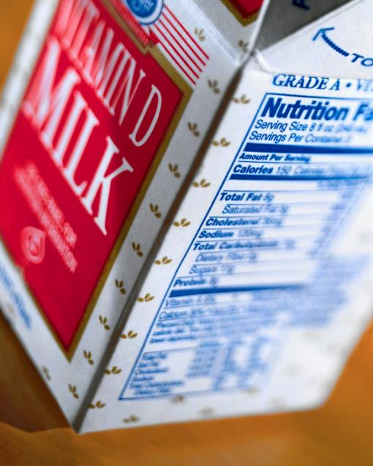
Function:
Forms a protective covering over the body which prevents infection and water loss
Sense our environment through touch
Formation of Vitamin D during exposure to the sun

Slide 35
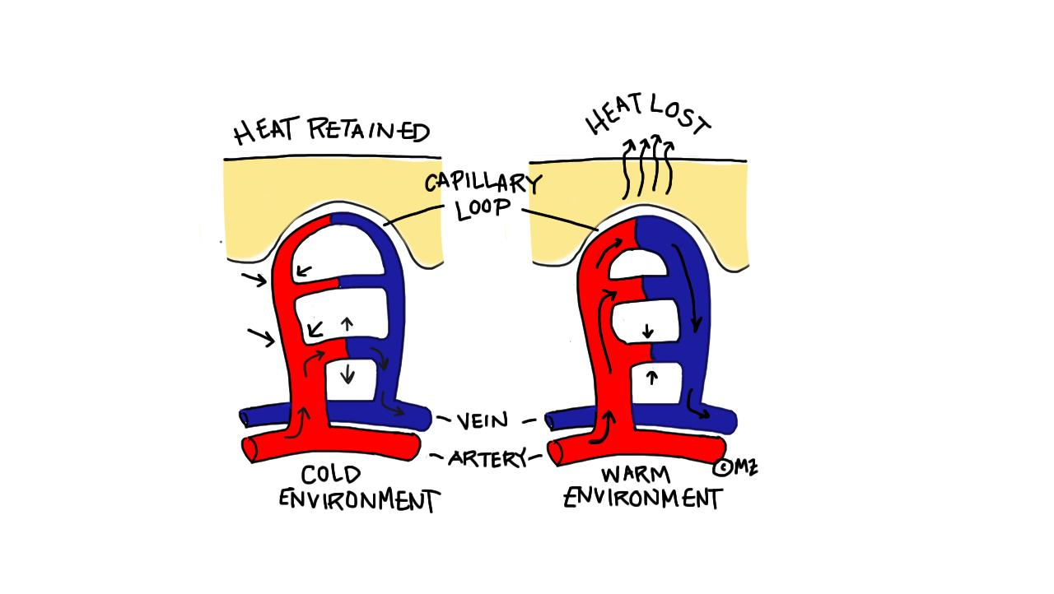
Regulation of body temperature
  Blood vessels in skin help release/hold heat
  Perspiration (sweating) to keep cool and shivering to keep warm

Slide 36
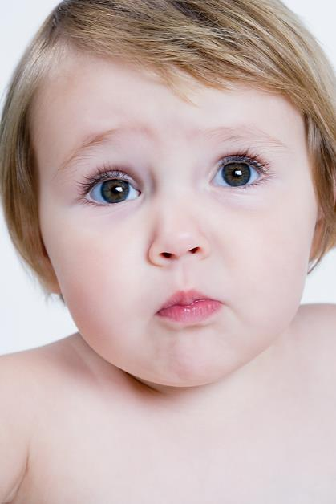
I’m Sensitive!
Skin Sensitivity Test
Objective: To identify which part of the body is most sensitive and explain why
Hypothesis: Predict which areas are most sensitive ranking 3 (least sensitive) to 1 (most sensitive).
What You Do: Have your partner close his or her eyes. Using the card you are given, test each area described on your paper and ask whether your partner can feel one or two points. For one point, record a minus (-) in the chart. For two points, record a plus (+) in the chart. After all areas are tested, switch roles and repeat.

Slide 37
The Results: What Happened?
Which part of the body tested can detect the closest stimuli (the shortest distance between toothpicks)?
What did YOU find?
Which part of the body seems least sensitive to close stimuli (could not detect the shortest distance)?
What did YOU find?
Rank the body parts tested from most sensitive to least sensitive.
What did YOU find?
What structure is located in the dermis that provides a sense of touch?
Nerve fibers
How do the results compare to your predictions? Explain.
What did YOU find?
What do the answers to 1-4 tell you about the distribution of touch receptors in the skin? Why do you think this might be important?
That the distribution of receptors is greatly concentrated in the fingertips because humans sense their environment with their hands. When you walk into a dark room, you don’t go in neck first, but hands first in order to sense the environment present.

Slide 38
Uniquely You: A Fingerprint Activity
Everyone on earth has a unique set of fingerprints, even identical twins! Learn about the various types of fingerprint patterns, and determine which pattern is yours.
Objective: To determine your unique fingerprint pattern and look at the distribution of patterns among your classroom population.
Here’s what you’ll need to conduct this activity:
Uniquely You Fingerprint Worksheet
Pencils
Scotch Tape
Hand lens
“Inspector Ink pad”

Slide 39
Uniquely You: A Fingerprint Activity
Read the background information and then answer the pre-lab questions about the National Fingerprint Pattern Distribution.
What percentage of individuals in the national population have loops?
Approximately 70%
What percentage have whorls?
Approximately 25%
What percentage have arches?
Approximately 5%
Which is greater, the percentage of individuals with loops or the percentage of individuals with whorls plus arches?
70% Loops vs. 30% Whorls and Arches
Hypothesis: What do you think will be the MOST common kind of fingerprint amongst your classmates? Why? What do you think will be the LEAST common? Why?

Slide 40
Uniquely You: A Fingerprint Activity
What You Do:
Create an “ink pad” by rubbing the graphite of your pencil on your “Inspector’s Ink Pad” until it turns dark grey. Refill your “ink pad” as needed.
Using your right hand, rub your pointer finger on your “ink pad” until it’s completely grey.
Take a small piece of scotch tape and place it over your fingertip, pressing down carefully so as not to smudge the print.
Remove the tape and place it in the appropriate part of your data table.
Repeat for your remaining fingers and thumbs on your right and left hand.
Using your hand lens, identify the type of fingerprints you have by comparing to the examples provided. Locate odd marks or scars as well - these make your prints uniquely you!

Slide 41
Uniquely You: A Fingerprint Activity
Once you have completed both sets of your prints, analyze your patterns and place that information below your prints. Now, let’s looks at how the patterns are distributed in the classroom population! Share your pattern count with the class so your teacher can total them up. Determine the percentages for each pattern by taking the total number of fingers with the pattern and dividing by the total number of fingerprints in the class. Then, graph your data and answer the Extension questions on the following page.

Slide 42
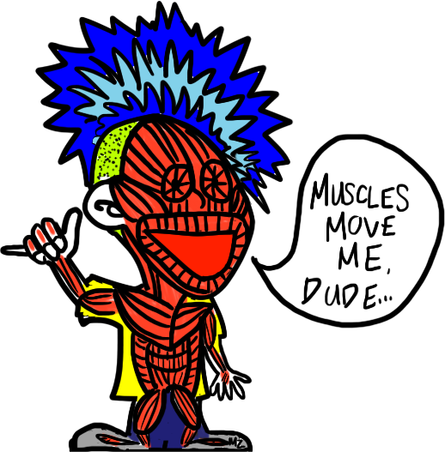
Muscles Move You!
Objective: To learn the structure and function of the Muscular System
Bell Work:
Muscles need lots of energy to complete their job. Which organelle do you think is most abundant inside muscle cells?
Muscles have lots of mitochondria in their cells in order to convert glucose into ATP energy.
Which systems of the body work to provide the nutrients and oxygen muscles need to perform?
Digestive, Circulatory & Respiratory

Slide 43
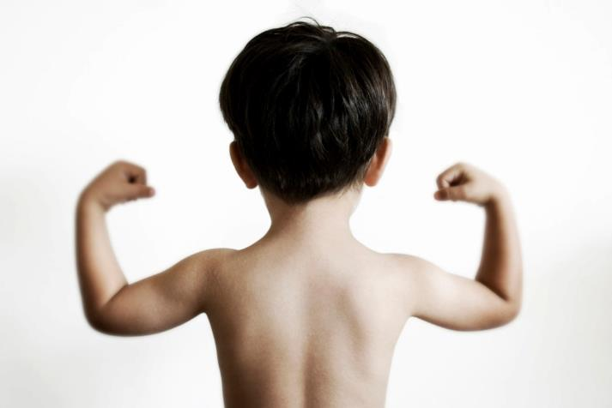
Muscle: an organ that can relax and contract, which moves your body. There are two types:
Voluntary muscles: muscles you can control (bicep)
Involuntary muscles: muscles you cannot control (heart)

Slide 44
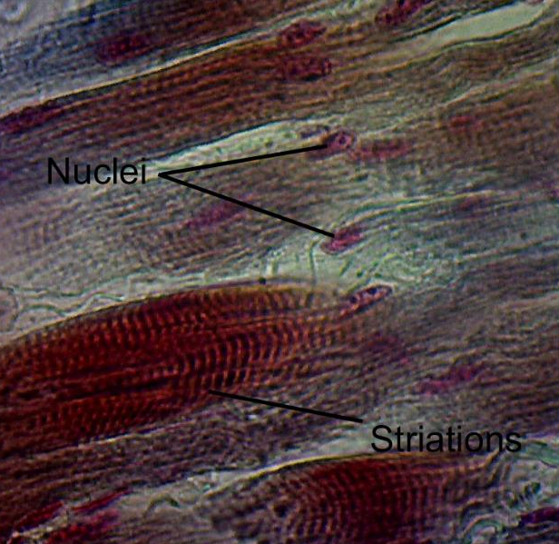
three types of muscle tissue
Skeletal muscle: moves bones
  Voluntary
  Tendons connect muscle to bone
  Contract quickly and tire more easily
  Look striped or striated
  Bicep, quadriceps, pectoral
  Draw & Label the striated muscle in the circle on your paper

Slide 45
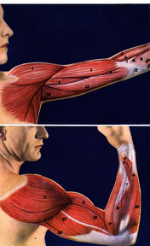
You move because pairs of muscles work together
  One end of the muscle attaches at the end of a bone by a tendon
  The opposite end of the muscle attaches to an adjacent bone
  Muscles always pull against the opposite bone

Slide 46
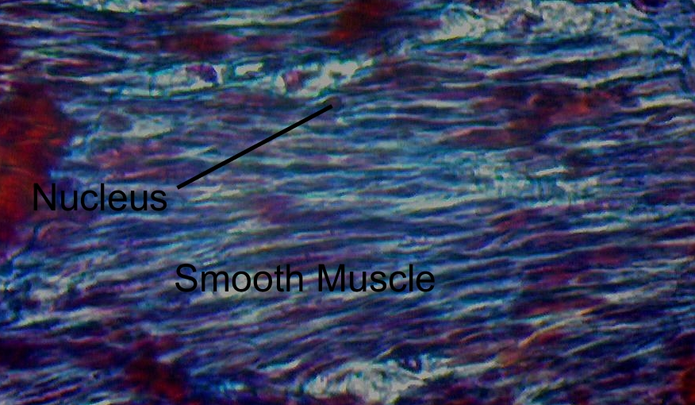
Smooth Muscles: responsible for regulating blood pressure, digestion, and other internal functions
  Involuntary
  Muscles in the stomach, bladder, blood vessels
  Draw & Label the smooth muscle in the circle on your paper

Slide 47
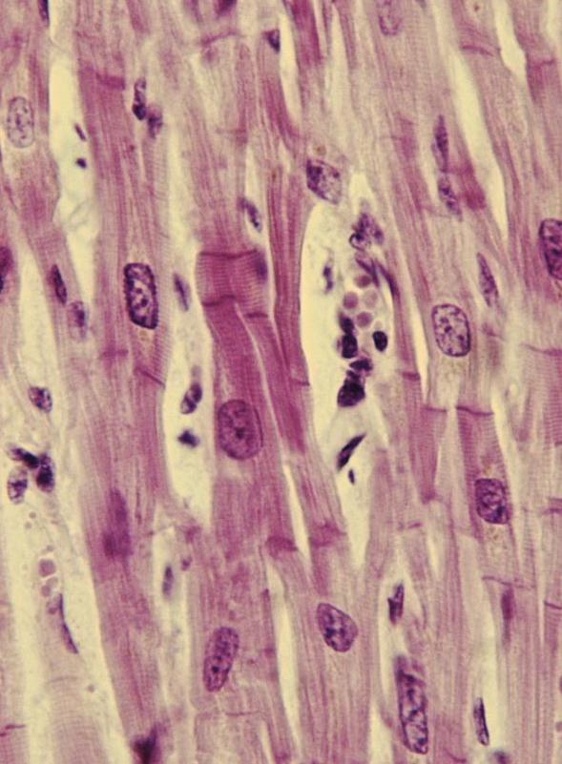
3. Cardiac Muscle: Found only in the heart
Involuntary
Can beat independently of input from the brain
Striated (striped)
Draw and Label the cardiac muscle in the circle on your paper

Slide 48

In a Blink…
Muscle Action Lab
Objective: To determine if blinking is voluntary or involuntary
Here’s What You’ll Need to Conduct This Experiment:
Partner
Transparent film such as saran wrap, a blank overhead transparency, or goggles
Wadded up paper balls
Stopwatch or timer
Hypothesis: Make a hypothesis about whether blinking is a voluntary or involuntary muscle action.
What You Do: You’re going to complete three different tasks during this lab to determine if blinking is a voluntary or involuntary muscle action.

Slide 49

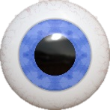
In a Blink…
What You Do:
Part 1: Have your partner read a book or do an everyday activity. The point is to not think about blinking. Count the number of times your partner blinks in one minute. Record that information in the chart on your paper. Change roles. Complete this activity for a total of two trials.
Part 2: Record the length of time your partner can go without blinking. Record that information in the chart. Change roles.
Part 3: Obtain a transparent piece of saran wrap or an overhead transparency. Have your partner hold the transparency in front of their eyes, about 6 inches away from their face. Instruct them to try and keep their eyes open as you gently toss a wadded up piece of paper at the transparency. Watch their eyes carefully and record in the chart whether or not they blinked.

Slide 50
In a Blink…
Muscle Action Lab
What Happened?:
Now that you have completed each task, use your data to analyze you results and answer the questions that follow.
What did YOU find?

Slide 51
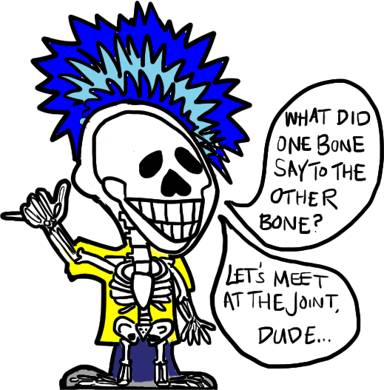
The Hip Bone’s Connected to the…
Objective: To learn the structure and function of the Skeletal System
Bell Work:
There is cartilage (like the stuff in your ears) located in your rib cage. Why do you think this is important with respect to breathing?
If your ribs were solid bone, you would be able to breathe in as much air as there was space inside your ribcage. Cartilage allows your ribs to be flexible so you can breathe deep!

Slide 52
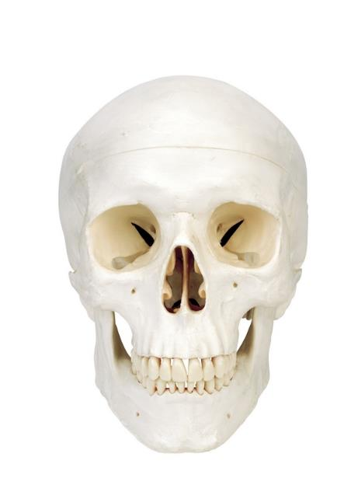



Bone: a type of connective tissue that makes up the endoskeleton of vertebrates.
Composed of four types of cells:
Osteoclasts: destroy bone
Osteoblasts: build bone
Osteocytes: hold bone together
Lining cells: protection of bone

Slide 53
Function:
Provides shape and support to body
Protects internal organs
Movement
Manufacture blood cells in bone marrow
Provides storage of calcium and phosphorus

Slide 54

Bone Structure:
Periosteum: thin membrane that covers and protects; contains blood vessels and nerves
Compact bone: hard bone that provides structure to bones
Cancellous bone: porous bone (aka spongy bone); contains blood vessels and marrow
Marrow: soft, jelly-like center of bones. Two types:
  Yellow: contains fat cells
  Red: manufactures platelets, and red & white blood cells

Slide 55


The porous nature of bones allows for them to be strong, yet flexible. Bones can bend a little before they break…
That’s why hard hits and falls in sports and other activities don’t always leave you with broken bones!

Slide 56

Your skeleton begins as cartilage, which is gradually broken down and replaced with bone which is why babies have more bones (300) than adults (which have 206).

Slide 57

Joint: any place where two or more bones come together
Cartilage: rubbery tissue that cushions bones; located at joints
Ligament: attaches bone to bone

Slide 58


Types of Joints
Fixed joint
  Allows little movement:
  Ex. joints of the bones in your skull
Pivot Joint
  One bone rotates around another bone:
  Ex. turning your head; rotating your wrist

Slide 59




Ball-and-socket joint
  The ball end of one bone fits into a cuplike cavity on another bone.
  Ex: Shoulder or hip joint
Hinge joint
  Back and forth
  Ex: knee or elbow joint

Slide 60

Sliding joint
  One part of a bone slides over another bone.
  Ex: Bones of wrist or ankle

Slide 61

Bones of the Skeleton label the left side of the skeleton in this order
Ocular Orbit (eye socket)
Maxilla (upper jaw)
Mandible (lower jaw)
Scapula (shoulder blade)
Sternum (breastbone)
Xihpoid Process (tip of breastbone)
Thoracic Vertebrae (12 attached to ribs)
Lumbar Vertebrae (5 in lower back)
Illium (hipbone)
Ischium (butt bone)
Femur (thigh bone)
Patella (knee cap)
Tarsals (ankle bones)
Metatarsals (sole of foot)
Phalanges (toes)
Calcaneus (heel bone)

Slide 62
Bones of the Skeleton label the right side of the skeleton in this order
Cranium (skull)
Frontal (forehead)
Nasal (nose)
Cervical Vertebrae (6 in neck)
Clavicle (collar bone)
Ribs (True, False, Floating)
Humerus (upper arm)
Radius (closest to thumb)
Ulna (closest to little finger)
Carpals (wrist bones)
Metacarpals (palm of hand)
Phalanges (fingers)
Sacrum (fused vertebrae in lower back)
Coccyx (tailbone)
Fibula (outer calf)
Tibia (shin bone)

Slide 63

Let’s Practice
How many do you know? (Round 1)
Are you sure you've got it? (Round 2)

Slide 64

Dem CRAZY Bones!
Here’s What You’ll Need to Create this Project:
11 x 14 Construction paper
Bones Template
Scissors
Markers, Colored Pencils
Other crafty supplies such as glitter, pipe cleaners, decorative papers, etc.
What You do:
Cut out the paper model of the skeleton.
Put your model together in order using glue and construction paper. (20 pts)
Your skeleton must be in a scene and your project must have a TITLE! (20 pts)
Label the bones using a pen and ruler (WRITE SMALL AND NEAT): (70 pts)
Outline ALL bones that are used for protection YELLOW. (5 pts)
Outline TWO bones that make blood cells (long bones) RED. (5 pts)
Draw and shade in a BLUE circle around 1 pivot joint. (5 pts)
Draw and shade in a GREEN circle around 1 ball-and-socket joint. (5 pts)
Draw and shade in a PURPLE circle around 1 hinge joint. (5 pts)
Draw and shade in an ORANGE circle around 1 gliding/sliding joint. (5 pts)
Create a KEY for your skeleton that explains the colors used in # 5-10. (10 pts)

Slide 65

We All Need Something, to Pull On…
Objective: To identify various types of joints and to build a muscle and analyze muscle action
Here’s What You’ll Need to Create this Scienstructable:
Muscle Scienstructable template
Joint analogy sheet
Scissors
Single hole punch
Glue stick
Clear Tape
Two 12” long pieces of red or pink yarn
Metal brad

Slide 66

We All Need Something, to Pull On…
What You Do:
Cut out your Scienstructable Hand, Radius and Ulna, and Humerus. Be sure to cut along the solid black lines.
Fold each piece on the dotted lines provided.
Using the hole punch, punch a hole wherever there is a black dot on the Scienstructable.
Using a glue stick, place glue where indicated on the hand bones. Attach the hand to the inside of the radius and ulna piece, so that when folded, the bones are on the outside of the paper. The hand should look like it is attached to the radius and ulna.

Slide 67

What You Do: (continued…)
Attach the end of one piece of yarn to the “X” on the Radius, with the yard leading away from the hand.
Attach the end of the other piece of yarn to the “X” on the Ulna, with the yarn leading away from the hand.
With the radius and ulna folded, line up the holes at the end with the hole at the end of the humerus bone.
Lay the yarn pieces inside the humerus so that they emerge from the other end of the humerus.

Slide 68
What You Do: (continued…)
Take the RADIUS yarn and thread it UP through the bottom BICEP muscle and DOWN through the top BICEP muscle. It should emerge from inside the humerus piece.
Take the ULNA yarn and thread it UP through the bottom TRICEP muscle and DOWN through the top TRICEP muscle. It should emerge from inside the humerus piece.
Now, fold the humerus so that it is closed and attach the humerus to the radius and ulna with the metal brad through the aligned holes.

Slide 69


What You Do: (continued…)
Holding on to the humerus, pull the bicep yarn to watch the bicep muscle flex and move the arm up. Then, pull the tricep yarn through the top of your humerus to see the tricep muscle flex and pull the arm down!
Bicep Flex!
Tricep Flex!

Slide 70
We All Need Something, to Pull On…
Now that you’ve made a working muscle, flex your brains and answer the following questions about your Scienstructable. Then, complete the joint analogy worksheet. Can you muscle your way through them?

Slide 71

You ARE What You Eat!
Objective: To learn the structure and function of the Digestive System
Bell Work:
Place the following in order according to the path that food takes through your body:
STOMACH
LARGE INTESTINE
RECTUM
ESOPHAGUS
ANUS
MOUTH
SMALL INTESTINE
MOUTH
ESOPHAGUS
STOMACH
SMALL INTESTINE
LARGE INTESTINE
RECTUM
ANUS

Slide 72



Your cells need nutrients found in food
Provide energy and materials for cell development, growth, and repair: Proteins (meats), Carbohydrates (sugars = energy), Fats (Lipids), Vitamins, Minerals, and Water
Maintain homeostasis
No food has every nutrient, so eat a variety of foods
+

Slide 73



Function: breaks food down into small molecules that are absorbed into bloodstream
Mechanical digestion: PHYSICAL process: food is chewed, mixed and churned
Chemical digestion: CHEMICAL process: food is turned into a mushy substance using stomach acid, bile, saliva, & other enzymes (proteins that speed up chemical reactions)

Slide 74


Organs of the digestive system
Accessory organs: food DOES NOT pass through. Includes tongue, teeth, salivary glands, liver, gallbladder, & pancreas
Digestive tract: food DOES pass through. Includes mouth, esophagus, stomach, small & large intestine, rectum & anus

Slide 75


Digestion begins NOW!
Mouth: tongue, teeth, & saliva change food into soft mass (bolus)

Slide 76


Esophagus: muscular tube moves food to stomach using peristalsis (muscle contractions)

Slide 77



Stomach: muscular sac that turns food into a thin, watery liquid called chyme
  Mechanical digestion by peristalsis
  Chemical digestion by digestive juices/enzymes

Slide 78

Small Intestine: long tube (small diameter) that functions in chemical digestion and nutrient absorption

Slide 79


Capillary bed
Microvilli
Each villus is composed of cells that have microvilli. Cells transport nutrients to the bloodstream through capillary beds to be distributed to the body cells
Lined with villi: finger-like projections

Slide 80


Let’s Compare…
If the small intestine were a simple smooth tube without folds and villi, the surface area would be the inside of the tube as seen below.
The gathering of the intestinal wall into folds lined with villi increases the surface area tremendously – imagine that the folds are a string and you are pulling on the end with the arrow. It would unravel to a length much greater than that of the smooth tube. In fact, it’s surface area is comparable to a tennis court!

Slide 81

* Accessory Organs of Small Intestine:
  Liver: large red-brown organ that makes bile
  Gallbladder: stores bile which is released into the S.I. and helps break down fat
  Pancreas: makes digestive enzymes & insulin which regulates blood sugar

Slide 82

Large intestine: absorbs water from undigested chyme
  Chyme can be in L.I. as long as three days
  Appendix: sac attached to the L.I. that is now known to provide immune support in the body
Rectum & anus: control release of solid waste (feces) from body

Slide 83
Trek the Tract!
Objective: To show the length of each organ involved in digestion and describe how food moves through the digestive system.
Hypothesis: Make a hypothesis about the length of the digestive tract. Which organ do you think is the longest?
What You do:
  Use the chart to measure out the length of the organ you were assigned in the digestive tract using a meter stick and your ticker tape. Cut that piece off of the roll.
  On your tape, write the name of the organ you were assigned down the length of the tape. Write it in the center in large neat letters so the name can be seen from far away. If possible, it should span the length of the ticker tape.
  At the center of your tape near the name, draw a picture of your organ. If possible, it should span the length of the ticker tape.

Slide 84
What You do:
  At the end of your tape, write the answers to the following questions in complete sentences:
        What is the function of this organ?
        What happens to food within this organ?
        Are there any other organs that interact with your organ? If so, which ones? (what are the organs that come before or after your organ? What accessory organs relate to your organ?
Present your organ in the order in which food travels through the tract & get it stapled in place. When it’s all complete, we will hang it from the ceiling!!
dirty gerdy smelly mellie gnllc

Slide 85
Digestion Story:
An Epic Tale of Food’s Digestive Journey
You’ve just taken a bite of your favorite food. Where does it go? What does it see? How does it change? Your meal has a story to tell about its journey through the digestive tract and the interactions it has with the accessory organs of the digestive system. Your job is to express and illustrate this journey!

Slide 86
Digestion Story:
An Epic Tale of Food’s Digestive Journey
What You Do:
For this project you will create an educational story for children from the point of view of a piece of food moving through the digestive system. Your goal is to generate a well thought, nicely illustrated account of what food goes through inside your digestive organs. This is a chance for you to be a gross as you want while using proper language and pictures in order to show the disgusting but fascinating facts of how your food is broken down. Be creative, it’s worth 150 points!!

Slide 87
Digestion Story:
An Epic Tale of Food’s Digestive Journey
What You Do:
Your project must be well-written, illustrated, and address the following ELEVEN elements using your own materials or the story template provided by your teacher:
1. Introduction - Summary
Include your NAME and CLASS PERIOD. Describe the project in a three sentences with ONE PICTURE of the whole digestive system
2. Where am I? - The Plate
Show your main character sitting on a plate as a happy piece of food (whatever you choose). Who is going to eat your piece of food – a person? An animal? Introduce the consumer here!

Slide 88
Digestion Story:
An Epic Tale of Food’s Digestive Journey
What You Do:
3. Where am I? - The Mouth: Teeth, Tongue, and Salivary Glands
Show the food as it moves into the mouth and gets changed into a ball of mush called a bolus. Describe how the accessory organs of the mouth: tongue, teeth, and saliva aid in both MECHANICAL and CHEMICAL digestion.
4. Where am I? - The Esophagus
Here you should show the food moving out of the mouth and down the esophagus. Explain the role of PERISTALSIS during your food’s time in the esophagus as it travels to the stomach.

Slide 89
Digestion Story:
An Epic Tale of Food’s Digestive Journey
What You Do:
5. Where am I? - The Stomach
Your food has dropped into a giant sac filled with different GASTRIC JUICES; explain what these juices are and what they help to break down. Show your food swimming in the pool of juices along with any previously eaten meals. Discuss how both MECHANICAL and CHEMICAL digestion change you into chyme before you move on to the small intestine.

Slide 90
Digestion Story:
An Epic Tale of Food’s Digestive Journey
What You Do:
6. Where am I? – The Duodenum of the Small Intestine being squirted by pancreatic juices
You are in the duodenum, the beginning of the small intestine. Show your food being showered by pancreatic juices while inside the small intestine. Remember, food does not pass through the pancreas, but you should include a picture of this organ and describe ALL of its functions including how it aids in chemical digestion within the small intestine.

Slide 91
Digestion Story:
An Epic Tale of Food’s Digestive Journey
What You Do:
7. Where am I? - The Duodenum of the Small Intestine being squirted by bile
While still in the duodenum, show the food being squirted by bile within the small intestine. Remember, food does not pass through the liver or gallbladder, but you should include a picture of these organs and describe ALL of their functions including how they aid in chemical digestion within the small intestine.

Slide 92
Digestion Story:
An Epic Tale of Food’s Digestive Journey
What You Do:
8. Where am I? - The Small Intestine
Here, your food has finished its short travel through the duodenum and has moved on to the rest of the small intestine - the jejunum, and the ileum. Describe what happens as food moves through this long muscular tube lined with VILLI (finger-like projections). Show & describe what the villi do.

Slide 93
Digestion Story:
An Epic Tale of Food’s Digestive Journey
What You Do:
9. Where am I? - The Large Intestine
Here, your food is packed into a large tube with other bits of food as it slowly turns into waste. Explain what happens to your food in the large intestine and how it becomes a waste product. Discuss how long food may spend in the large intestine before it moves on to the rectum and anus.

Slide 94
Digestion Story:
An Epic Tale of Food’s Digestive Journey
What You Do:
10. Where am I? - The Rectum and Anus
Describe and illustrate the job of the Rectum and Anus. What has your food now become?
11. Where am I? - The Toilet
Finally, you made it out of the body! What happens next?? The big FLUSH!

Slide 95

It’s Totally Tubular, Dude!
Objective: To learn the structure and function of the Cardiovascular and Lymphatic Systems
Bell Work:
For the following, place the items in order from most simple to most complex:
HEART
BLOOD
CIRCULATORY SYSTEM
ERYTHROCYTE
ERYTHROCYTE
BLOOD
HEART
CIRCULATORY SYSTEM

Slide 96

Three Types of Circulation:
  Coronary: arteries and veins supply the heart with blood
  Pulmonary: pulmonary artery carries deoxygenated blood to the lungs to release CO2 and pulmonary vein carries oxygenated blood back to the heart
  Systemic: arteries bring oxygenated blood to body cells and veins return deoxygenated blood back to heart

Slide 97
Function:
  Carry nutrients & oxygen to cells & waste and carbon dioxide away from cells
  Contains cells that fight disease
  Includes heart, blood vessels, blood

Slide 98


  The left ventricle is much more muscular than the right ventricle. Thinking about what you just learned, why do you think the heart has evolved in such a way?
  Think about it: The right pumps blood to the lungs, while the left to the entire body. If the right were as strong as the left, the capillaries of the lungs would explode when the heart would beat due to the pressure and force behind each pump. The left has to be strong in order to get blood to all parts of the body efficiently. Think about the carnival game where you hit the hammer on the lever to try and get the ball to fly up to the top of the pole and ring the bell. Only the strongest people can do that… your left ventricle is the “strong man!”
  Heart: pumps blood to all parts of body and has four chambers
      Atria (atrium): upper two chambers that receive blood.
      Ventricles: lower two chambers that pump blood. The right ventricle pumps blood to the lungs, while the left pumps blood to the body.

Slide 99

12
As blood returns from the systemic circulation of the body, it follows this path:
1. Superior & Inferior Vena Cava
2. Right Atrium
3. Tricuspid Valve
4. Right Ventricle
5. Pulmonic Valve
6. Pulmonic Arteries
7. Pulmonic Veins
8. Left Atrium
9. Mitral Valve
10. Left Ventricle
11. Aortic Valve
12. Ascending & Descending Aorta
1
6
6
7
7
8
5
9
11
2
10
3
4
Color and label your heart diagram following the path provided here…
1
12

Slide 100


  Blood Vessels carry blood to every cell
      Arteries: oxygen-rich blood AWAY FROM heart to body
      Veins: oxygen-poor blood from body BACK TO heart
      Capillaries: microscopic blood vessels connect arteries to veins (only ONE CELL THICK!!)
          Nutrients and oxygen diffuse into body cells
          Waste and carbon dioxide diffuse out of body cells

Slide 101


Parts of Blood
  Plasma: “watery” part of blood that carries nutrients, minerals, oxygen to cells and carries waste away
  Red blood cells: made in the bone marrow, these cells carry oxygen to body cells using an iron-containing protein called hemoglobin
  White blood cells: made in the bone marrow, these cells fight bacteria and viruses
  Platelets: cell fragments that help in the process of clotting

Slide 102







Blood Types:
There are 4 phenotypes for human blood: A, B, AB, and O. Depending what blood type you are, you will have you also have a certain type of antigen on the surface of your blood cells, as well as certain types of antibodies floating in your blood plasma.
ANTIGEN: sugar-based receptor that is attached to the surface of red blood cell
ANTIBODY: protein produced by the body to “neutralize” foreign invaders
Blood Type | Antigen Type | Plasma Antibodies
A | A | B
B | B | A
AB | AB | No Antibodies
O | No Antigens | AB

Slide 103
How they work:
Antigens and antibodies work like a lock and key. If you mix two together that shouldn’t be mixed, they lock together – and the results could be fatal! This is especially important when dealing with blood transfusions. In a blood transfusion, a patient receives blood cells (minus the antibodies) from a donor. Let’s say you have A type blood and you need a transfusion. If you receive B type blood by accident, the B antibodies in your blood plasma will attach to the B antigens on the donor’s blood cells, causing the blood to agglutinate or clot – and clotting inside your body can lead to heart attack, stroke and even death.
Incorrectly Donated Blood
A
A
A
B
B
B
A
Your Blood
B

Slide 104
Who can donate to who?
So, you’ve learned that you can’t mix certain blood types together – but what kinds of blood can go together? Think back to our chart:
has and can receive blood from
has and can receive blood from
has NO ANTIBODIES and can receive blood from
has and can receive blood from
O is the universal donor, and AB is the universal recipient.
O
A
B
A
B
B
A
O
AB
A
O
AB
B
A
O
B
O

Slide 105

Lymphatic/Immune System
Function:
Filter and return fluid (lymph) to the bloodstream; fights disease
Consists of:
  Lymph: consists of water, glucose and white blood cells.
  Lymph nodes: filter lymph, trapping bacteria; makes white blood cells; enlarge when fighting disease

Slide 106

  Lymph vessels: Lymph moves through vessels through skeletal muscle contraction. Connects to circulatory system through lymphatic veins in the chest that return the filtered fluid to the bloodstream
(Lymphatic vessels are shown as dotted lines in this diagram)

Slide 107




Pump it Up!
Objective: To determine what pulse rate tells you about how the heart works and to determine your heart rate before and after various activities (resting, standing, jogging, holding breath).
Hypothesis: Write a hypothesis explaining which activity will increase your heart rate the most and why.
What You Do:
Do each activity for ONE MINUTE as directed by the teacher. To find your pulse, place two fingers on your wrist, closest to your thumb. Measure your heart rate for a total of 15 seconds as directed by the teacher and then multiply by 4 to get beats per minute.

Slide 108

Just Wasting Away!
Objective: To learn the structure and function of the Respiratory System
Bell Work:
How are respiration and cellular respiration related?
Respiration is the process of taking in oxygen and releasing carbon dioxide. Cellular respiration uses the oxygen in the body to break down glucose and create energy in the form of ATP as well as the byproducts water and carbon dioxide.

Slide 109

Function: Exchange oxygen and carbon dioxide with the external environment and your internal environment

Slide 110

Consists of:
Nose and Mouth: passageway into respiratory system that helps to warm air
Pharynx (Throat): transports air, food, and water, includes parts of the trachea and esophagus
1
2

Slide 111


Larynx (Voice Box): vocal cords are stretched across larynx opening
Trachea (Wind Pipe): carries air from larynx to lungs. Covered in cartilage for protection
3
4

Slide 112

Bronchi/Bronchial tubes: two tubes split off from trachea - one tube goes to each lung. Each tube splits into tiny tubes called (#7) bronchioles)
5
7

Slide 113
Alveoli (Air Sacks): tiny sacks in (#8) lungs are surrounded by capillaries (oxygen enters bloodstream and carbon dioxide exits).
Mouth
Alveoli
6
CO₂ Blood from Body to Lungs
O₂ Blood Out from Lungs to Body
O₂ IN
CO₂ OUT
Red Blood Cell
Carbon Dioxide Molecule
Oxygen Molecule

Slide 114
Each lung has thousands of alveoli, making the breathable surface area of the lung the size of a tennis court!
8

Slide 115
Breathing and Respiration
Respiration: Body obtains and uses oxygen and removes carbon dioxide & water
Two parts to respiration:
    Breathing:
      Inhale - Diaphragm - muscle moves down/lungs expand
      Exhale - Air moves out automatically
    Cellular respiration: chemical reaction that uses oxygen to release energy from food.

Slide 116

Don’t Hold Your Breath!
Objective: To compare the amount of air taken in during various breathing exercises.
Background: Lung Capacity is the amount of air contained within the lungs during various breathing activities. It can be measured in several ways:
TOTAL LUNG CAPACITY is the amount of air in the lungs after a very deep inhalation. This would include vital and residual capacities.
RESIDUAL LUNG CAPACITY is any air left in the lungs after a deep exhalation. Even after you breathe out everything in your lungs, there is still some air in there!
VITAL LUNG CAPACITY is the amount of air you can forcibly exhale in a single breath. So after inhaling as much air as possible, vital capacity would be measured by blowing it all out until you can blow no more.
TIDAL LUNG CAPACITY is the amount of air you breathe normally. This is not a deep breath, but the type of breathing you would do if you were reading a book or washing the dishes.

Slide 117
Don’t Hold Your Breath!
What You Do:
Stretch out your balloon by pulling it several times.
- Measure your Tidal Capacity (Normal Breath)
  In order to do this, take a normal breath in. Place the balloon to your lips and exhale a normal breath into the balloon. DO NOT force the air into the balloon.
  Pinch the open end of the balloon and place the balloon on the table. Holding the balloon, measure the diameter of the balloon with the ruler.
  Record your information in the chart below. Release the air and complete steps 1-5 four more times.
- Measure your Vital Capacity (BIG breath)
  In order to do this, take a DEEP breath in. Place the balloon to your lips and exhale as much breath as you can into the balloon. Force as much air as you can into the balloon.
  Repeat steps 2-3 from above.

Slide 118

Just Wasting Away!
Objective: To learn the structure and function of the Urinary/Excretory System
Bell Work: The kidneys are similar to the lysosome of the cell. What do you think they do?
Lysosomes are the waste disposal of the cells. The kidneys are similar in that they filter waste from the bloodstream and collect it to be eliminated from the body as urine.

Slide 119

Function:
Collects wastes produced by cells and removes them from the body
Maintains homeostasis by regulating body pH, blood pressure, and eliminating waste like urea and salt
Works with other excretory organs including the skin, liver, and lungs to remove waste
Consists of kidneys, ureters, bladder and urethra

Slide 120


  Kidneys: filter blood of waste using tiny structures called nephrons
    Nephron consists of two parts – glomerulus and renal tubule
    Includes a network of arterioles and venules
    Unfiltered blood from artery enters kidney and passes through nephrons, removing waste
    Nephrons collect waste and release to ureters
    Filtered blood returns to bloodstream in veins
1
Glomerulus
Tubule
Arteries & Veins
Capillary Bed

Slide 121
1
  Ureters: tubes that carry urine from each kidney to the urinary bladder
  Bladder: stores urine until it is released from the body
  Urethra: carries urine from the bladder to the outside of the body
    Males have common exit for both urine and sperm
    Females have a single exit for urine
2
3
4

Slide 122
Urine Trouble!
Objective: To create a simple kidney model, filter waste from the “blood”, determine the functions of each urinary organ, and analyze the different waste products removed.
Here’s What You’ll need to Conduct this Activity:
Plastic Funnel
Iodine
Cornstarch
Water
Yellow Food Coloring
Two 150 ml Beakers
Paper Coffee Filter
Measuring spoons for measuring/mixing
Now, read the background information and let’s get started!

Slide 123







What You Do:
Set up your functioning kidney model following the diagram to the right.
  Place beaker 1 on a stable surface.
  Place the funnel so it rests inside the beaker.
  Fill the funnel with a paper coffee filter.
  Set beaker 2 off to the side.
Add the following to beaker 2 in this order:
  50ml Water
  3 drops of yellow food coloring
  ½ teaspoon Cornstarch
  5 drops of iodine
Mix solution together in beaker 2. When it’s fully mixed, record the color and consistency of the solution in the table below.
Now, slowly pour the solution in beaker 2 through the filter paper and funnel so that the solution collects in beaker 1. Wait until all of the solution has filtered through the paper.
What changes do you see occurring to the filter paper? Record your data in the table below.
What happens to the solution as it is filtered into beaker 2? Record your data in the table on your paper.
1
2

Slide 124
When you’re all done, complete the Results and Analysis questions. If you don’t, Urine Trouble!

Slide 125

Wah, Dude!
Objective: To learn the structure and function of the Reproductive & Endocrine Systems
Bell Work:
What is the ultimate purpose of sexual reproduction?
To increase the genetic diversity of a species

Slide 126


Reproductive System
Consists of endocrine glands that control sexual reproduction
Sexual Reproduction involves the production of egg and sperm
Egg and sperm join together in fertilization
A fertilized egg is called a zygote
The purpose of sexual reproduction is to increase the diversity of traits within a species

Slide 127

Male Reproductive System
Testes: Create sperm and male hormone called testosterone
Penis: Carries semen (mixture of sperm and fluid) from testes to outside of body

Slide 128

Female Reproductive System
Ovaries: Create eggs and female hormone called estrogen
Fallopian tubes: Carry eggs from ovaries to uterus
Uterus: muscular organ that houses egg if it becomes fertilized
Vagina: (birth canal) muscular organ that delivers the baby

Slide 129

Let’s meet T.E.D. – The Endocrine Diagram
Use the information within the PowerPoint to fill in each circle with the appropriate notes describing the function of each endocrine gland and hormones associated. Then, cut out each circle and glue it into the appropriate place on the TED scienstructable on the previous page.

Slide 130
T.E.D. – The Endocrine Diagram
What is the Endocrine system?
A collection of glands of that secrete hormones directly into the circulatory system to be carried toward specific target organs.
What are hormones?
Hormones are your body's chemical messengers. They travel in your bloodstream to specific tissues or organs and work slowly, over time, affecting your growth, development, metabolism, reproduction, and mood.

Slide 131
T.E.D., I am your master…
Pituitary
Function:
Stimulates specific glands and tissues in the body: thyroid, ovaries, testes, mammary glands, and adrenal glands.
“Master gland”
Stimulates growth/repair of cells
Hormones:
Produces seven hormones:
Human growth hormone (hGH)
Thyroid-stimulating hormone (TSH)

Slide 132

Parathyroid
Function:
Produce hormones that regulate calcium and phosphorous levels which help in bone development.
Hormones:
Parathyroid hormone

Slide 133

Thyroid
Function:
Controls rate at which the body produces energy from nutrients - known as your metabolism.
Hormones:
Triiodothyronine (T3)
Thyroxine (T4)
Nom, nom…

Slide 134

Thymus
Function:
Increases white blood cell function
Increases immune response
Stimulates certain pituitary hormones
Hormones:
Thymosin and Thymulin
I’m helping!

Slide 135
Adrenal
Function:
Helps to react to danger - fight or flight response
Regulates body’s response to:
  Stress
  Blood sugar levels
  Cardiovascular function
  Gastrointestinal function
Hormones:
Adrenaline
Steroid hormones (Cortisol)
Wheeeeeee!

Slide 136

Pancreas
Function:
Lowers blood glucose levels after meals by stimulating the absorption of glucose in the liver and muscle tissue
Hormones:
Insulin
Sweeeeeeet!

Slide 137
Egg-cellent…
Ovaries
Function:
Egg production
Sexual maturity
Healthy menstrual cycle
Hormones:
Estrogen and Progesterone

Slide 138

I’m strong!
Testes
Function:
Sperm production
Sexual maturity
Maintains healthy levels of muscle and bone mass
Hormones:
Testosterone

Slide 139

What Did You Learn?
You see a car accident and feel a rush of hormones through your body causing you to react to this dangerous situation and try to help the victims involved. What gland is involved in this scenario?
ADRENAL
– the release of adrenaline heightens your senses and gives you a rush of energy allowing you to jump into action.

Slide 140

What Did You Learn?
You hit a growth spurt and find that you’ve grown three inches over the summer! What gland is involved in this scenario?
PITUITARY
gland is responsible for growth

Slide 141

What Did You Learn?
Throughout the year you’ve found that you feel tired and sluggish and you’ve put on some extra weight. What gland might be the cause of this?
THYROID
- maintains your metabolism and might be to blame for your lethargy and weight gain

Slide 142

What Did You Learn?
Sometime in your teens you’ve begun to develop body hair and your body shape has changed. If you’re a male, the gland responsible for this would be the ____. If you’re a female, it would be the _____.
TESTES & OVARIES

Slide 143

What Did You Learn?
After eating a sugary snack you feel an incredible rush in energy followed by a crash and exhaustion. The gland responsible for this is the _____.
PANCREAS
- as it helps stabilize blood sugar levels after eating

Slide 144

Don’t Be Nervous!
Objective: To learn the structure and function of the Nervous System
Bell Work: How does the nervous system help the body to maintain homeostasis?
The nervous system regulates other parts of the body by sensing and responding to conditions. For example, if your body drops in temperature, the brain will sense it and respond by causing an increase in body temperature - maintaining that stable internal environment.

Slide 145

Made up of the brain, spinal cord, and nerves

Slide 146

Neuron: cell that carries nerve impulse information
Three parts:
Dendrites (#1): delivers impulse to cell body
Cell body (#2): contains nucleus & organelles
Axon (#3): carries impulse away from cell body
Label the neuron on your sheet according to the numbers above

Slide 147


Nerve cells have a space between them called a synapse.
When a message reaches the end of a cell, a chemical moves across the synapse of the AXON to the DENDRITE of the next cell, delivering the chemical “message”

Slide 148

Function:
Receives & responds to information from inside and outside of body
  Regulates body functions through stimulus & response
  Maintains homeostasis

Slide 149


There are two parts to the Nervous System:
Central Nervous System (CNS):
Brain: control center of the body
Spinal cord: links brain with body nerves, controls reflexes. Protected by vertebrae
  Peripheral Nervous System (PNS): includes all nerves branching from CNS to body

Slide 150
So why is the brain so wrinkled?
Your brain is a really neat organ, storing all of your memories throughout your life, not to mention controlling everything you do! When you’re born, your brain is only half the size it is when you’re an adult. As it grows, it fills up your skull and runs out of growing room, creating the characteristic wrinkles you see as it folds in on itself. The purpose? To give you more surface area to THINK!

Slide 151
CNS and PNS work together to respond to stimuli in your surroundings through the five senses:
  Light
  Sound
  Heat
  Chemicals
  Pressure

Slide 152

Vision: light stimulates rods (dim light) and cones (colors) and sends impulse to brain.

Slide 153


Hearing: outer ear gathers sound waves that vibrate tiny bones & fluid which sends the impulse to brain

Slide 154


3. Smell & Taste: molecules in air stimulate nerve cells in the nasal passages (olfactory cells) & on the tongue (taste buds)

Slide 155






Touch: receptors found in organs & skin detect changes in pressure, pain, and temperature
What do you notice about the distribution of nerve receptors for each type of condition?
Pain
Touch
Cold

Slide 156

Catch Me if You Can!
Objective: To determine your reaction time by measuring how long you take to catch a falling ruler during times of concentration and distraction.
Hypothesis: Make a hypothesis about whether you think your reaction time will be faster under normal or distracted conditions.
What You Do:
  Have your partner hold the ruler with the 0 centimeter mark level with your thumb and forefinger. Do not touch the ruler. Focus on catching the ruler as soon as your partner releases it.
  When your partner releases the ruler, attempt to catch it as quickly as possible.
  Observe and record the measurement where your thumb and forefinger have caught the ruler in the chart below.
  Use the conversion chart to change centimeters to seconds and record this data in your table. Complete four trials.
  Once complete with normal conditions, have your partner distract you by asking you multiplication problems as you try to catch the ruler. Complete four trials under distracted conditions following steps 2-4.

Slide 157
Conversion Chart
Distance ruler fell (cm) | time in Seconds (s) | Distance ruler fell (cm) | time in Seconds (s)
2 | 0.06 | 18 | 0.19
4 | 0.09 | 20 | 0.20
6 | 0.11 | 22 | 0.21
8 | 0.13 | 24 | 0.22
10 | 0.14 | 26 | 0.23
12 | 0.16 | 28 | 0.24
14 | 0.17 | 30 | 0.25
16 | 0.18

Slide 158

So what does the brain do?
Brain Scienstructable
What You Need to Know:
Use the notes about the brain to fill in your graphic organizer. For each part of the brain, you should identify the main functions. When finished, cut out each section of your scienstructable and glue it to the appropriate tab on the brain template.

Slide 159

Brain Hemispheres:
The brain is made of two symmetrical parts, the right and left hemispheres. Although they are equal in size, they carry out two very different jobs. The right side of the brain controls the left side of the body and performs tasks related to creativity and the arts. The left hemisphere controls the right side of the body and performs tasks related to logic like math and science. Both hemispheres are connected to each other by the corpus callosum, which allows the two sides to communicate with one another.

Slide 160





Brain Hemispheres:
Left Hemisphere Function: Controls the right side of the body. Considered the academic and logical side of the brain - language, reasoning, science, math, writing, and number skills.
Right Hemisphere Function: Controls the left side of the body. Considered the artistic and creative side of the brain - intuition, insight, art and music awareness, imagination, creativity, and 3-d form understanding.
¡Buenos dias!

Slide 161

Cerebellum: Cauliflower shaped part of the brain located in the back under the pons.
Function: Performs everyday voluntary (movements you choose to carry out) tasks such as walking and writing. Helps us stay balanced and upright along with coordinating our muscles.
I’m balanced and coordinated! Yay!
How do you think a damaged cerebellum would affect the body?

Slide 162


For each part of the brain stem, Identify parts 1-8 and the function of each
Brain Stem: comprised of the midbrain, pons, and medulla
Thalamus: It is involved in sensory perception, controlling sleep and awake states of consciousness. It also regulates movement.
Optic Nerve: transfer visual information from the retina in the eye to the vision centers of the brain.
Optic Tract: Part of the optic nerve found where the nerves of the left eye and right eye cross to create a complete picture.
Pituitary: This "master gland" regulates how your other glands operate. The pituitary gland secretes and stores hormones, which it uses to stimulate your other glands. Hormones regulate your body’s temperature, urine production, growth, and the production of sex hormones.

Slide 163


Midbrain: Regulates body movement, vision and hearing.
Pons: Links to the cerebellum to help with posture and movement. The Pons serves as a message station between several areas of the brain. It helps relay messages from the cortex and the cerebellum. Controls our sleeping states and dreams.
Medulla Oblongata: Maintains involuntary body functions necessary for life such as breathing, swallowing, blood pressure, and heart rate
Spinal Cord: A long, thin bundle of nervous tissue that extends from the brain. Makes up part of the Central Nervous System. Transmits signals between the brain and the rest of the body. By itself, it can control numerous reflexes.

