Slide 1
Motion And Forces

Slide 2
Describing Motion

Slide 3
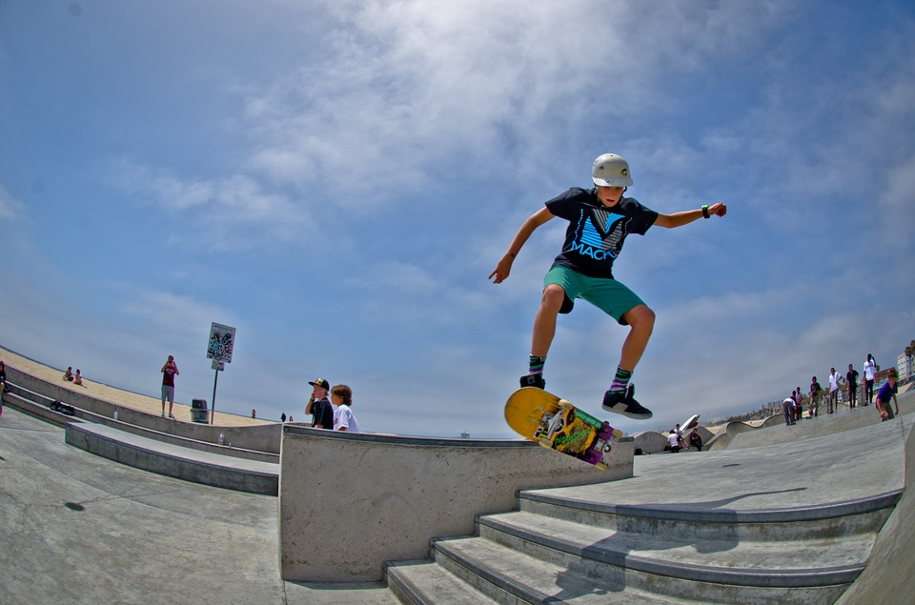
Motion
Occurs when an object changes position relative to a reference point.

Slide 4
To make sense of motion …
we use Reference Points!
A Reference point is a stationary object, such as a tree, sign, dead body, a line in the road that you use to see if you are moving.
We use the Reference Point…because it is motionless…to determine the position, direction and speed of motion.

Slide 5
Position refers to an object’s location relative to a reference point. (Is it in front, behind, next to, beside, across from and so forth)…
Direction is the line or path along which an object moves.
Speed is a measure of the distance traveled per unit of time (usually meters per second)

Slide 6
Distance Vs. Displacement
Distance
how far an object has traveled
Displacement
distance AND direction of an object’s change in position from its starting point

Slide 7
Speed
Speed – To calculate an object’s speed, you MUST know the distance traveled and the time it took the object to travel that distance.
Speed Formula:

Slide 8
Speed

Slide 9
Computing Speed…Example
Fast Motorcycle: Bike travels 120 miles in 0.5 hour
Speed = 120 miles / 0.5 hour = 240 mph (miles per hour)

Slide 10
Your turn!
Track athlete: the runner travels 800 meters in 2 minutes 40 seconds. What was the runner’s speed (in meters per seconds)?
Speed = 800 meters ÷ 160 seconds
= 5 m/s

Slide 11
Type of Speed | Description | Example
INSTANTANEOUS | Speed at any given point in time | Driving a car and looking down at speedometer
AVERAGE | Total distance traveled divided by total time | Taking a road trip
CONSTANT | Speed that does not vary | Putting car in cruise control

Slide 12
Graphing Motion
Motion of an object can be plotted on a distance – time graph.
Y
D
I
S
T
A
N
C
E
The slope of a line on a distance – time graph gives the speed of an object in motion.
RISE
RUN
X
TIME
Note: the STRAIGHT line means that speed is CONSTANT!
X axis -> TIME
Y axis -> DISTANCE

Slide 13
Acceleration

Slide 14
Velocity – includes speed of an object and the direction of its motion
So …. what is the difference between
speed & velocity?
Velocity includes direction where as speed does not.

Slide 15
Acceleration – rate of chance of velocity.
Acceleration occurs when an object changes speed, its direction, or both.

Slide 16
Calculating Acceleration

Slide 17
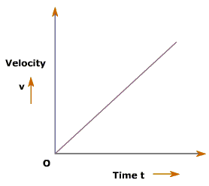
Positive Acceleration
When acceleration is increasing, we say it is positive and its graph has an upward angled line.
The plane is speeding up so acceleration is positive.

Slide 18
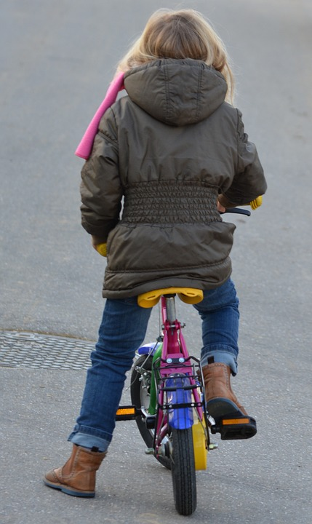
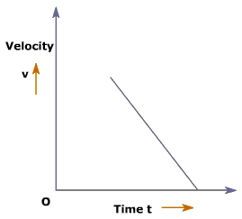
Negative Acceleration
When acceleration is decreasing, we say it is negative and its graph has a downward angled line.
The bike is slowing down so acceleration is negative.

Slide 19
Motion And Forces

Slide 20
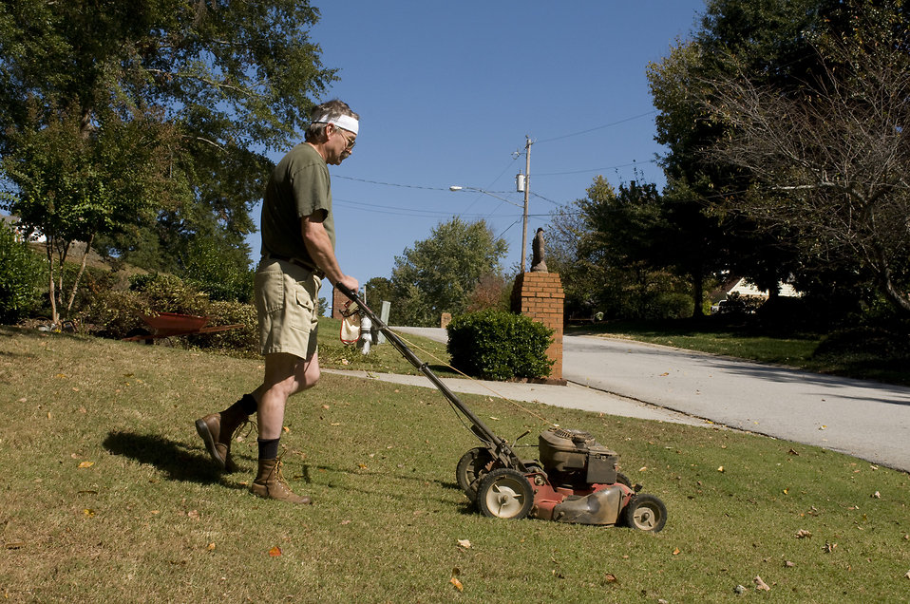
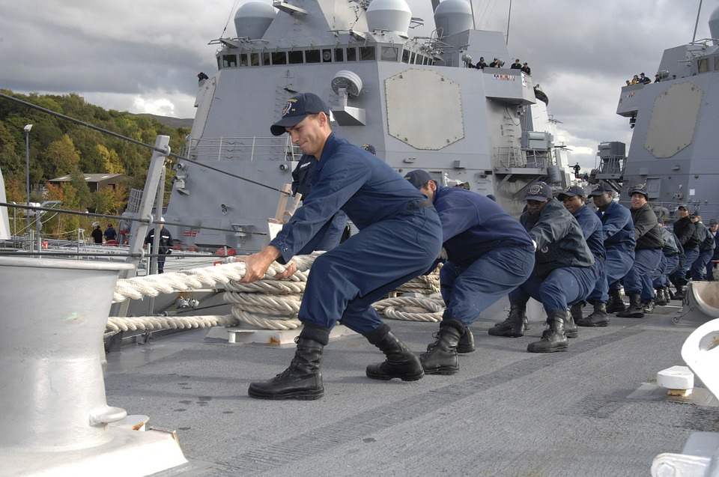
Force — a push or pull applied to an object.

Slide 21
Net Force – When two or more forces act on an object at the same time
COMBINED
forces
UNBALANCED
forces
BALANCED
forces

Slide 22
Friction – the resistance that one surface or object encounters when moving over another. Or ….
the force that opposes the sliding motion of two surface that are touching.
Friction is caused by microscopic bumps on surfaces called microwelds.

Slide 23
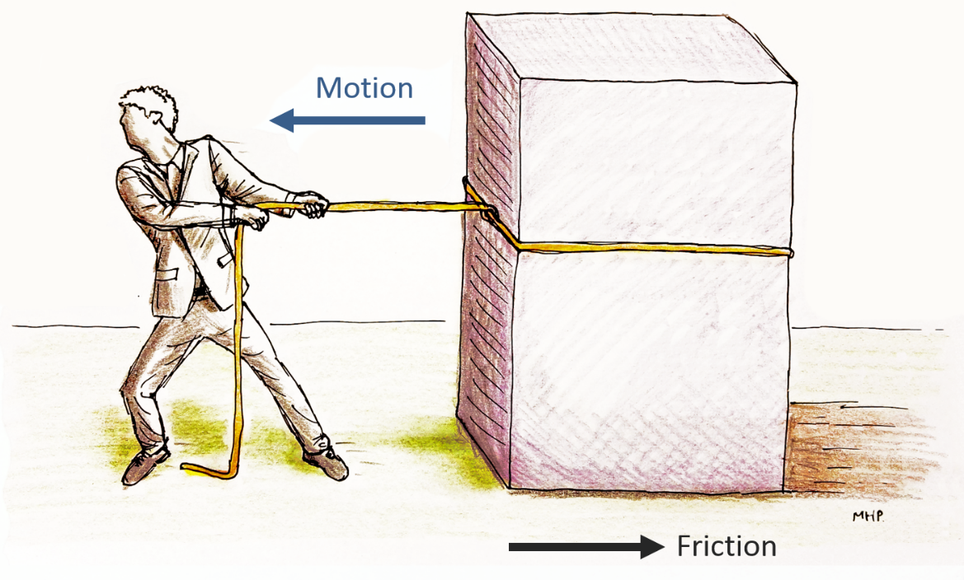
Friction
Friction is a contact force that acts between two surfaces that touch each other and OPPOSES motion.
If you push a book across the desk friction slows the motion of the book.
If you throw a ball through the air, air friction (resistance) works to slow the ball down.

Slide 24
Friction operates on the atomic level…all objects that are in contact have friction…regardless how smooth the surfaces may appear.
Even air has friction…when an object moves through air, its surface collides with air particles, slowing the motion of the object.

Slide 25
Factors of surface and weight of the moving object
Smooth surfaces = low friction
Rough surfaces = high friction
Moving object that is high weight = high friction
Moving object that is low weight = low friction

Slide 26
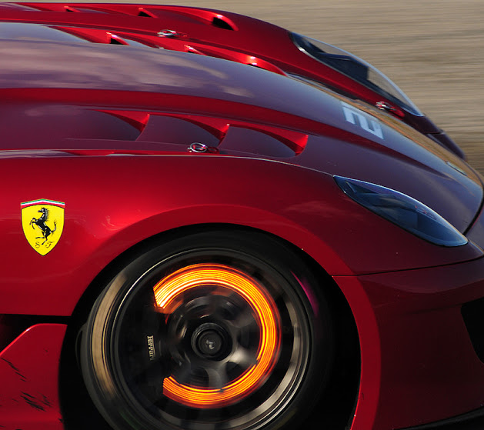
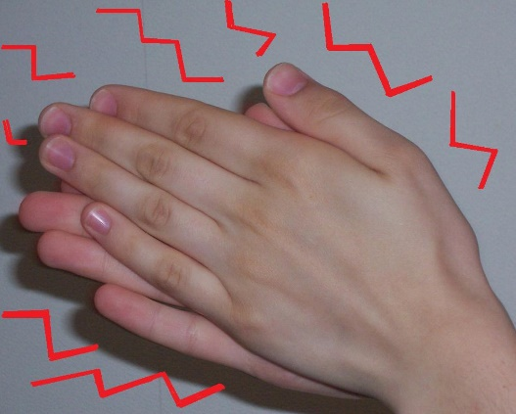
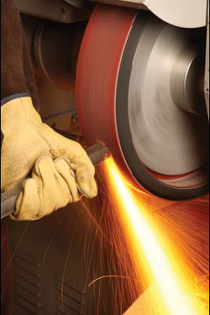
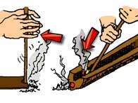
A very important situation with friction is that friction also changes some of the energy of a moving object into heat.
Friction causes the warmth you feel if you rub your hands together.
Friction is why the brake pads on your car get so hot after a drive.

Slide 27
TYPE OF FRICTION | DESCRIPTION | EXAMPLE
STATIC | Friction in which two surfaces are not moving past each other. | PUSHING A FRIDGE ACROSS A FLOOR
SLIDING | Friction where two surfaces slide past one another. | SLEDDING DOWN A HILL
ROLLING | Friction between a rolling object and surface it rolls on. | SKATEBOARD MOVING ON GROUND
FLUID | Friction when object moves through fluid, meaning either a liquid or gas | SKYDIVING
Air Resistance – friction-like force that opposes motion of objects that move through air (it depends on speed, size, and shape of object)

Slide 28
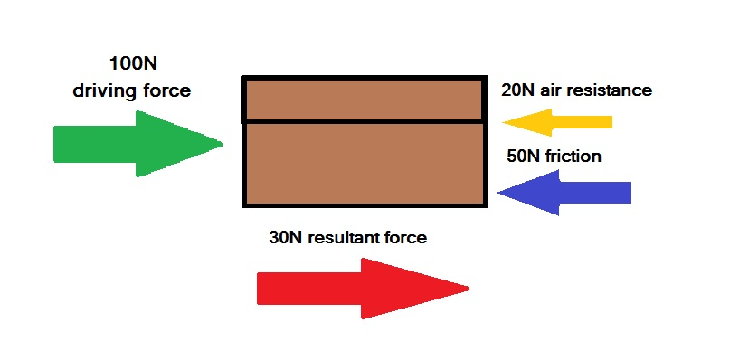
So, when we look at multiple forces acting on an object ….

Slide 29
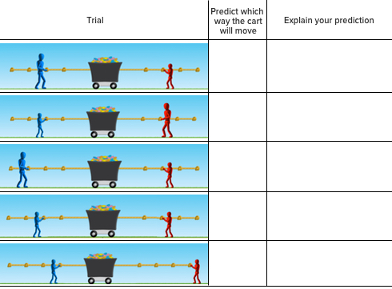

Slide 31
Newton’s Laws Of Motion

Slide 32
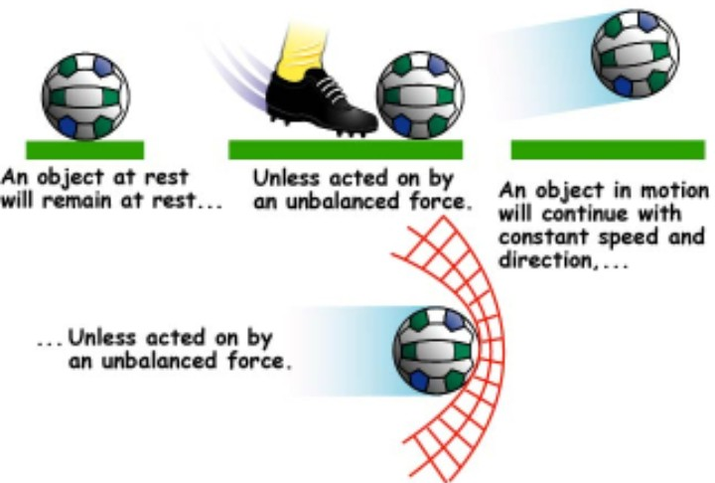
Newton’s First Law of Motion
Also known as Law of Inertia!
An object in motion stays in motion … or an object at rest stays at rest … until an unbalanced net force acts upon it.

Slide 34
Inertia – tendency of an object to resist any change in its motion.
Inertia is based on MASS…the greater the mass, the greater the inertia.
WILL STAY AT REST UNTIL FORCE ACTS IN IT
WILL CONTINUE IN MOTION UNTIL THESE FORCES ACT ON IT
GRAVITY
FRICTION
WALL

Slide 35
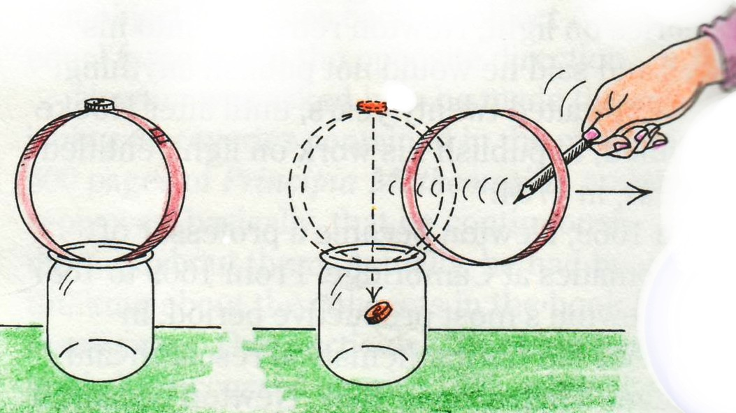
Explain what’s happening …

Slide 36
Explain what’s happening …

Slide 37
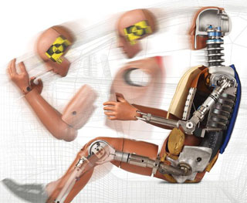
Explain what’s happening …

Slide 38
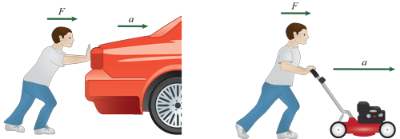
Newton’s Second Law of Motion
A net force acting on an object causes the object to accelerate in the direction of the force.
Acceleration is determined by
size of force and the mass of an object.
Force = mass x acceleration

Slide 39
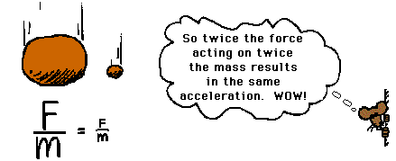
Newton’s Second Law of Motion
Acceleration is determined by
size of force and the mass of an object.

Slide 40
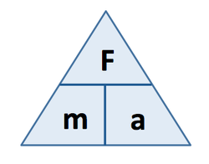
Newton’s Second Law of Motion
A net force acting on an object causes the object to accelerate in the direction of the force.
Force = mass x acceleration

Slide 41
The FORCE required to change the motion of an object depends on two factors –
mass and acceleration.
When a force is applied to an object, it can either speed up (positive acceleration), slow down (negative acceleration) or change directions

Slide 42
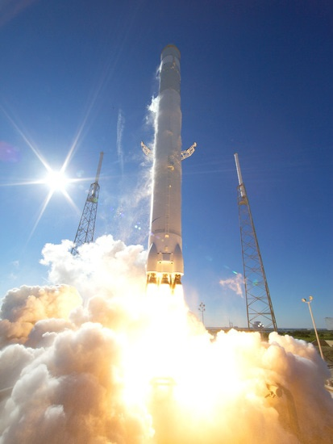
Newton’s Third Law of Motion
For every action (or force), there is an equal and opposite reaction (or force).
Momentum – property of moving object resulting from its mass and velocity.
ACTION REACTION
Momentum (p) = mass x velocity

Slide 43
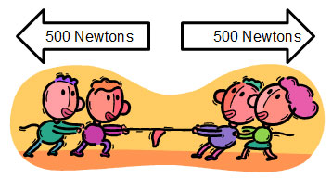
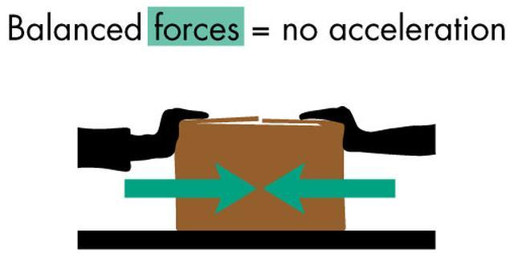
Balanced forces produce a net force that equals zero.
When forces are balanced, there is no change in motion. When balanced forces act on an object in motion, the object keeps moving at the same velocity.
When balanced forces act on an object that is still…the object does not move.

Slide 44
Unbalanced forces produce a net force that is greater than zero.
The object acted on moves in the direction of the greater force.

Slide 45
Gravity

Slide 46
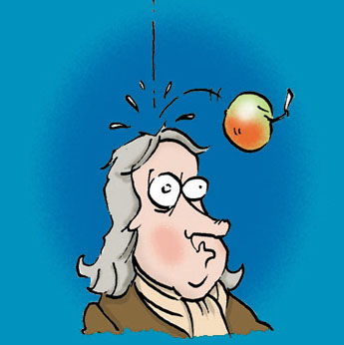
Gravity – any two masses that exert an attractive force on each other.
(NONCONTACT force that attracts objects toward one another)
Gravity depends on mass & distance between objects
Weight – gravitational force exerted on an object; measured in units called Newtons
The greater the object’s mass,
the stronger the gravitational force on it

Slide 47
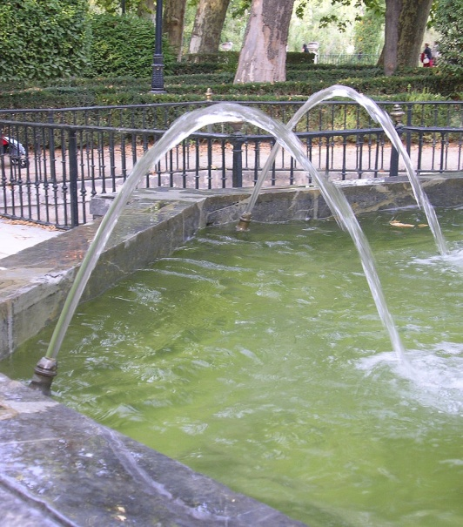
Projectile Motion
Projectile – anything that is
thrown or shot through air
A projectile follows a curved path and has:
and
V
E
R
T
I
C
A
L
Motion perpendicular to Earth’s Surface
Horizontal Motion
Motion parallel to Earth’s surface
MOTION

Slide 48
Centripetal Force
Centripetal acceleration – acceleration toward the center of a curved or circular path
“centripetal” means toward the center
Centripetal force – force acting
toward the center of a curved
or circular path

